Slide 1


Introduction by Pauline Seales
Oct 2018

Slide 2
DRAWDOWN SOLUTIONS
This project used scientific experts to review worldwide solutions to Climate Change
They evaluated how much CO2 in GT (gigatons) each would save by 2050
(a gigaton is a million million kilograms)
They ranked them all and published a book and website

Slide 3
Drawdown Game
Each person will review a SOLUTION card and explain it to the group
The group will vote by assigning 1,2,3,4 to their choices (#1 best!)
Group will add ranking and produce a table ranking

Slide 4
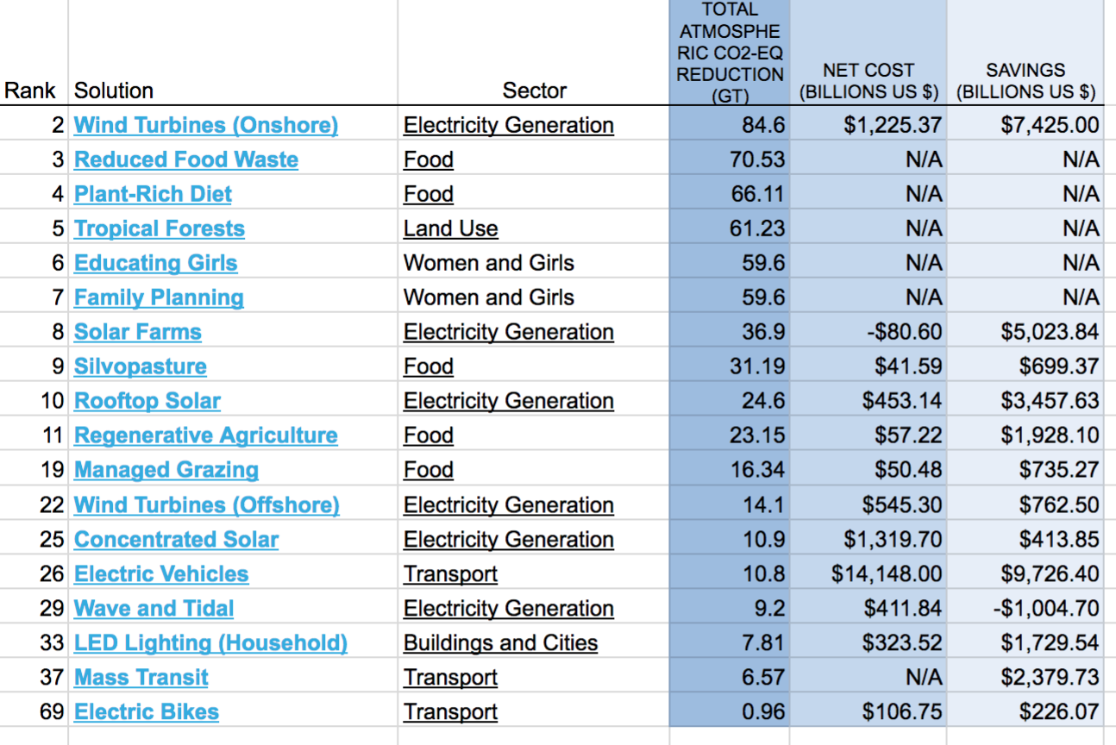

Slide 5
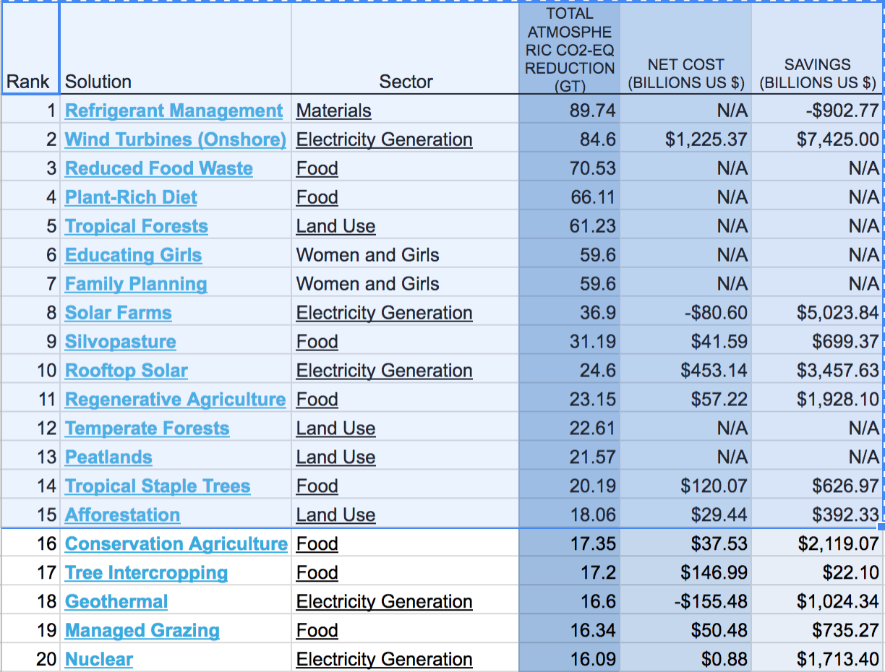

Slide 6
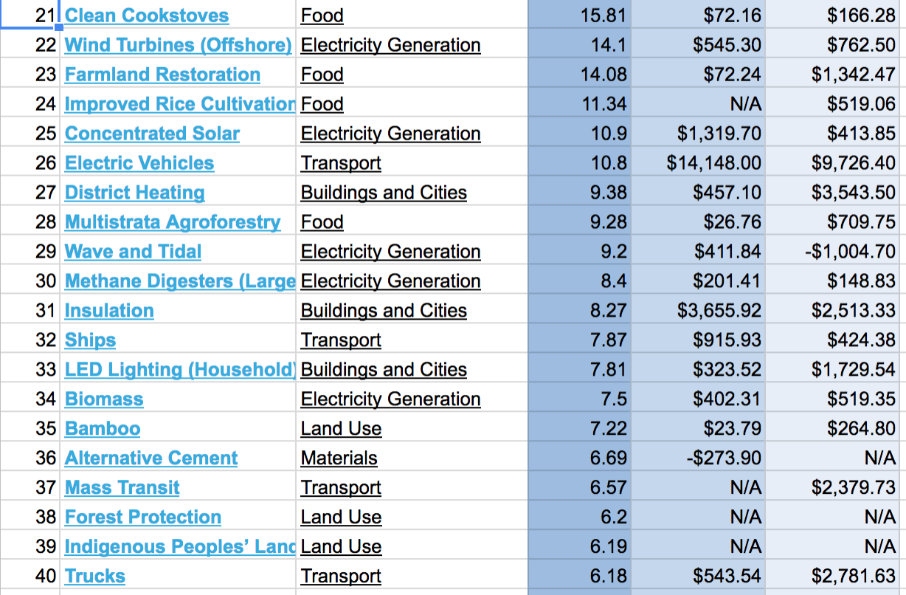

Slide 7
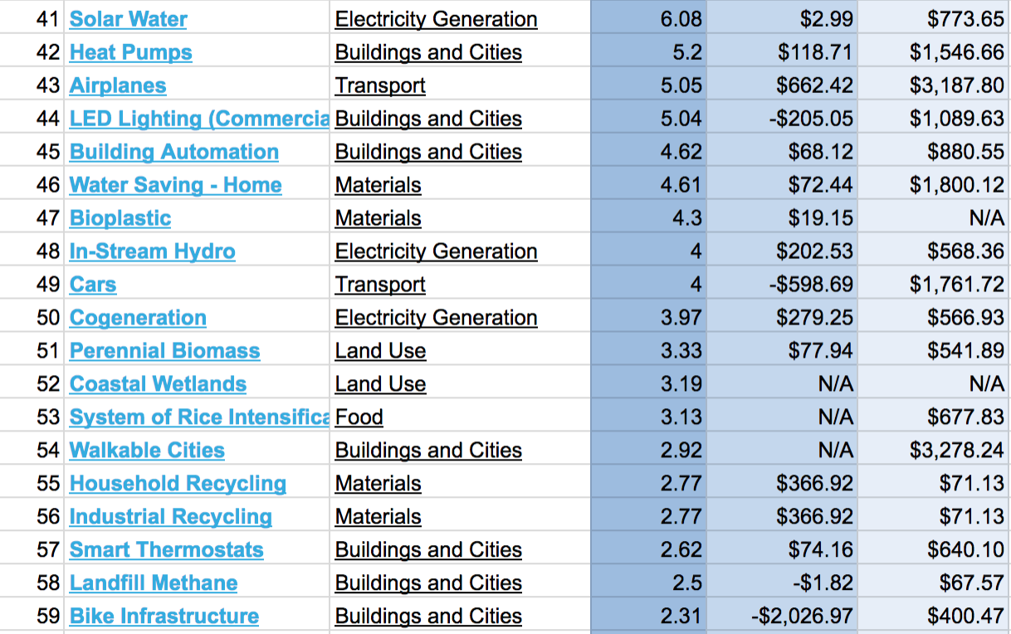

Slide 8
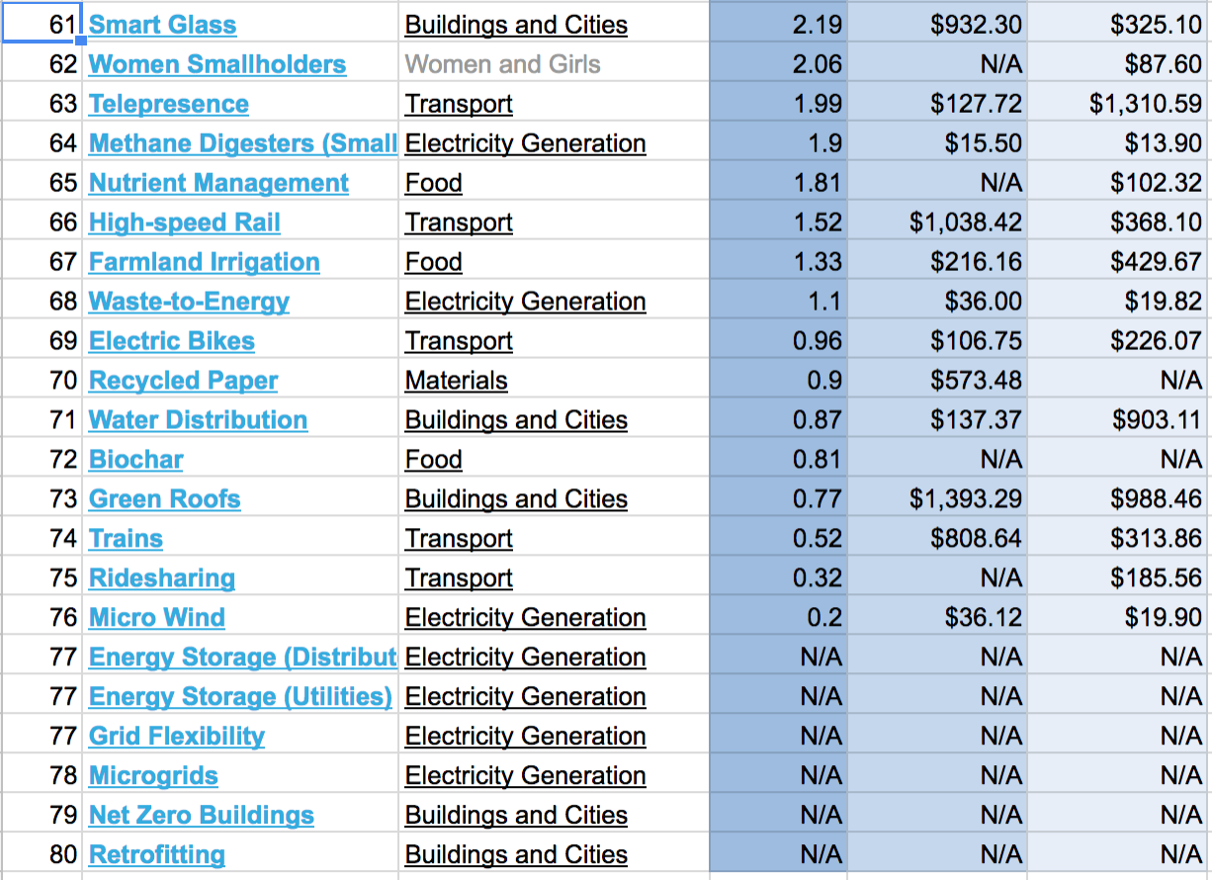

Slide 9
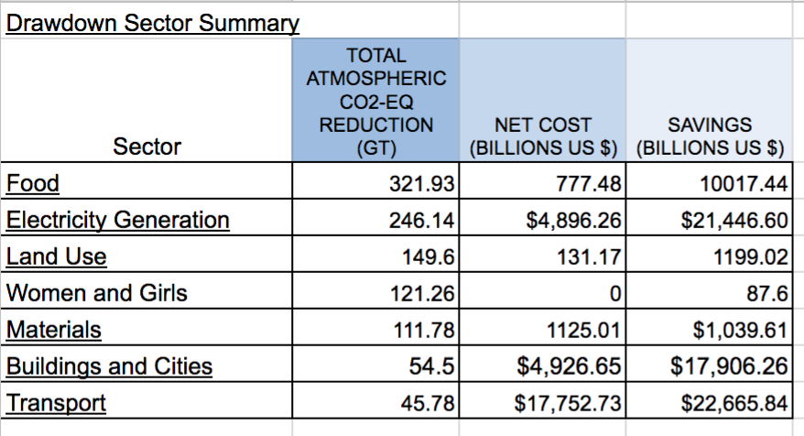

Slide 10
Solutions for Santa Cruz

