Slide 1

Is It Time to PANIC?
aka
How F***ed Are We?
Presentation by
Ami Chen Mills-Naim, Ernestina Saldana and Pauline Seales, May, 2019

Slide 2
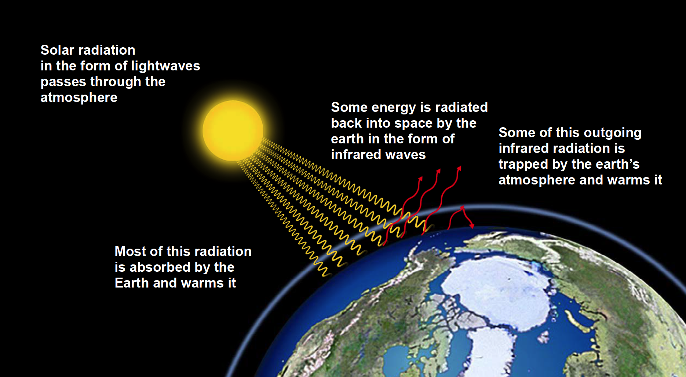
The Basics: “Greenhouse Effect”

Slide 3
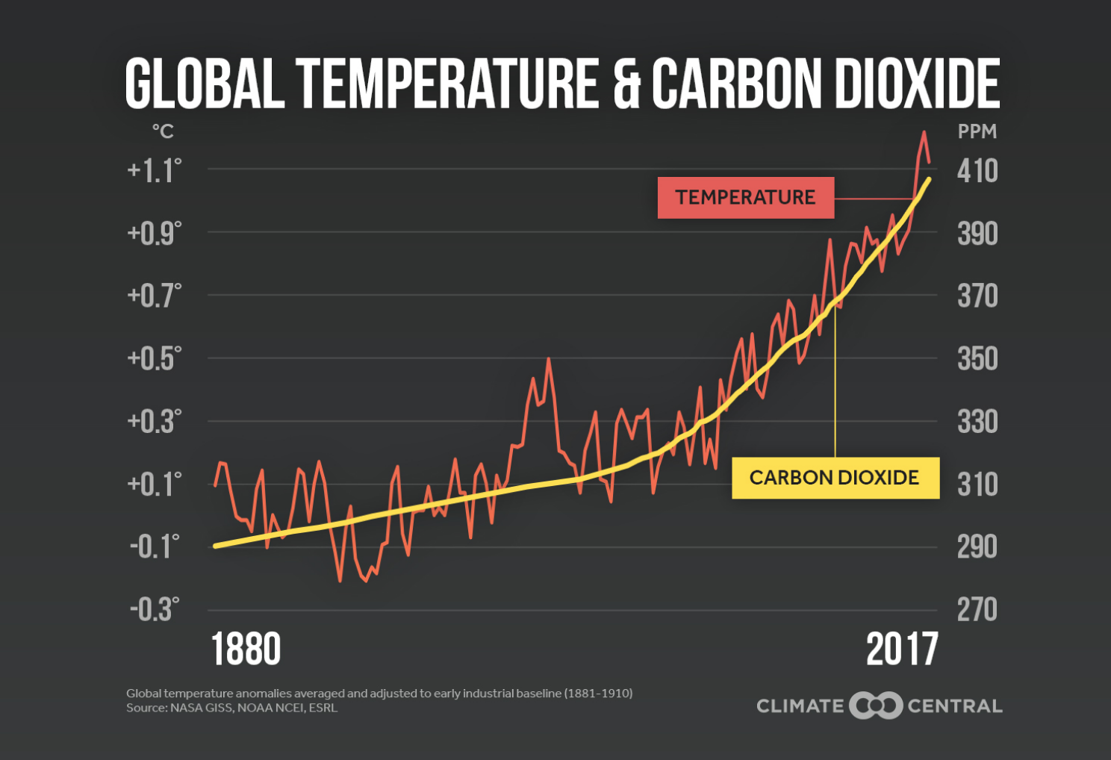
It’s getting Hotter! And there’s more CO2

Slide 4
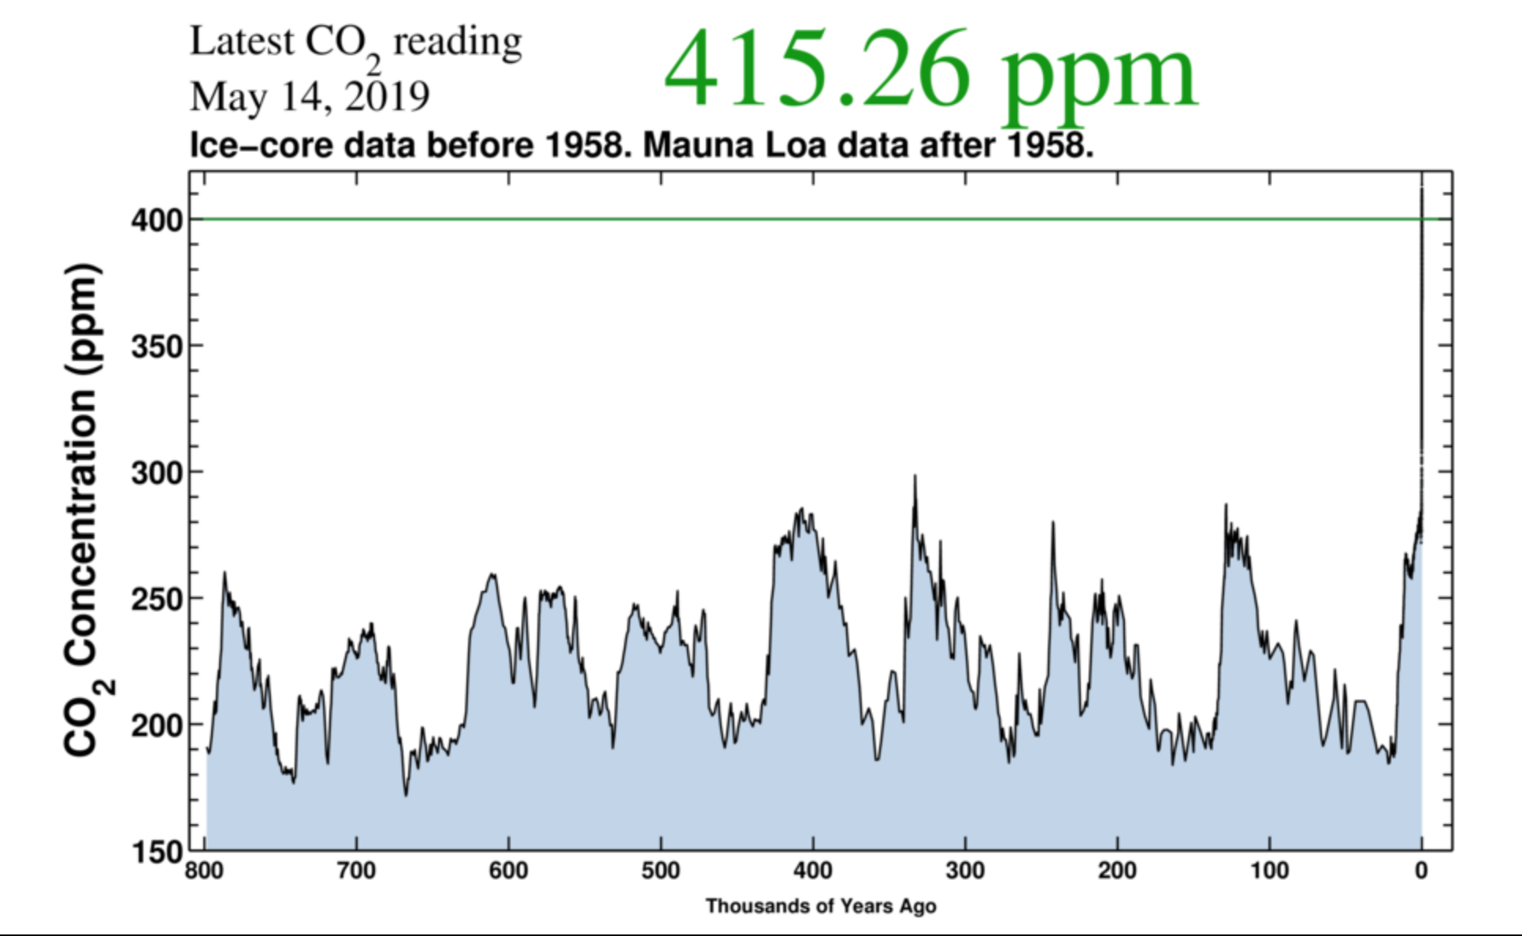
Notes:
CO2 graph going back 800,000 years
Now the scale has changed showing the past 800 thousand years.
The ups and downs represent the ice ages caused by wobbles in earth orbit
Right now we are already way above anything in the past million years—NOW 3 MILLION YEARS. C02 stays in atmosphere for 100 years. Begins to really heat in 10 years.

Slide 5
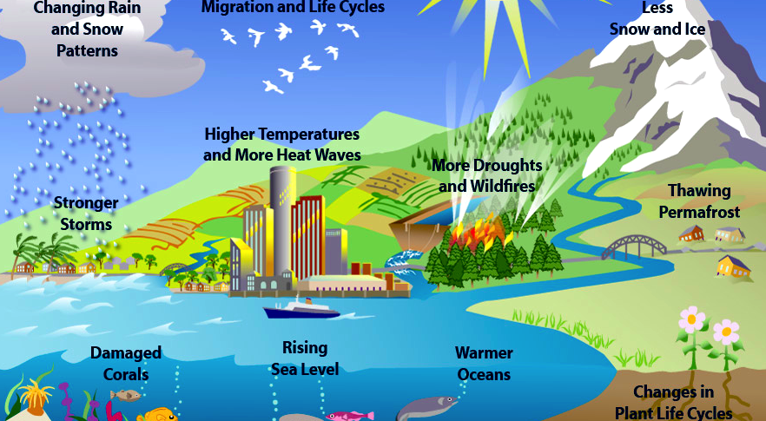
Climate Change Crisis has many effects
Notes:
30% of coral reef now lost. Stronger storms and wildfires already apparent. Miami Beach sea level rise = $500 million in road and water system fixes. More to come. Apple orchards. This map looks almost “happy” ☺

Slide 6
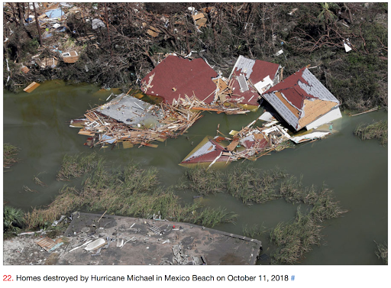
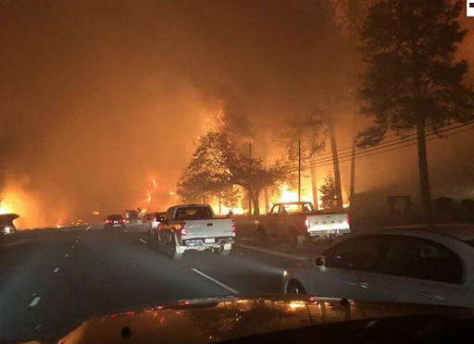
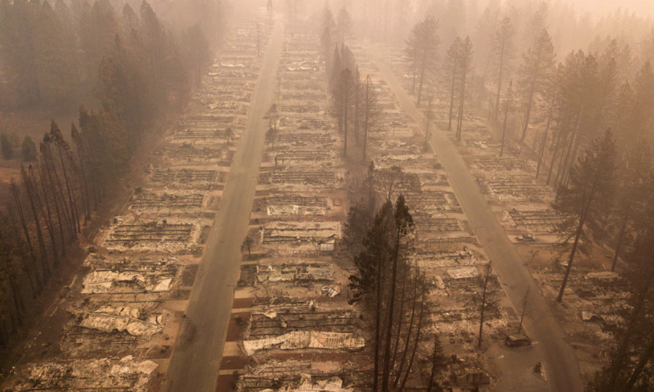
REAL WORLD IMPACTS: In 2018, the world and U.S. East Coast suffered several hurricanes and California was hit with deadly, record breaking fires
Notes:
In Santa Cruz, we experienced smoke from the Paradise Fire near Chico. Last year, California experienced the “worst wildfire season in recorded history.” NBC News. 20 of last 22 years now hottest on record.

Slide 7
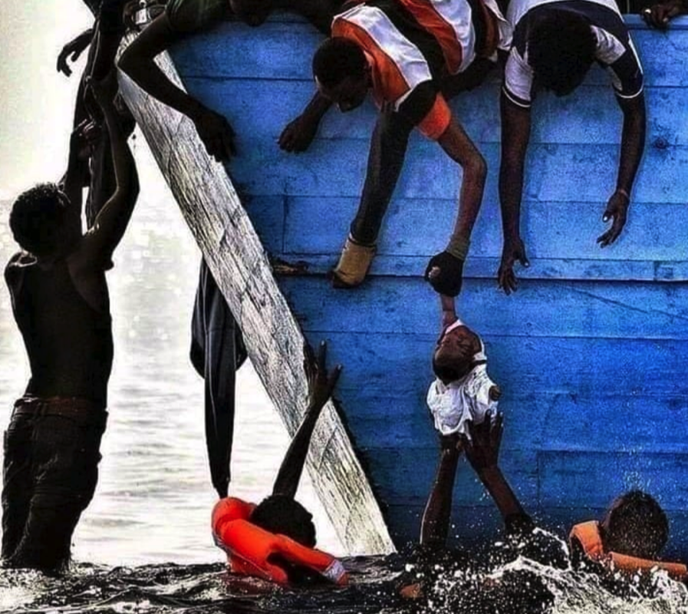
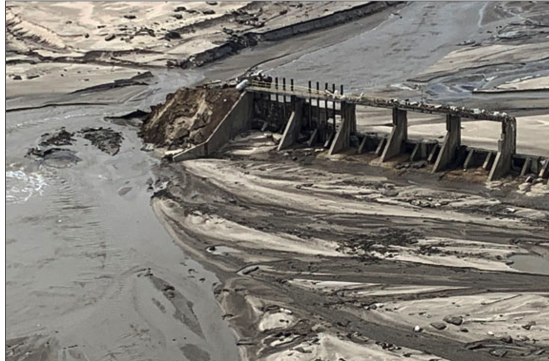
2019 Climate Chaos
Mozambique Nebraska

Slide 8
Do a few degrees matter?
We see drastic effects with only
1 deg C = 1.8 deg F change
(Some say we are now accurately at 1.4 C degrees, actually)
IPCC Report indicates 1.5 C is a terrible scenario. 2 C = MUCH WORSE

Slide 9
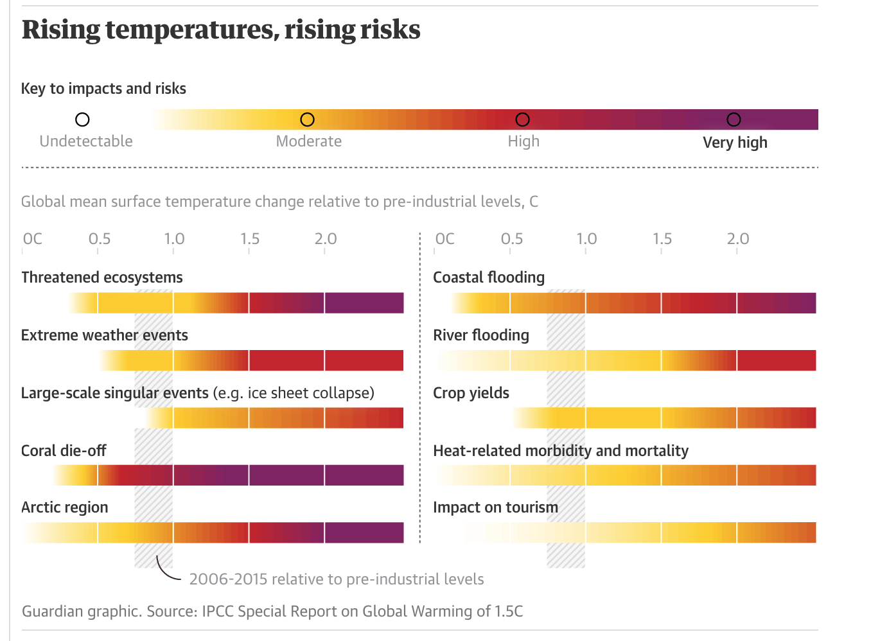
IPCC 2018 Summary
Intergovernmental Panel on Climate Change(U.N.)

Slide 10
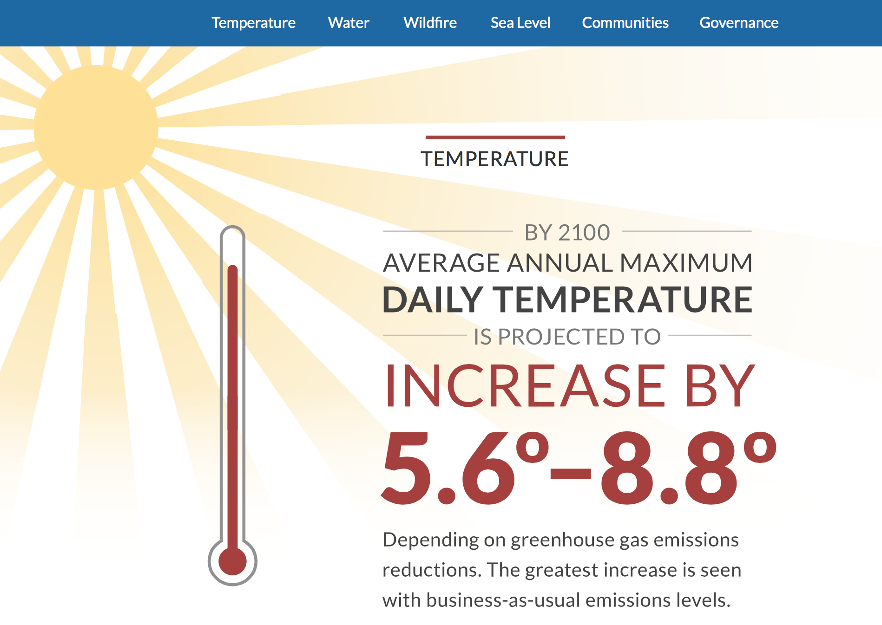
Notes:
Prediction from 4th Ca assessment is disastrous. We cannot survive this. These nice looking graphics belie the severity of the situation.

Slide 11
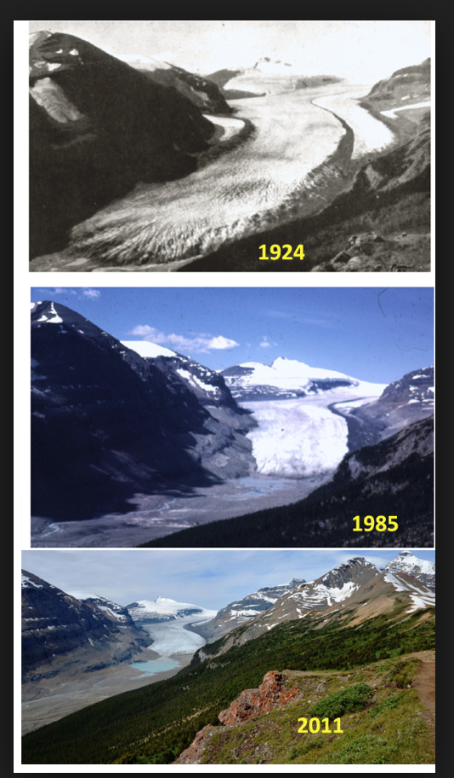
Ice and snow are melting everywhere, and sea level is rising.
Ice melting faster than predicted. Major ice shelves now calving. Arctic becoming unstable.
Saskatchewan Glacier, Alberta

Slide 12
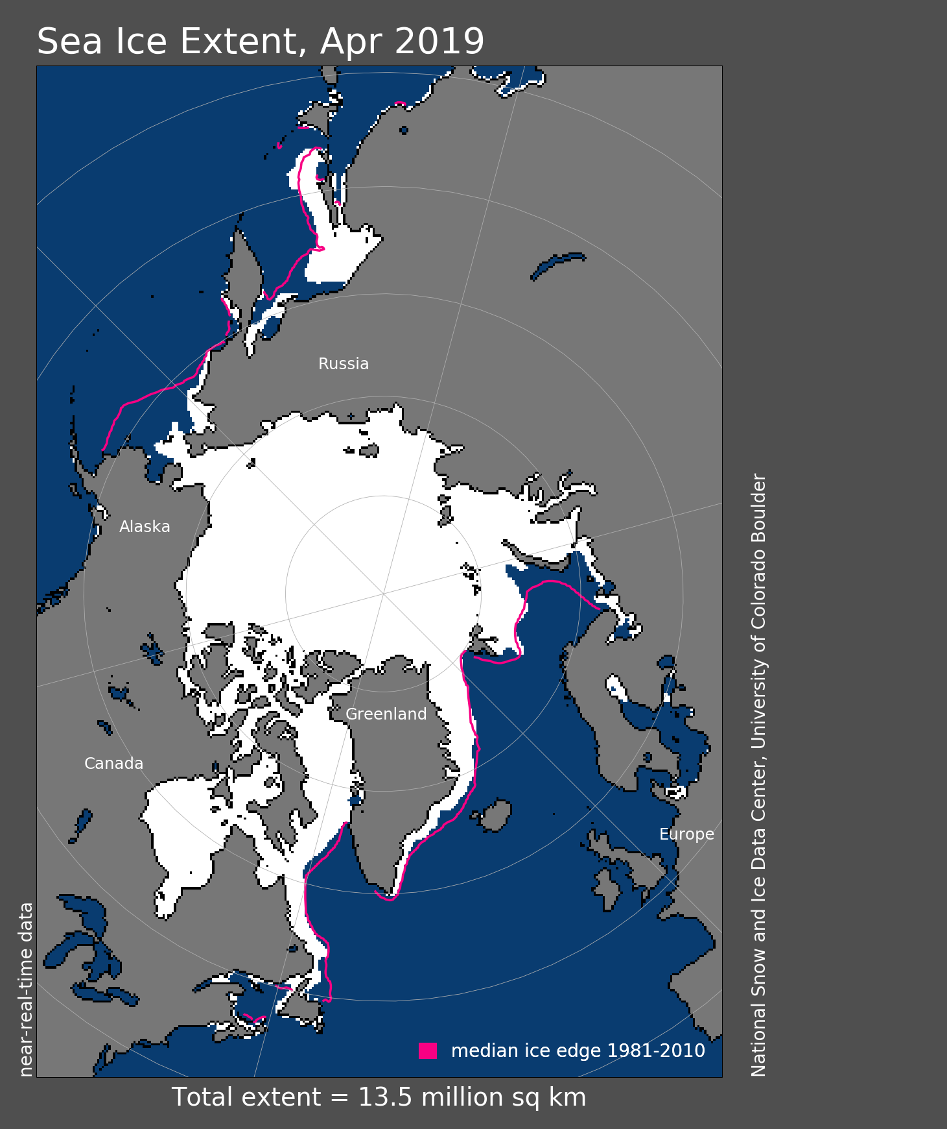
Greenland and Antarctica
ice loss doubled in Greenland and tripled in the West Antarctic between 2009 to 2014. The West Antarctic is losing ice 5 times faster in 2000s than in 1990s. Loss is now exponential, doubling every decade.
Antarctica is our biggest store of ice.
Notes:
Source: The Guardian. Please support the Guardian. Thwaites Glacier in Antarctica.

Slide 13
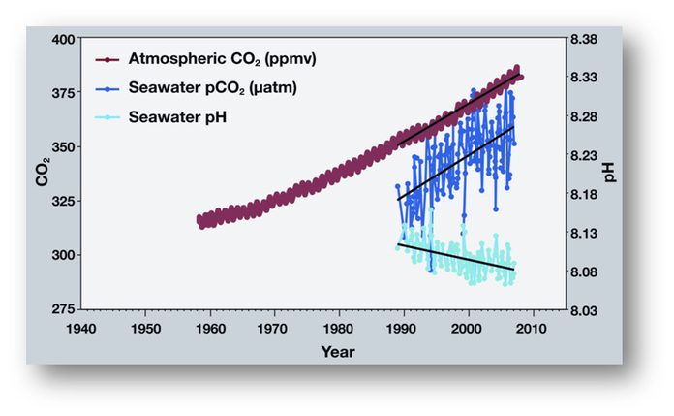
Our CO2 (30%) is absorbed by oceans, making them roughly 30% more acidic so far.
This is changing the PH of the oceans and may also tip us into ocean warmth and mass release of CO2 from oceans.
Carbon dioxide in oceans leads to ... ocean acidification, which dissolves the calcium carbonate that makes up mussel shells and coral skeletons, and interrupts processes like fish breathing. “Increasing ... carbon dioxide in the ocean interior is already having an impact on the shellfish industry, particularly along the West Coast,” Richard Feely of NOAA, Seattle.
Notes:
The trends in the atmosphere and ocean have continued with CO2 now at 400 in the atmosphere and ocean pH lower. This affects shell producing creatures. 30 percent of coral reefs have now died.

Slide 14
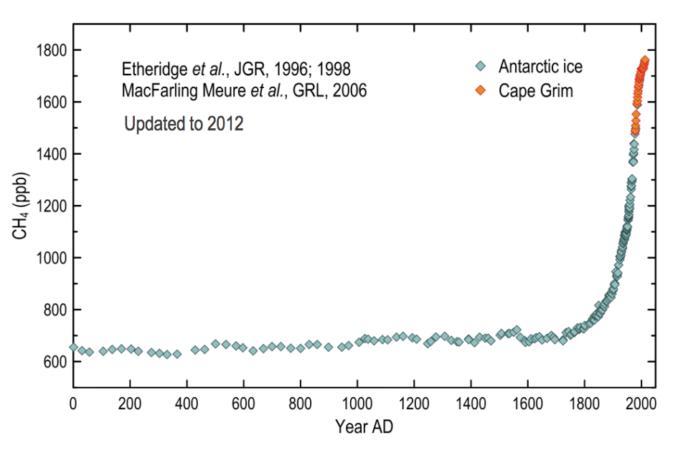
Methane levels for the past 2000 yrs

Slide 15
Extinctions
Alarming recent UN report: One million species are at severe risk of extinction. We are currently in the midst of the Sixth Mass Extinction of Species. According to the World Wildlife Fund, we are now losing species at the rate of roughly 200 per day. In some parts of the world, insect species are down by 70-80 percent. As these species go, we go.
Notes:
Reasons for extinction: Habitat loss, pesticides, climate change,

Slide 16
OK, if we have not made the point:
We emitted more CO2 last year, globally, than ever before.
More methane and CO2 is stored beneath the ice and oceans in the melting Arctic than already in the atmosphere.
There is no scalable technology for removing CO2 at this time.
The IPCC report, highly alarming as it is, is considered conservative. The last report did not include impacts of Arctic & other feedback loops.
Notes:
Fossil Fuel Industry tried to influence and has attacked, etc.

Slide 17
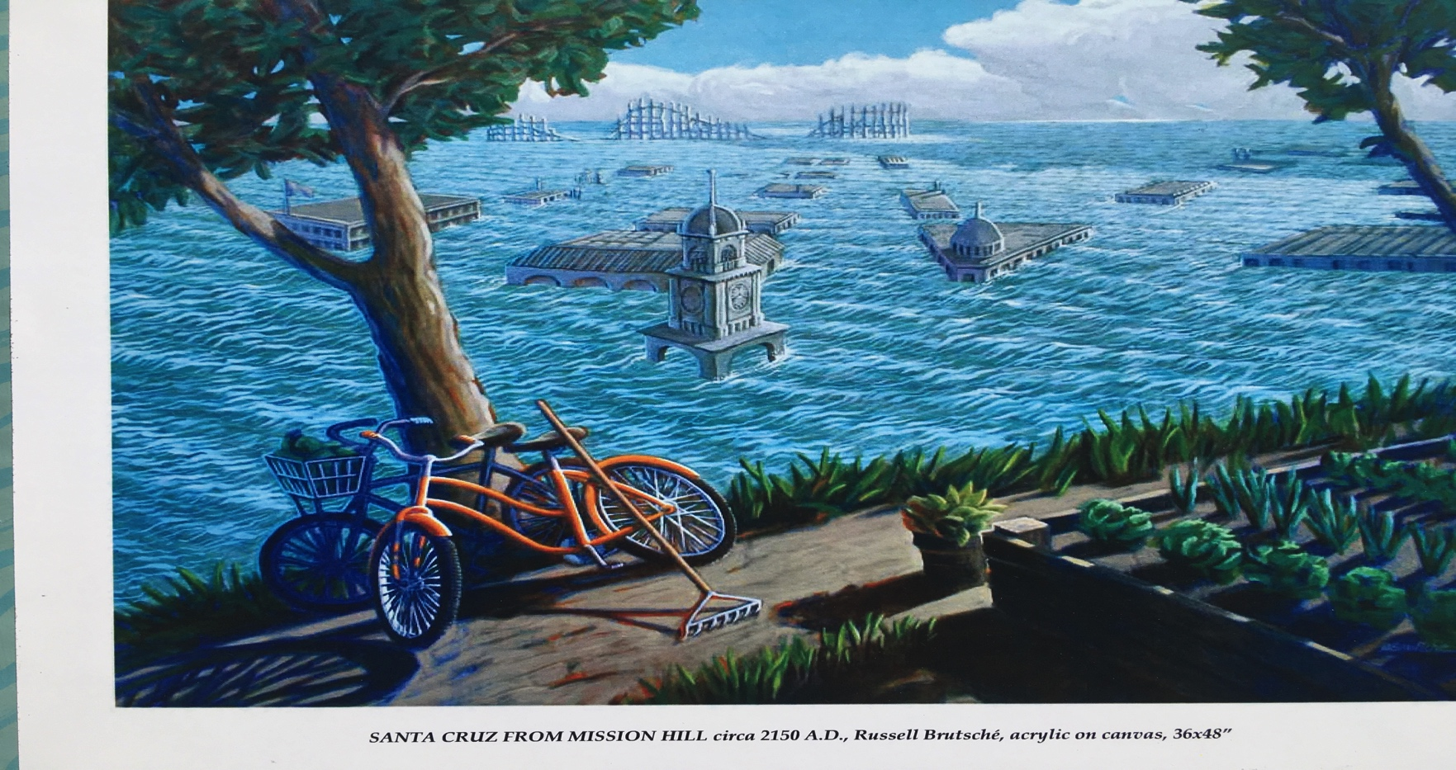
Local Impacts: Monterey Bay Area
Notes:
We hope it looks this good.

Slide 18
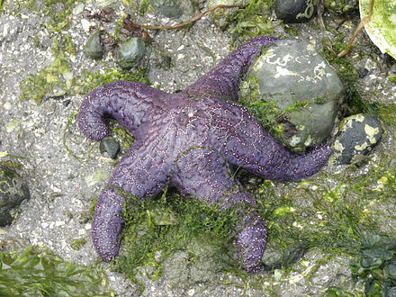
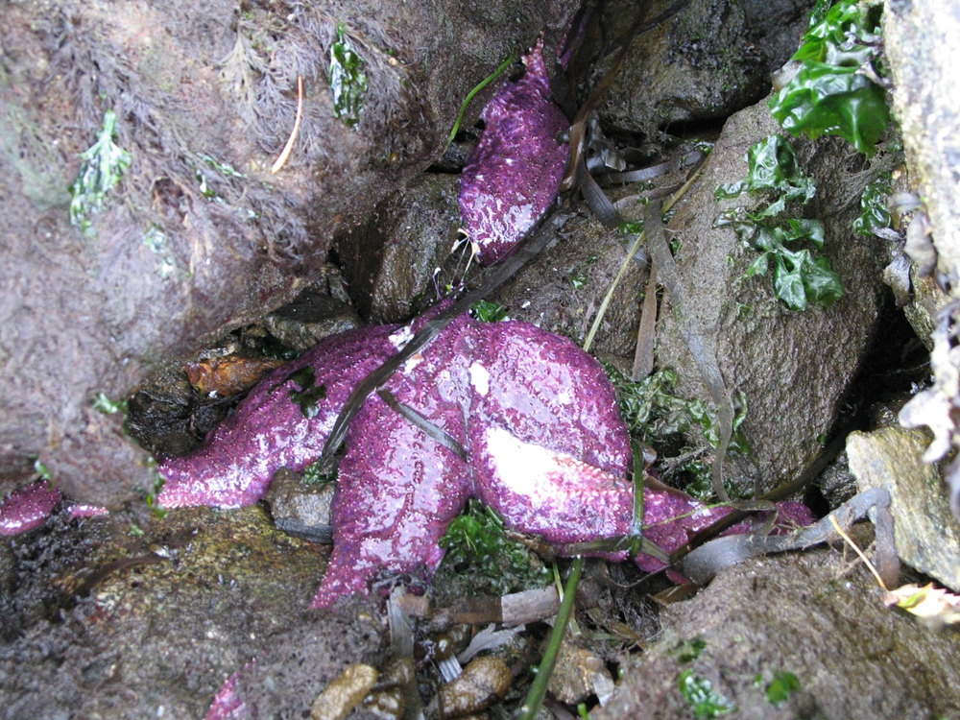
Warmer ocean waters appear to have affected the severity of the recent “sea star wasting syndrome” outbreak. There are no sunflower sea stars to be found in the Bay at this time.
Notes:
To help out, go to www.seastarwasting.org ... Tracking this disease. These are Ochre sea stars.

Slide 19
Warming and Our Bay Ecosystem
“The widespread loss of bull kelp forests on the north coast of Calif. is considered to be, at least in part, a manifestation of climate change. The loss of kelp is a direct consequence of the sea urchin outbreak there, but the sea urchin outbreak appears to be the result of three mechanisms: (1) they lost their predator, the sunflower star (Pycnopodia), due to a disease that appears to be related to elevated water temperature, (2) they also likely overgrazed the kelp because the kelp was less productive due to elevated water temperature (and low nutrients), and (3) there may have been an urchin recruitment event (increased settlement of larvae) also possibly associated with the warm water.
“Oceanographers feel the elevated water temperatures caused by an unprecedented warming event (the "Blob" and El Nino from 2013-2016) was a manifestation of climate change. On the north coast, this led to widespread loss of kelp forests, which in turn led to the decline in red abalone and poor quality of red sea urchins.
“Here in Central California, the giant sunstar also declined dramatically (we simply can't find them now), and we have had urchin outbreaks but the urchin barrens are much more patchy. ... We're tracking the fate of the forests and barrens along the Monterey Peninsula and exploring whether otters and other predators (especially rock crabs) are going to contribute to the recovery of the forests ...” Mark Carr, Professor, Dept. of Ecology & Evolutionary Biology, UCSC

Slide 20
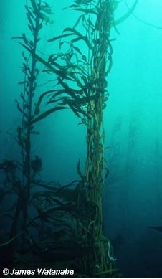
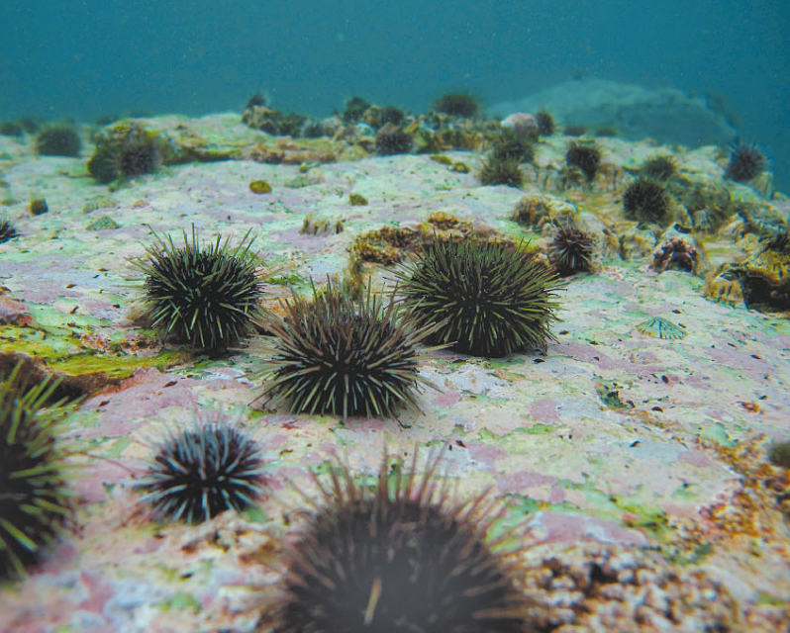
We are losing healthy kelp forests in the Bay—Pacific Grove—to “urchin barrens”

Slide 21
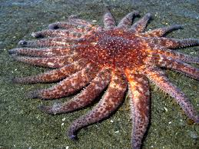
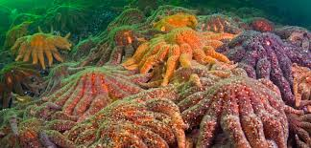
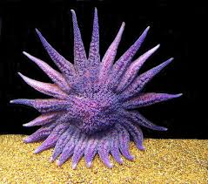
The Sunflower Sea Star

Slide 22
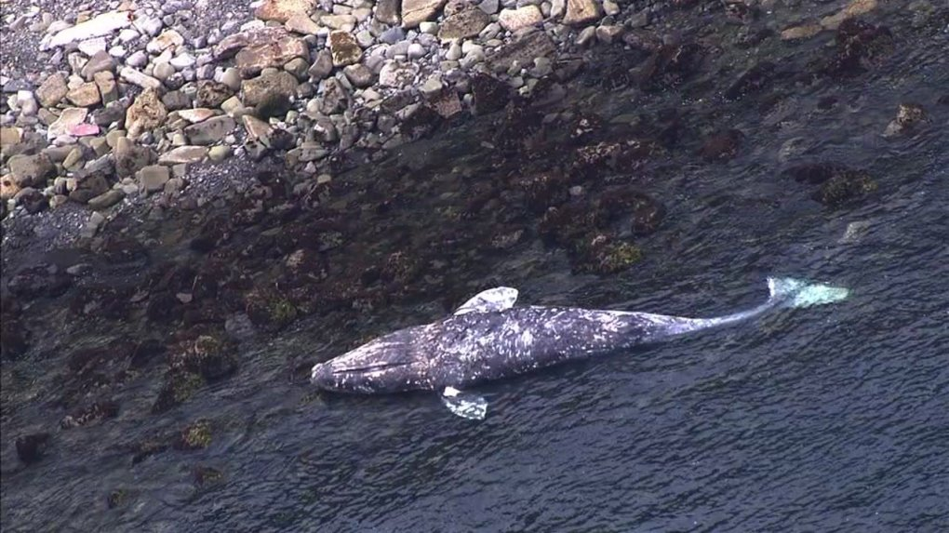
Gray whales dying in record numbers this year something to keep an eye on ...
Too little food in the ecosystem this year, according to S.F. Chronicle. This may have to do with numbers of whales (26,000).
And/or this may correlate with loss of ice in the Arctic which affects gray whale food supply. Gray whale is considered a “canary” whale species for global heating.

Slide 23
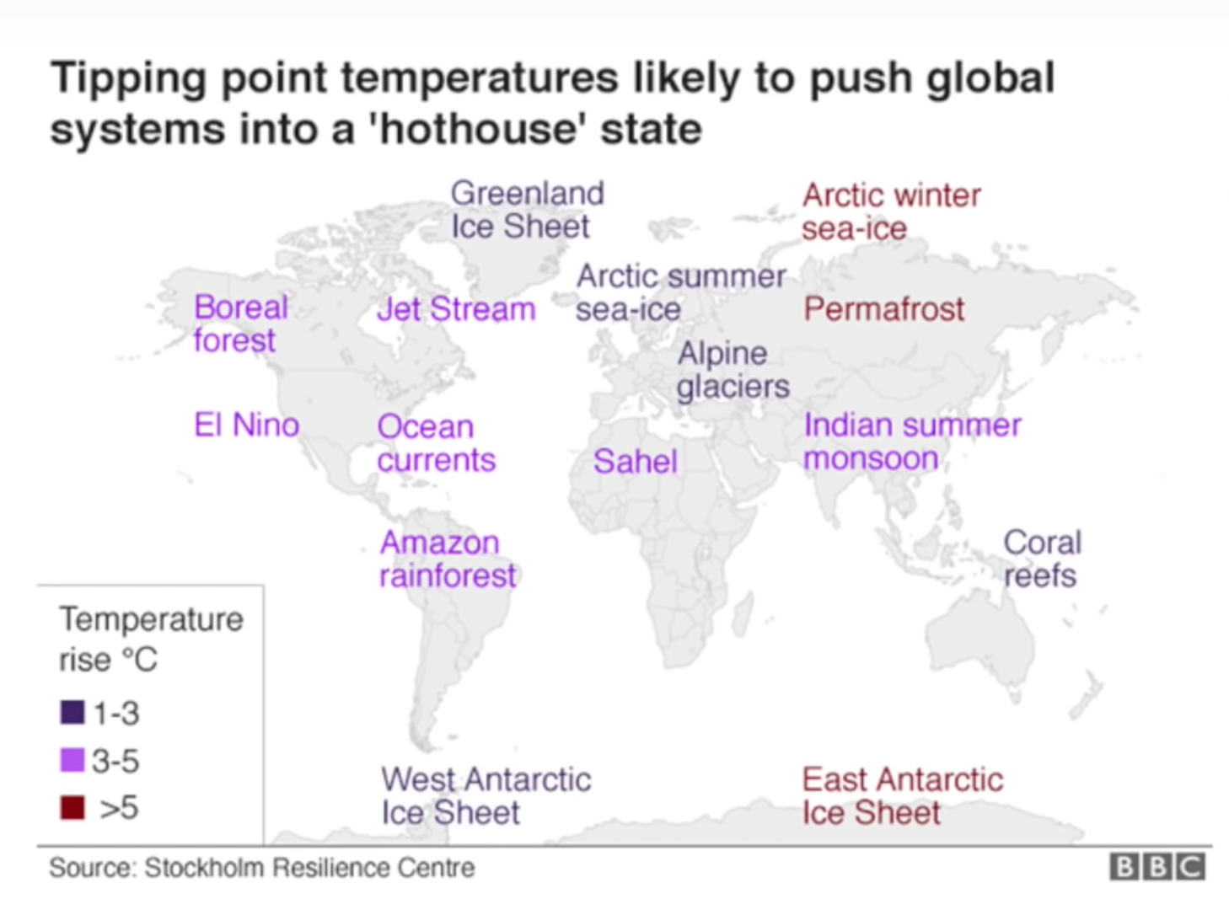
2018 PNAS Paper released about dangerous “feedback loops” or accelerating factors.
Notes:
What does PNAS stand for?

Slide 24
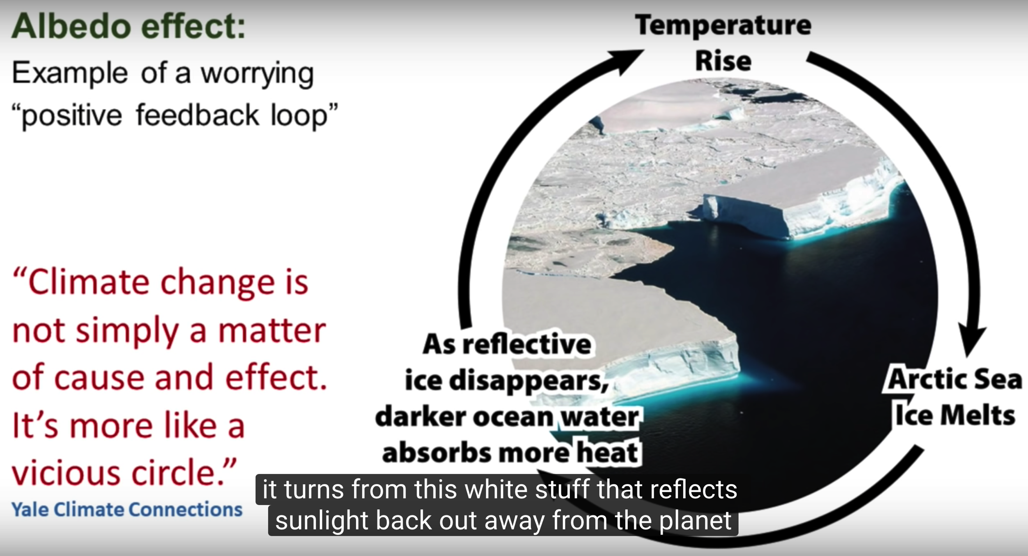

Slide 25
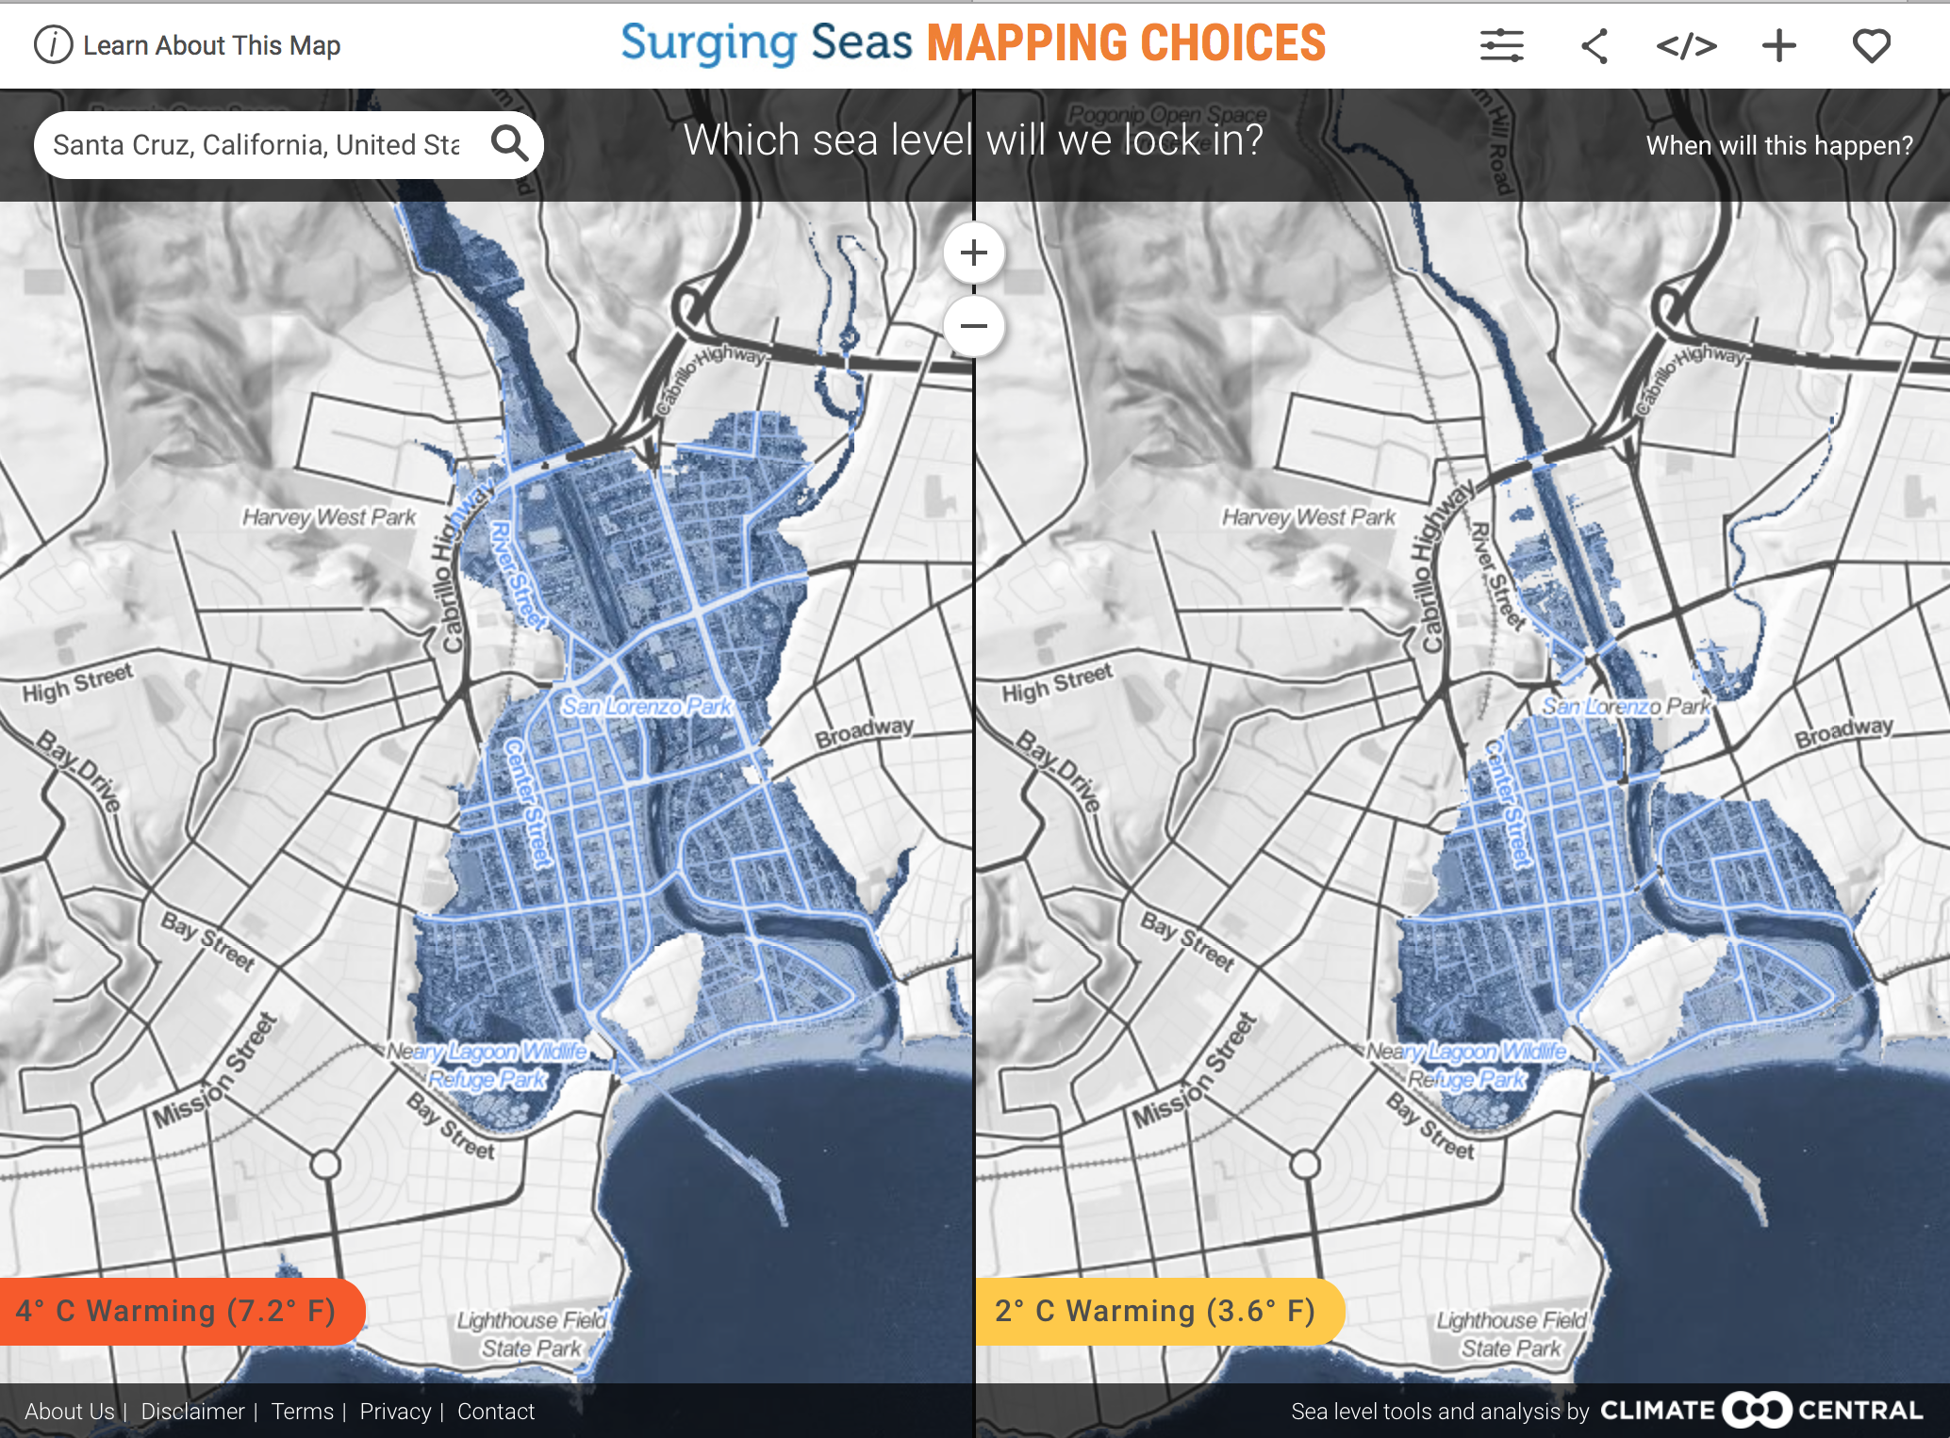

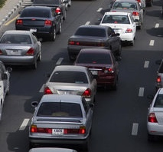


What to reduce or avoid
Notes:
Ernestina to talk here ... Also migration!

Slide 26
Mass Migration and Disruption
The U.S. Government Accountability Office (GAO) in a report to Congress ... criticized the manner in which the Trump administration has sought to remove any acknowledgement of climate change from our foreign policy and diplomatic strategies, keeping experts in the dark about an issue that’s growing only more urgent as a shifting climate—and all that comes with it—displaces millions of people and disrupts societies across the globe.
A 2018 World Bank Group report estimates that the impacts of climate change in three of the world’s most densely populated developing regions—sub-Saharan Africa, South Asia, and Latin America—could result in the displacement and internal migration of more than 140 million people before 2050. That many people on the move could easily lead to massive political and economic strife and significantly stall development in those regions. [Italics added.]
--Natural Resources Defense Council (NRDC), Jan. 2019
Notes:
Otherwise known as climate chaos.

Slide 27

Five migrant children have died in custody this year
Carlos Gregorio Hernández Vásquez
Jakelin Caal Maquín
Felipe Gómez Alonzo
Juan de León Gutiérrez
Associated Press reported last week the death of a child of two-and-a-half years, from Guatemala, in the hands of the Border Patrol.

Slide 28
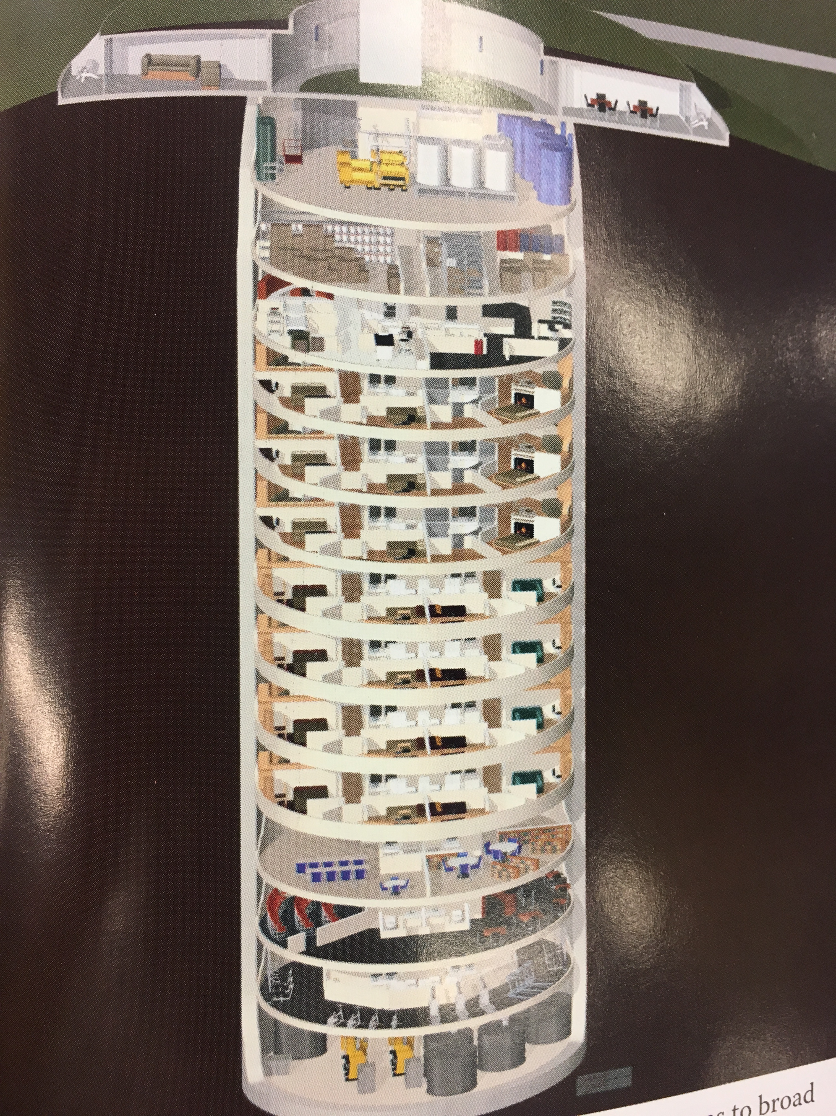
The very wealthy are very aware
They are building and buying bunkers and guarded mansions in New Zealand, private islands, gated farms.
From “Upheaval” by Jared Diamond, and The New Yorker, “Doomsday Prep for the Super Rich,” Jan. 2017.
They are wondering how to motivate armed guards when there is no functioning monetary system.
See “Medium” Piece by Douglas Rushkoff: “Survival of Richest.”
https://medium.com/s/futurehuman/survival-of-the-richest-9ef6cddd0cc1

Slide 29
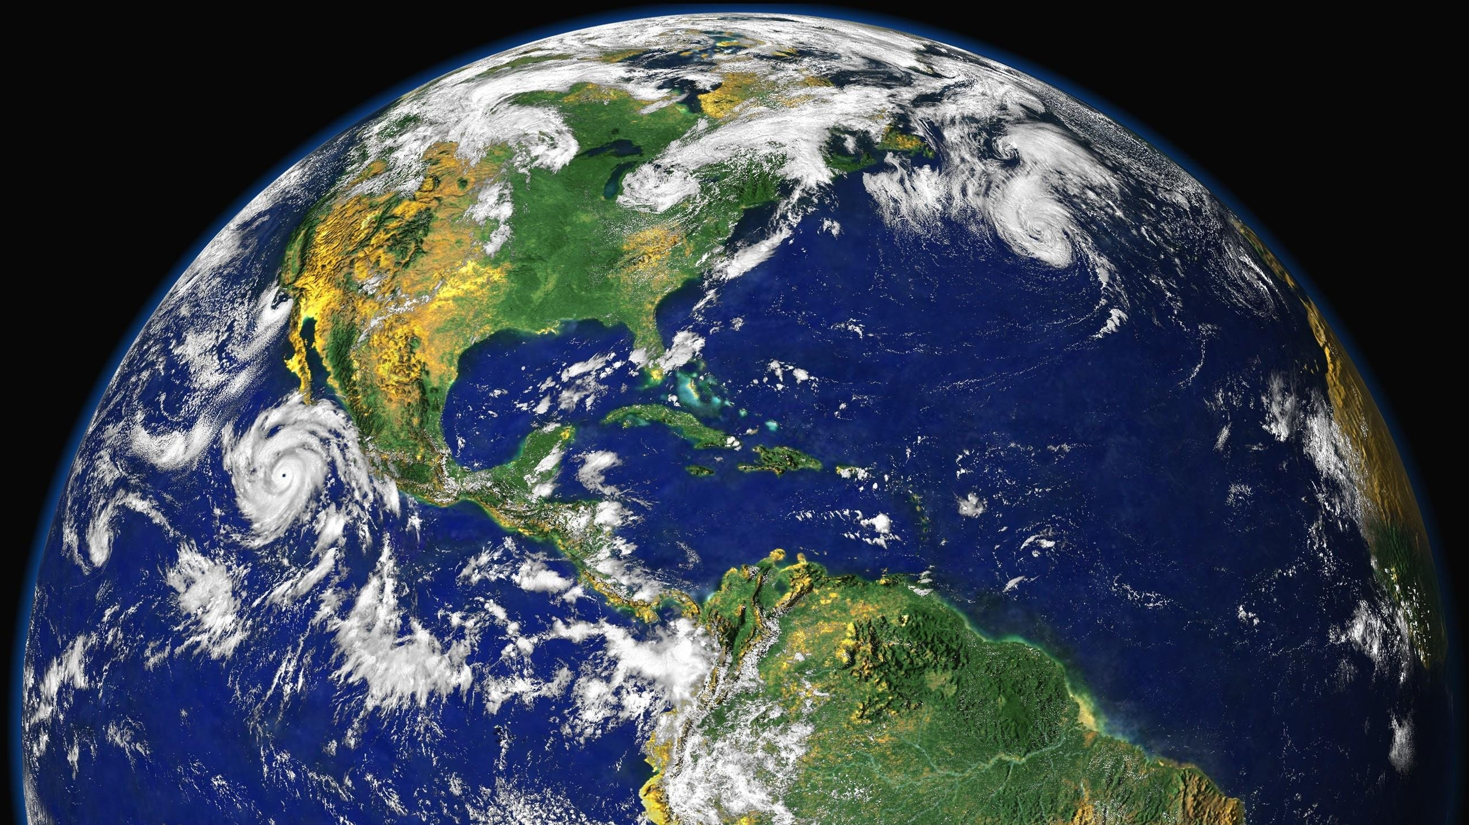
“CLIMATE CHANGE IS NOW REACHING THE END GAME…
THE ISSUE IS THE VERY
SURVIVAL OF OUR CIVILISATION”
PROF HANS JOACHIM SCHELLNHUBER
SENIOR ADVISOR TO
GERMAN CHANCELLOR ANGELA MERKEL, EUROPEAN UNION AND POPE FRANCIS
Notes:
Much of what we’ve discussed may be quite shocking to you.
We are now entering the end game of climate change, the risks are very much higher than most people are aware of.
We are here tonight to tell the truth based on scientific research and the truth is our survival is now in question.

Slide 30
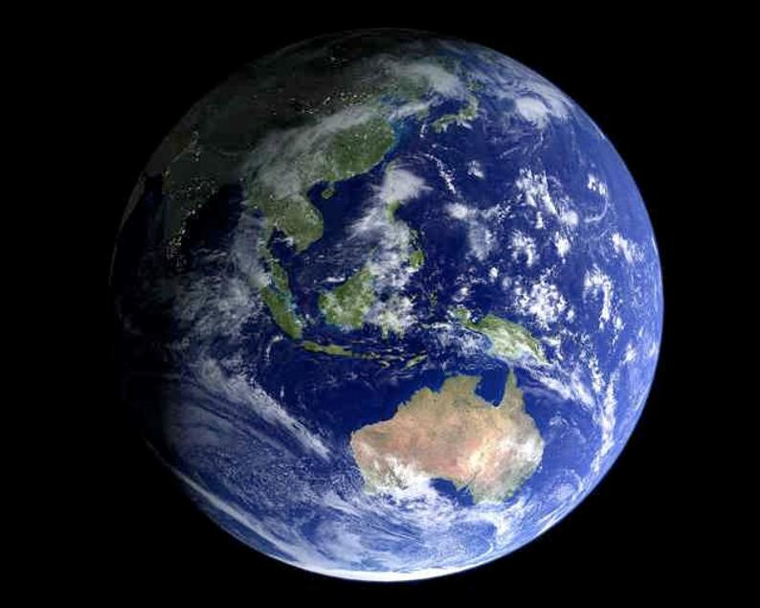
Moment of Silence

Slide 31
Exercise:
Share your thoughts and feelings with a neighbor ... Quiet and deep listening please.
(5 minutes each)

Slide 32
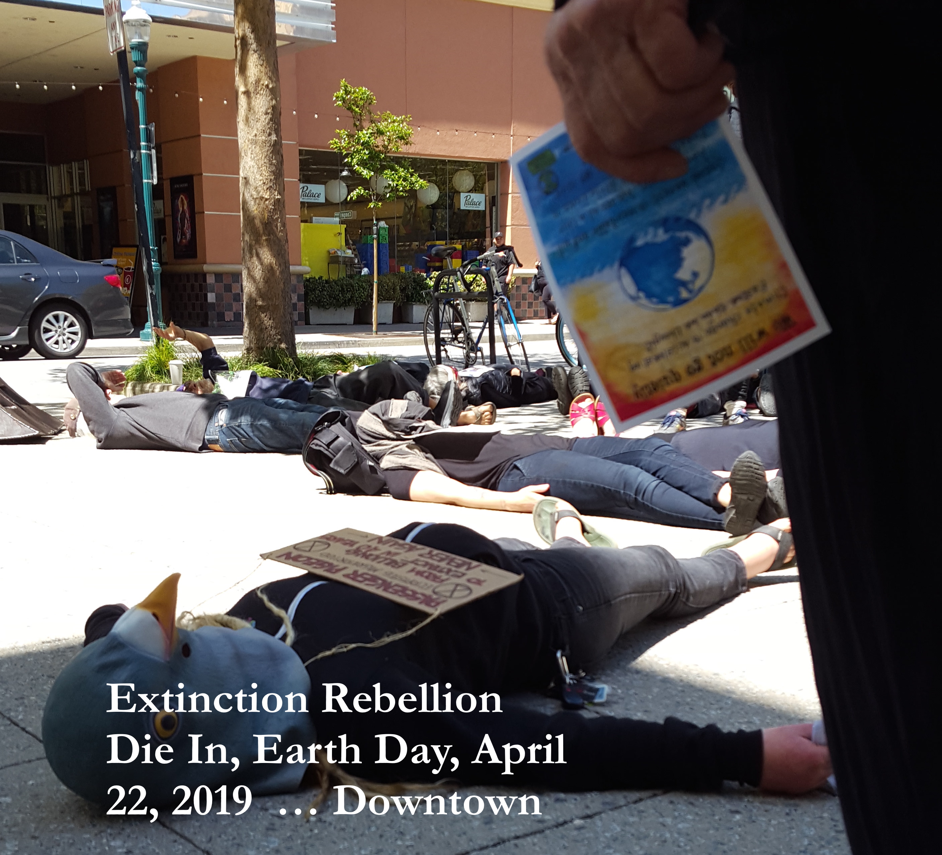
Two Things You Can Do
Become politically active (XR, etc.)
Change your personal & family lifestyle to reduce overall consumption and CO2 output.

Slide 33


Detailed Carbon Reduction program by Paul Hawken.
Includes analysis of 80 different solutions by impact.

Slide 34

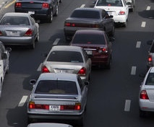

What to Reduce or Avoid
Drive less. Carpool. Bike. Walk.
Buy less new stuff
Notes:
We need to reduce Red meat consumption, because cows produce another grrenhouse gas Methane, and cut unnecessary driving,
buying stuff we really don’t need, and use of oil products

Slide 35

Reduce Food Waste: #3 solution

Slide 36
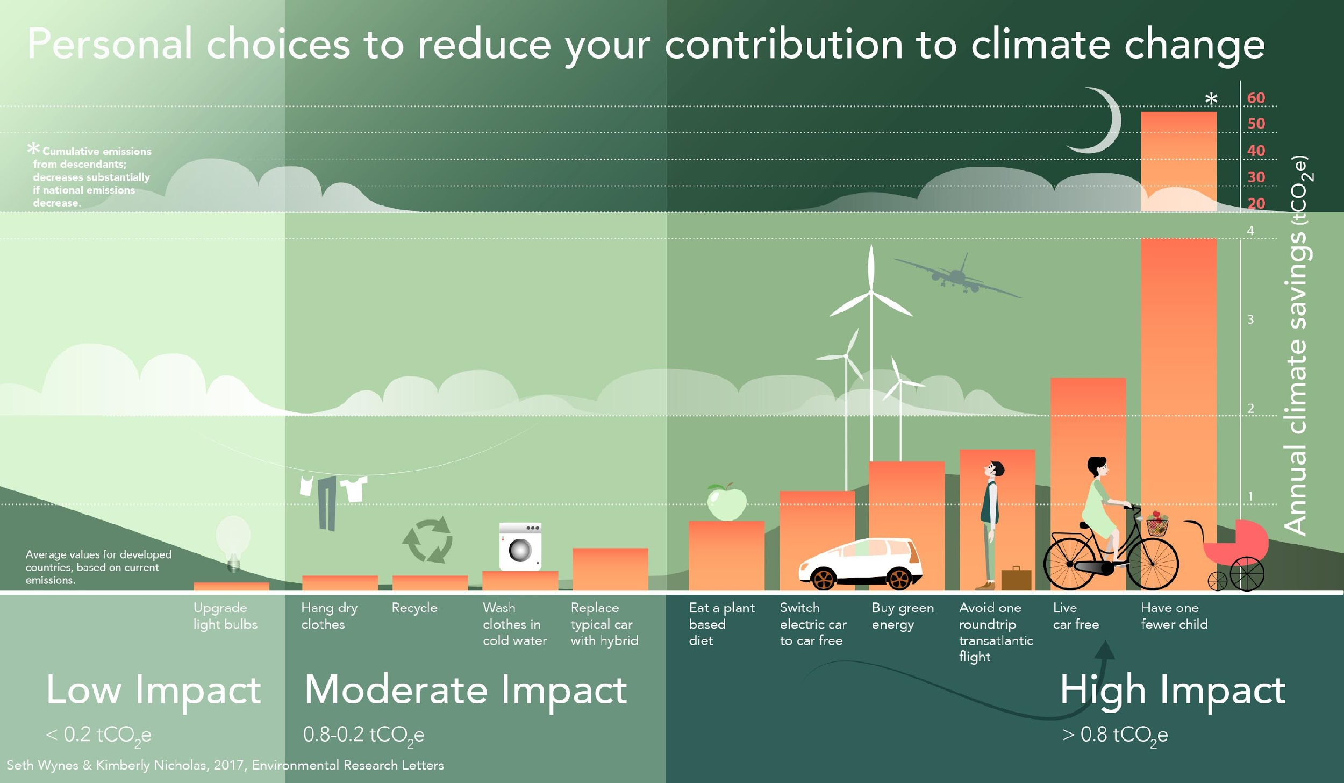

Slide 37
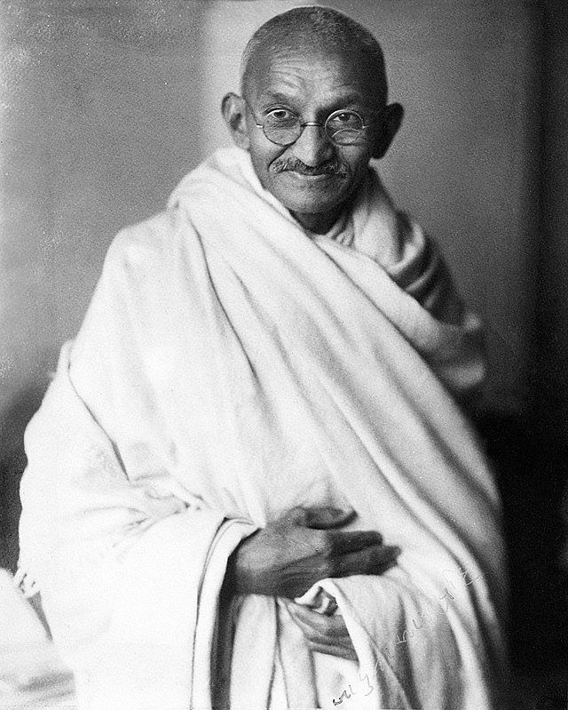
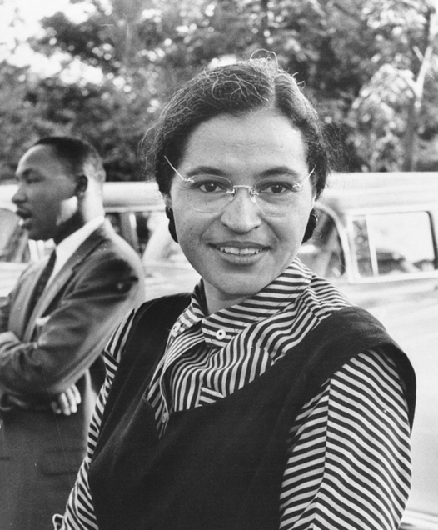
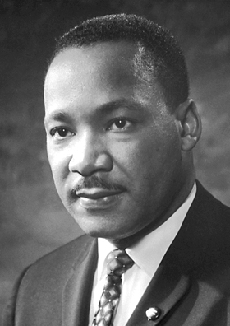

NON-VIOLENT CIVIL DISOBEDIENCE
HAS HONORABLE AND SUCCESSFUL HISTORY
MAHATMA GANDHI
ROSA
PARKS
MARTIN
LUTHER KING
NIKOL
PASHINYAN
ALSO SOUTH AFRICA, WOMEN’S SUFFRAGE ... NEED NON-VIOLENT CIVIL DISOBEDIENCE FROM MAXIMUM 3.5% OF THE POPULATION
Notes:
Non-violent protest, often called “civil disobedience”, has been deployed effectively in the struggles for civil rights.
Famous historic examples are represented by
Mahatma Gandhi peacefully mobilising the Indian people against British rule
Rosa Parks making a quiet stand against injustice by refusing to give up her seat on a bus to a white person, sparking an entire rebellion which helped overturn segregation in the US
Martin Luther King deployed non-violent resistance to fight for civil rights
You probably haven’t heard of Nikol Pashinyan though. In 2018 he led a successful peaceful revolution in Armenia using non-violent civil disobedience.
These and many other events show us that people consider it is morally right to deploy non-violent civil disobedience in direct action to remove injustice. Extinction Rebellion considers that there is no greater civil right than the right to a future for our children, and no greater injustice than the ending of our species.
3.5%: Studies of successful movements by the Harvard Professor Erica Chenowith and others shows that whenever 3.5% of people have joined these movements they always succeed and they often succeed with far less.
So unlike the response to climate change for the last 30 years which emphasised personal lifestyle change which would require everyone to act to really make a difference, by taking disruptive, peaceful Civil Disobedience we only need enough people.

Slide 38
We can and should do all of these things, but it still will not be enough.
We have marched. We have worked with corporate. We have funded Green orgs. We have sued. We have become vegetarian and vegan. We have passed legislation. We have sat in trees. We have biked. We have worked with Congress. We have voted. We have argued. We have debated. We have spoken gently, and angrily.
It is not enough. We are still en route at Mach 9 to climate catastrophe.
We need world governments & media to declare states of emergency, tell the truth about the crisis, and act accordingly. We need to WAKE UP.

Slide 39
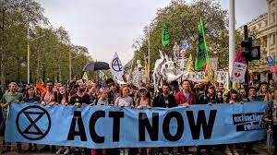
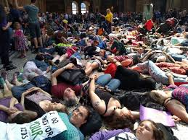
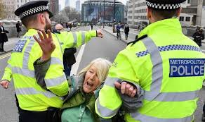
XR in London
Call for International Week of Action, April 15-22
Bridges, streets and plazas taken throughout London. Concerts held. Museums invaded. Airport mobbed. People glued to trucks and doors. Families. Young people. Celebrities. Artists.

Slide 40






EXTINCTION REBELLION’S THREE DEMANDS
TELL THE TRUTH
ACT AS IF THE TRUTH IS REAL
Notes:
We have three demands.
1. Declare climate emergency
The Government must tell the truth about how deadly our situation is
It must work with the media to communicate the urgency for change
It must specify what individuals, communities and businesses need to do.
2. Zero net carbon by 2025
The Government must enact legally-binding policies to reduce carbon emissions in the UK to net zero by 2025
It must take further action to reduce atmospheric greenhouse gases.
It must cooperate internationally
3. Citizens’ assembly – we will explain this in more detail later, but on a high level
Many solutions could be implemented to avoid ecological collapse, and it is not our place to propose exactly which ones are the best. We therefore propose a system through which the policies and solutions are chosen - a Citizens’ Assembly.
The first demand fits with tell the truth, the second two with act as if the truth is real.

Slide 41
Extinction Rebellion
So far ...
Climate States of Emergency called in
U.K., Ireland and Zurich, Basel in Switzerland. France calls for Citizens Assembly.
Since April 22.

Slide 42
Normal political mode Emergency mode
Crisis constrained by business as usual | Crisis embraced with urgency by all
No urgent threat perceived, time of response not important | Known escalation beyond control if immediate action not taken
The crisis is one of many issues | The crisis is of highest priority
Budgetary restraints | All available resources devoted to the emergency
Slow rate of change, systemic inertia | Rapid transition & scaling up
Based on material by The Climate Mobilization (TCM)

Slide 43
Normal political mode Emergency mode
Targets & goals determined by political tradeoffs Politics is adversarial & divisive | Critical targets and goals not compromised Collaborative and effective leadership
Based on material by The Climate Mobilization (TCM)

Slide 44
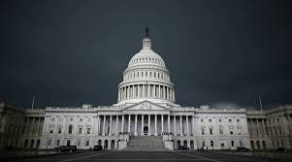




We need URGENT action by all world governments, and ours.
Good News:
Santa Cruz City Council passed an Emergency Resolution
Oct 27, 2018
Santa Cruz County Resolution passed Jan 29, 2019.
Notes:
Lets make it happen Locally. We’ll be working with the Santa Cruz Climate Action Program staff

Slide 45
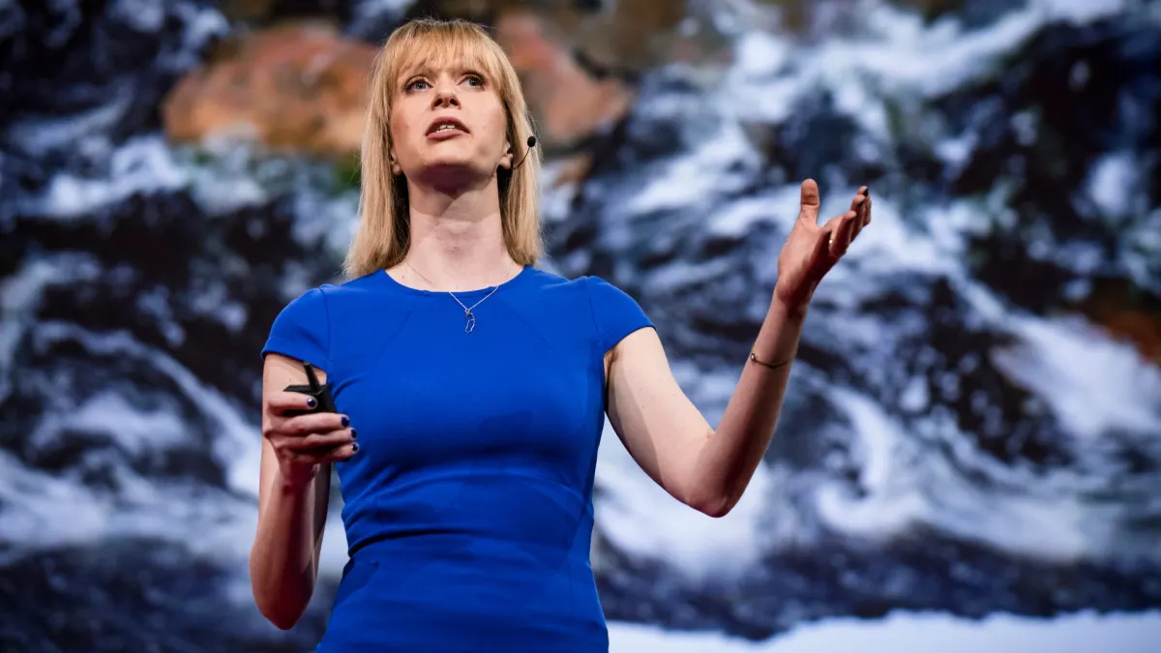
DR KATE MARVEL
NASA’S GODDARD INSTITUTE
“AS A CLIMATE SCIENTIST, I AM OFTEN ASKED TO TALK ABOUT HOPE.
CLIMATE CHANGE IS BLEAK, THE ORGANIZERS sAY.
TELL US A HAPPY STORY. GIVE US HOPE. THE PROBLEM IS,
I DON’T HAVE ANY…
…WE NEED COURAGE NOT HOPE.”
Notes:
[SPEAKERS NOTE]: LET THE AUDIENCE READ THE MAIN QUOTE FOR THEMSELVES THEN REVEAL THE SECOND QUOTE
This quote by Dr Kate Marvel summarises the situation we are in….
CLICK TO REVEAL “... WE NEED COURAGE NOT HOPE”
However, all isn’t lost, but we can’t just hope that somebody else will sort this out for us, we need to take courageous action to

Slide 46

Positive revolutions can
happen when decided necessary
US: NEW DEAL TRANSFORMED ECONOMY 1933-37. victory gardens produced 40% us produce during WWII.
UK: MASSIVE CHANGE IN 6 YR OF WWII MOBILIZATION.
US: moon landing IN 7 YEARS
US: Massive bank bailout 2008 recession. Banks called “too big to fail.” is planet earth ecosystem too big to fail?
Notes:
Six years is a very short period of time to transform our economy to being net carbon zero.
As the existing environmentally destructive solutions are embedded in the current global system, you might think it is impossible to make the massive changes fast.
However it has been demonstrated many times that if there is sufficient desire that massive changes can happen very quickly as represented by these three examples.
In the early 1930s America faced the Great Depression, and the response was huge government investment, which got the country back on it’s feet very quickly
Britain faced an existential threat in 1939, but not only did deal with the threat of Nazi Germany, but also laid the foundations for things such as the NHS and widespread social housing.
In 1962 John F Kennedy set an objective to place a man on the moon by the end of the decade, and in 1969 this seemingly impossible feat at the time was achieved.

Slide 47
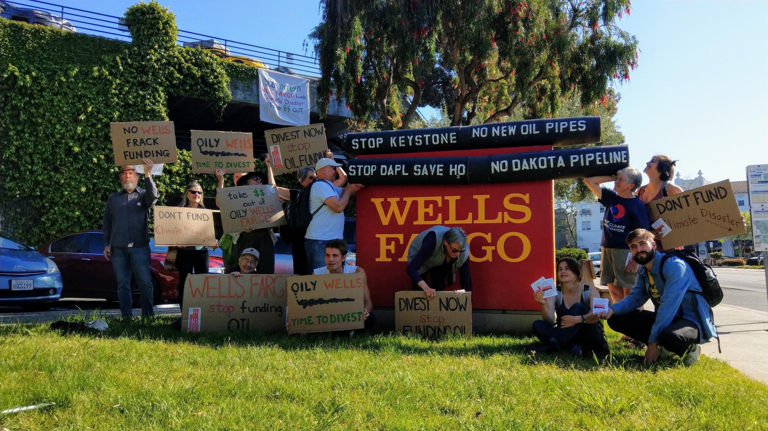
SC CAN action at Wells Fargo included a Die-in and letters delivered to the manager 4/10/19

Slide 48
Good News, Bad News
Feb: Congressman Jimmy Panetta agreed to back the Green New Deal
May 15: Congressional hearing on Climate Crisis
May 15: CA AB 857 PUBLIC BANKING authorization co-authored by Mark Stone progressed
Panetta has not signed onto HR763, Carbon Tax Bill, “Energy Innovation and Carbon Dividend Act”
Romero Institute working on California Green New Deal
Trump Administration attempting to open California Central Coast (and state) to fracking. Contact Bureau of Land Management.
Fracking pipelines produce methane. Methane is 20+ times more potent than CO2.

Slide 49
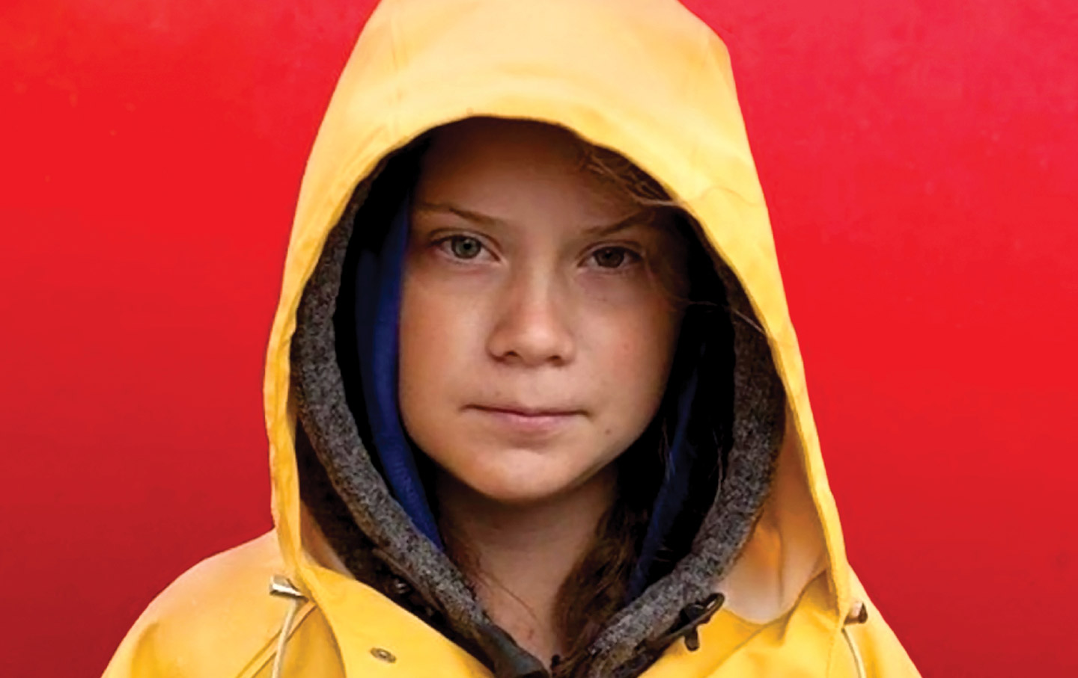
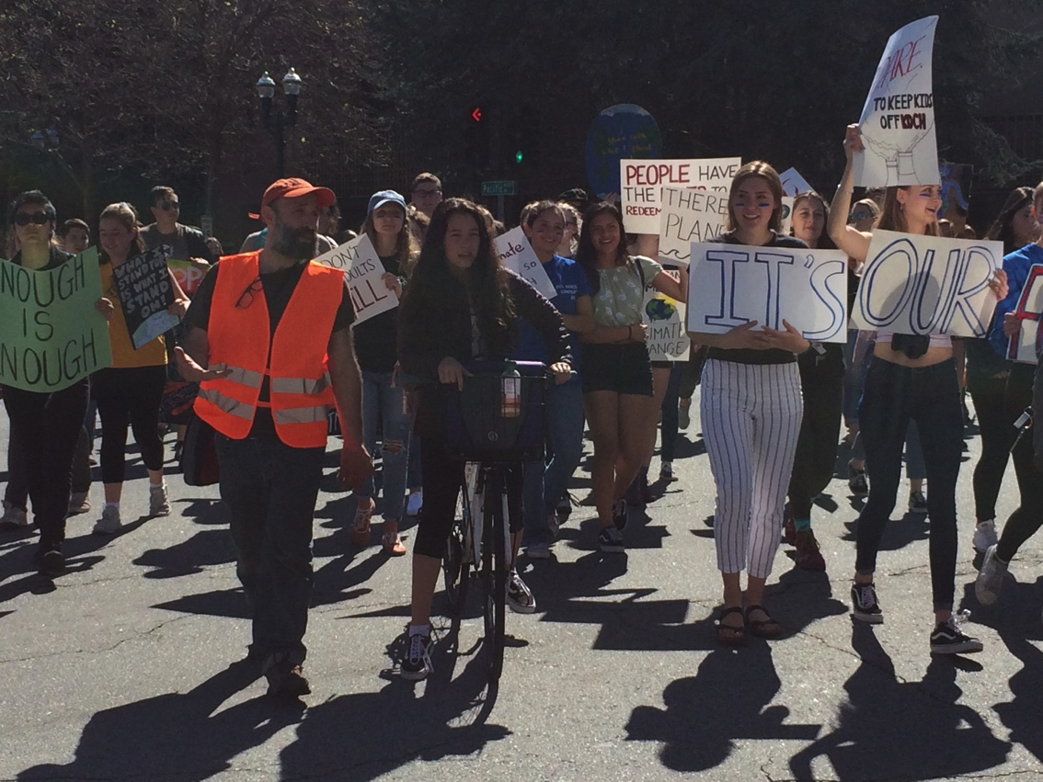
Young people worldwide are protesting. Their future is in serious jeopardy.
March 15, 2019: Local young people held their first Climate Strike. Next strike called for tomorrow.

Slide 50
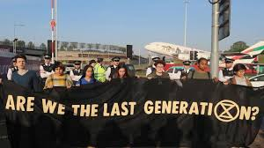
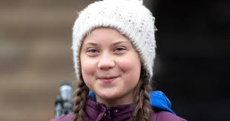
One planet, last chance.
Only together can we do this and only if we act massively and act now.
For more see Extinction Rebellion: Santa Cruz and Monterey (Facebook) plus U.S. and International
& https://scruzclimate.org/

