Slide 1
The Greenhouse Effect & Climate Change

Slide 2
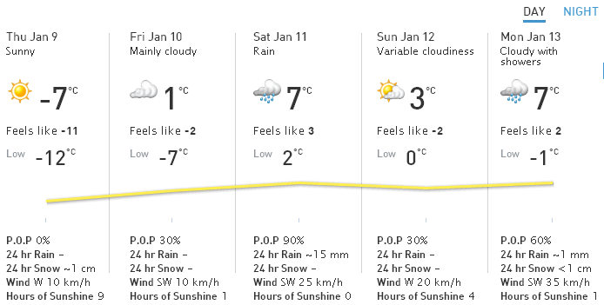
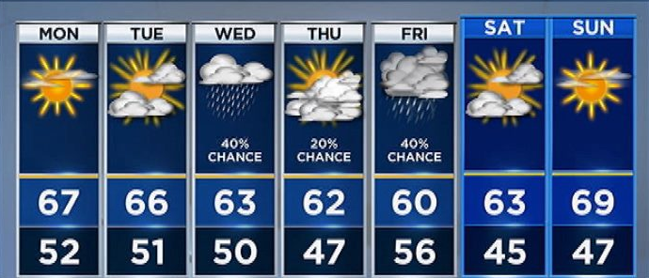
Weather vs. Climate
Weather: atmospheric conditions, including temperature, precipitation, wind, and humidity, in a particular location over a short period of time, such as a day or a week
Climate: the average of the weather in a region over a long period of time

Slide 3
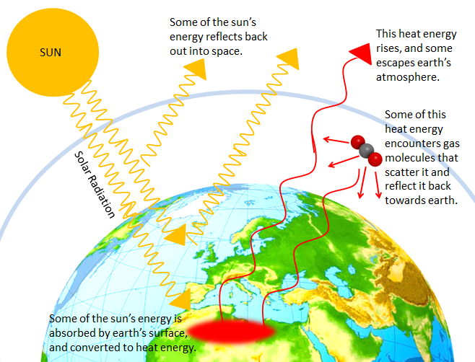
How does the Greenhouse Effect work?

Slide 4
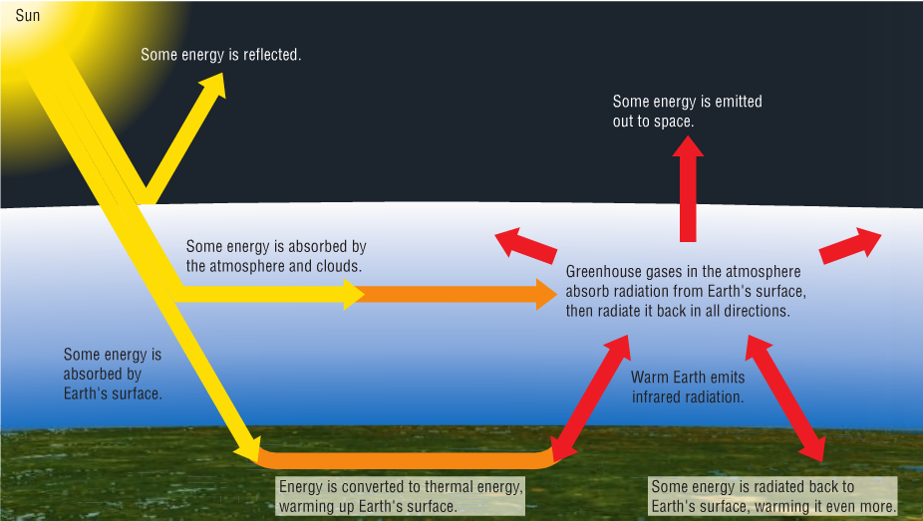
High-energy radiation from the Sun enters the atmosphere.

Slide 5
2. It is converted to heat energy and emitted from the Earth’s surface.

Slide 6
3. Certain gases in the atmosphere trap some of the radiation from Earth’s surface and radiate it back, warming the atmosphere

Slide 7
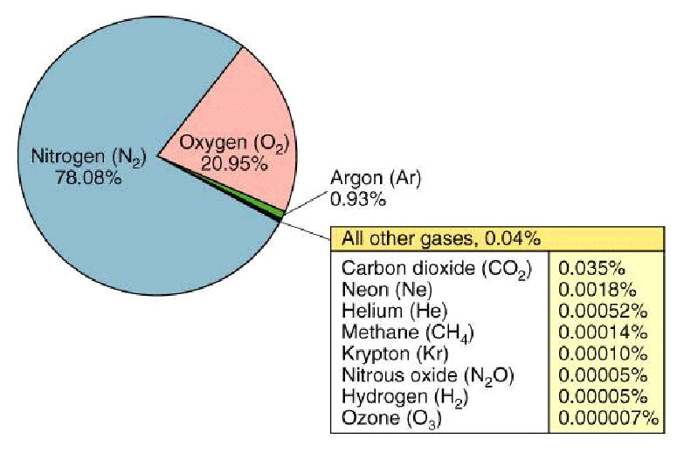
What is a Greenhouse Gas?
Any gas in the atmosphere that absorbs and emits infrared radiation (thermal energy) from the Earth
Most of the air in the
atmosphere is made
of N₂ and O₂ which
do not absorb
radiation from the
surface of the Earth

Slide 8
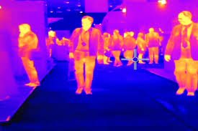
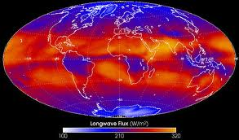
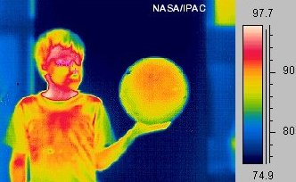
Infrared (long-wave) Radiation

Slide 9
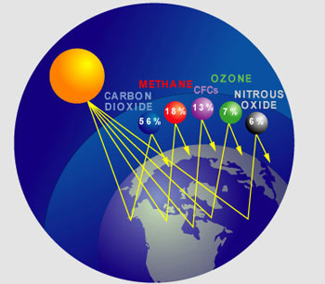
Greenhouse Gases
  Consist of less than 1% of the atmosphere
It is their concentration in the atmosphere which determines how much energy they can absorb

Slide 10
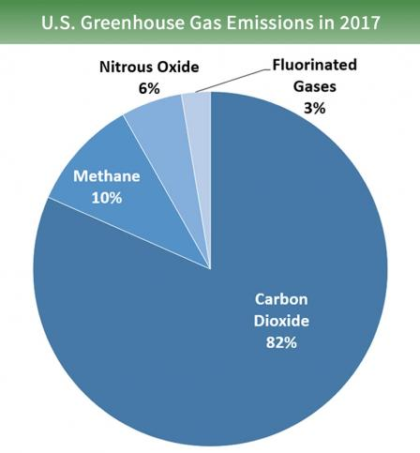
Greenhouse Gases
Greenhouses gases include:
  H₂O
  CO₂
  CH₄ (methane)
  N₂O nitrous oxide
  CFC’s
  (and a few others)
Produced “naturally” AND by human activities

Slide 11

We need the Greenhouse Effect!
The heat from the natural greenhouse effect warms Earth’s atmosphere an average of 33°C
Eventually, this heat dissipates to outer space
If there were no greenhouse effect, Earth’s average temperature would be -19°C—Impossible for life as we know it!

Slide 12
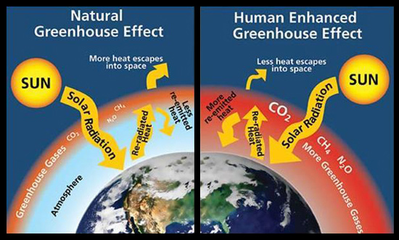
Enhanced Greenhouse Effect
(Human impact on the Greenhouse Effect)
Humans are increasing the concentrations of greenhouse gases

Slide 13
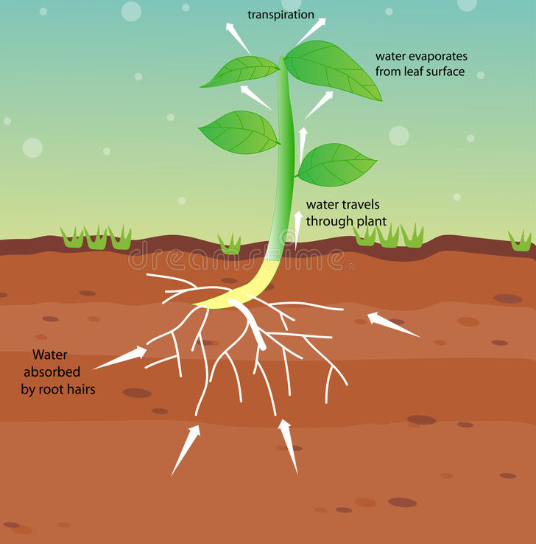
Water Vapour (H20)
(95% of Earth’s greenhouse effect)
Part of the “natural” greenhouse effect
- Human activities do not release significant amounts of water vapour into the atmosphere
-remains on average for 9 days
Most abundant greenhouse gas
Sources:
  Evaporation
  Plant transpiration

Slide 14
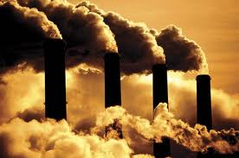
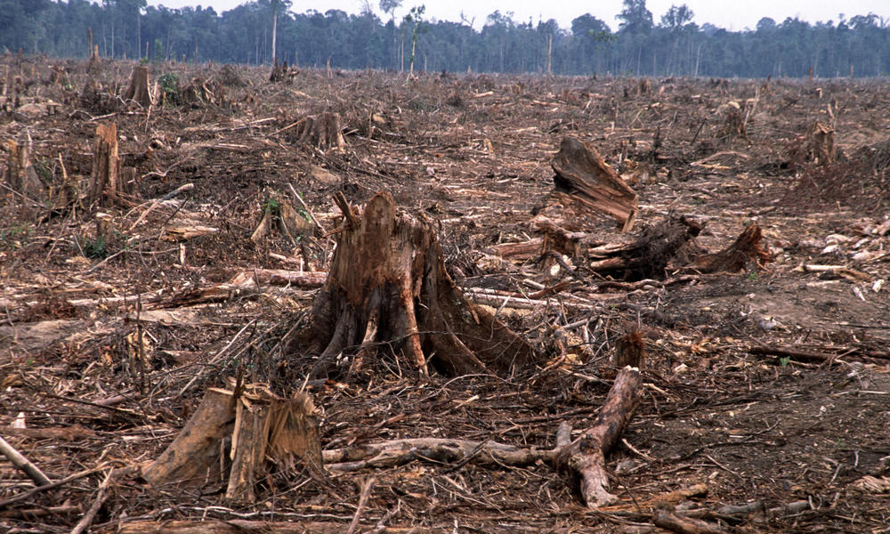
Carbon Dioxide (CO2)
Main Sources:
  Burning fossil fuels- coal, oil and natural gas
  Increases due to the removal and burning of forests

Slide 15
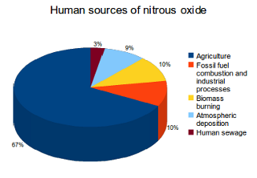
Nitrous oxide (N20)
Main sources:
  Burning of biomass
  Burning of fossil fuels
  Released by bacteria from soil fertilizers
Traps heat 296 times better than carbon dioxide

Slide 16
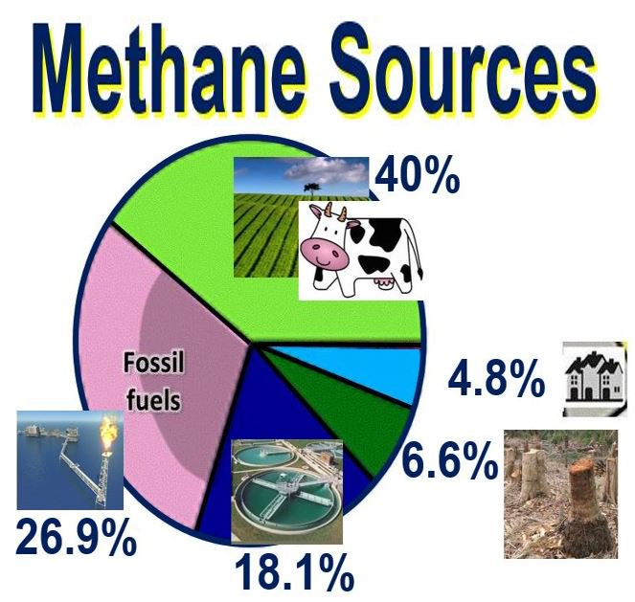
Methane (CH4)
Main Sources:
  Production, distribution, burning of fossil fuels
  Livestock farming (animal waste)
  Landfills & waste

Slide 17
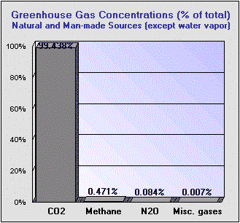
The Important Greenhouse Gases (except water vapor)
U.S. Department of Energy
(all concentrations expressed in parts per billion) | Pre-industrial baseline | Natural additions | Man-made additions | Total Concentration (ppb) | Percent of Total
Carbon Dioxide (CO₂) | 288,000 | 68,520 | 11,880 | 368,400 | 99.438%
Methane (CH₄) | 848 | 577 | 320 | 1,745 | 0.471%
Nitrous Oxide (N₂O) | 285 | 12 | 15 | 312 | 0.084%
Misc. gases ( CFC's, etc.) | 25 | 0 | 2 | 27 | 0.007%
Total | 289,158 | 69,109 | 12,217 | 370,484 | 100.00%
Think about it:
What is the most abundant gas?
Which gas do you think will have had the largest % increase (total) post industrial revolution?
Which has had the largest % increase (total) post industrial revolution?

Slide 18
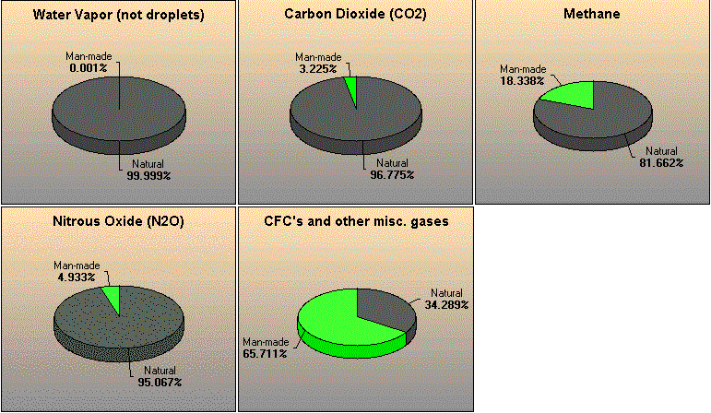
The Remaining 5%
Water vapor accounts for about 95% of Earth's greenhouse effect
The remaining 5% is shown below. These charts shows human influence on the remaining 5% of greenhouse gases

Slide 19
Anthropogenic (man-made) Contribution to the "Greenhouse
Effect," expressed as % of Total (water vapor INCLUDED)
Based on concentrations (ppb) | % of Greenhouse Effect | % Natural | % Man-made
Water vapor | 95.000% | 94.999% | 0.001%
Carbon Dioxide (CO₂) | 3.618% | 3.502% | 0.117%
Methane (CH₄) | 0.360% | 0.294% | 0.066%
Nitrous Oxide (N₂O) | 0.950% | 0.903% | 0.047%
Misc. gases ( CFC's, etc.) | 0.072% | 0.025% | 0.047%
Total | 100.00% | 99.72 | 0.28%

Slide 20
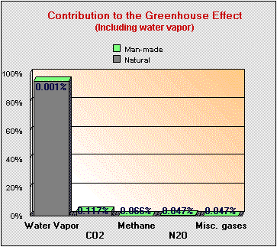
In Summary
Water vapor which is responsible for 95% of Earth's greenhouse effect, is 99.999% natural. Even if we wanted to we can do nothing to change this.
Anthropogenic (man-made) CO₂ contributions cause only about 0.117% of Earth's greenhouse effect.
Adding up all anthropogenic greenhouse gas sources, the total human contribution to the greenhouse effect is around 0.28% .

