Slide 1
Changing World Oceans
Ocean Acidification

Slide 2
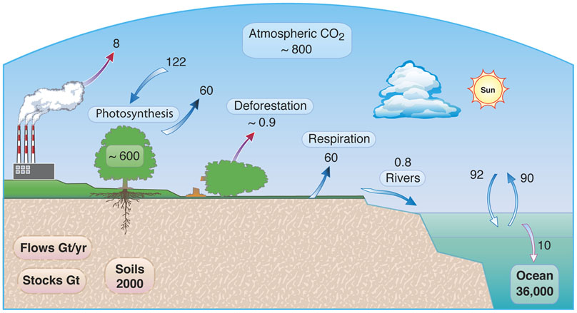
The Carbon Cycle
The Global Carbon Cycle. Graphic by Walter Denn, LBNL, 2010.
Notes:
Carbon dioxide diffuses along a concentration gradient, moving from a high concentration to a low concentration
Even though there are 36,000 Gt in the ocean the ocean is vast so the carbon dioxide is presently in a lower concentration than in the atmosphere. That is why there is more CO2 moving into the ocean from the atmosphere than moving out.
Flows is what changes between reservoirs
Stocks is what is presently held in the reservoir
Note the greater amount of carbon moving into the ocean compared to out of the ocean
Note all fluxes are in two directions except for the burning of fossil fuels (making the fossil fuels is too slow to be considered here)
http://www.arm.gov/news/features/post/15256
ARM Climate Research Facilities
Gt/yr = giga tons per year

Slide 3
pH Scale
7 is neutral
Lower pH values are more acidic
Higher pH values are more basic
The pH scale is a log scale
5 6 7 8 9
10 times more
H+ ions
10 times more
H+ ions
100 times more H⁺ ions
Notes:
A decrease of 1 pH unit represents a 10-fold increase in H+ ions compared to OH⁻ ions
A decrease of 2 pH units represents a 100-fold increase in H+ ions compared to OH⁻ ions
pH scale is dimentionless (no units) because it’s a ratio of H+ to OH- ions (for our purposes; there are other acid definitions in chemistry)

Slide 4
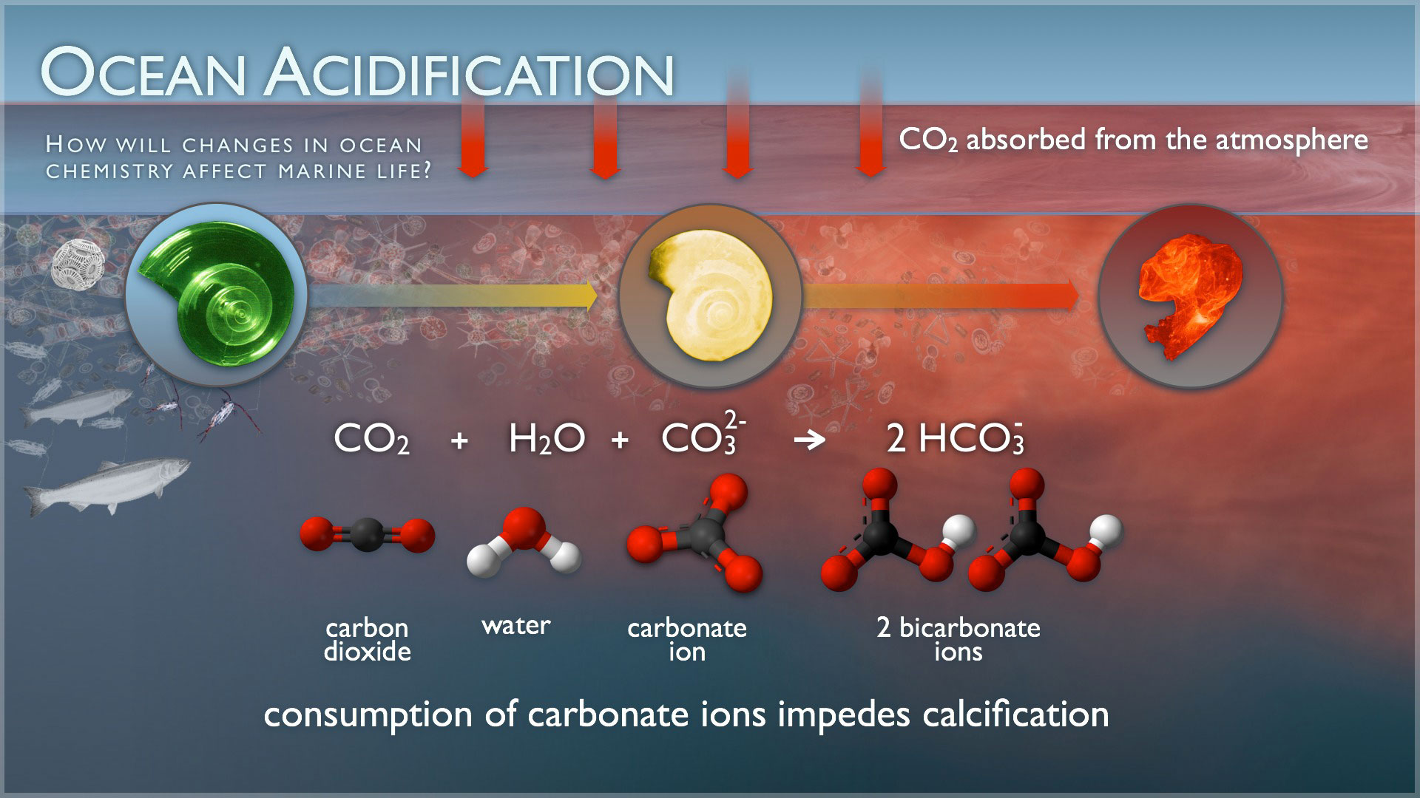
How Does The Ocean Get Acidified?
Notes:
http://www.pmel.noaa.gov/co2/story/Ocean+Acidification
The higher concentration of carbon dioxide in the water results in fewer carbonate ions available to make shells; the carbonate ions become bicarbonate ions

Slide 5
Chemical Reaction CO₂ and H₂O
CO₂ + H₂O H₂CO₃ HCO₃⁻ + H⁺
carbon
dioxide
water
carbonic acid
Bicarbonate ion
Hydrogen ion
An acid is something that produces an excess of hydrogen ions
The more acidic a solution is, the lower the pH and the more the H+ ions

Slide 6
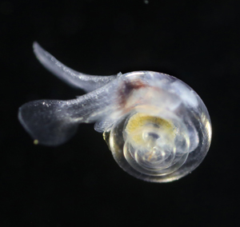
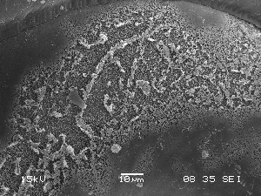
Pteropod SEM
Acid is etching away the surface of the shell
Notes:
Pteropods are marine planktonic (drifting) and nektonic (can swim against a current) mollusks
The shells are composed of the aragonite form of calcium carbonate and may be more sensitive to acidification
They range in size from a bean to a tennis ball
Click on the right photo to see the dissolving of the pteropod shell
http://upload.wikimedia.org/wikipedia/commons/transcoded/c/c5/Impacts_of_ocean_acidification_%28NOAA_EVL%29.webm/Impacts_of_ocean_acidification_%28NOAA_EVL%29.webm.480p.webm

Slide 7
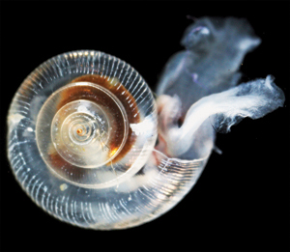
How Will Acidification Affect Marine Organisms?
Pteropod shells malformed
Notes:
Click on the right photo to go to the NOAA video showing how these pteropods’ swimming ability is negatively affected
http://www.noaanews.noaa.gov/stories2014/20140430_oceanacidification.html
Pteropods are one of the clearest pieces of evidence that ocean acidification is affecting marine organisms directly
Pteropods this shows how the healthy one on the left can be degraded to the weaker-shelled version on the right

Slide 8
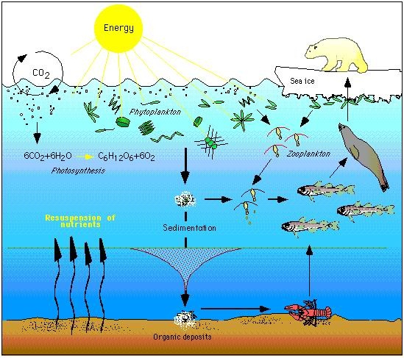
Food Resources Diagram
Notes:
This slide shows how plankton, zooplankton (like small pteropods), are important food resources for fishes, and other large marine organisms

Slide 9
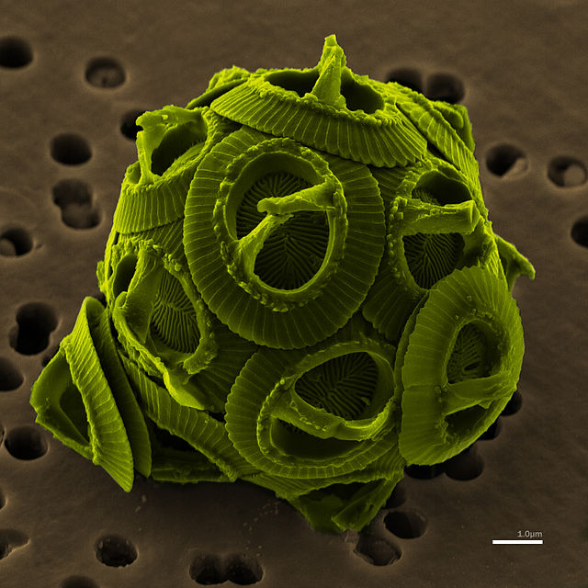
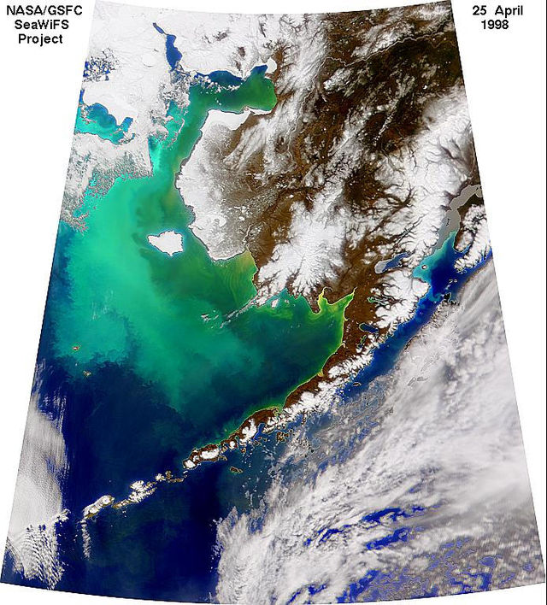
High Mag Calcitic Phytoplankton
May not be as susceptible to acidification as aragonitic and calcitic organisms
Notes:
Coccolithophores microscopic plankton important in the base of the food chain
May not be as affected by acidification because of the chemical make-up of their shells
http://shadow.eas.gatech.edu/~kcobb/ocean_acid/Kroeker%20et%20al%202010.pdf (reading)
http://simple.wikipedia.org/wiki/Coccolith#mediaviewer/File:Coccolithophore_bloom.jpg

Slide 10
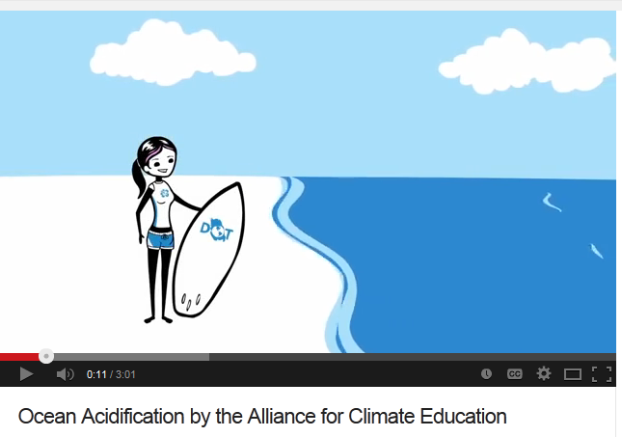
Ocean Acidification
Notes:
https://www.youtube.com/watch?v=Wo-bHt1bOsw
A high interest video that wraps up the issue of ocean acidification and adds the human impact of ocean acidification.

Slide 11
The Earth Will Adapt. . .
But will we?
Will our quality of life change?
These are reasons among others that we need to be good stewards of our environment.
Notes:
Just a final note emphasizing how the earth doesn’t care what we do to it. It will be here long after we are gone. But we need to be good stewards of our environment to ensure a good quality of life for us and our children.

