Slide 1
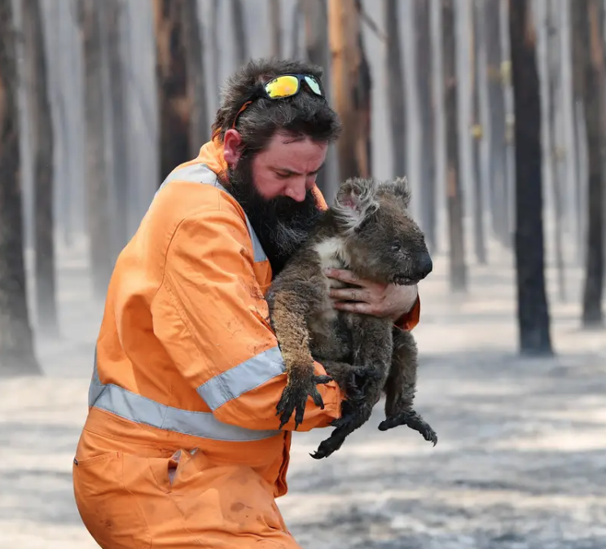
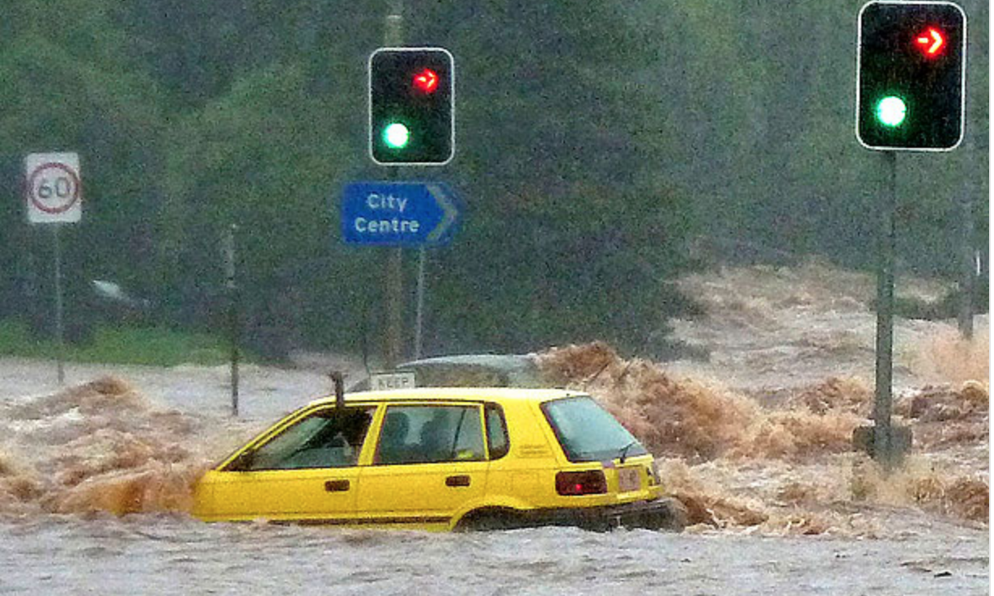
Climate CRISIS
In Brief
By Pauline Seales Spring 2020
Sad pictures from Australia

Slide 2
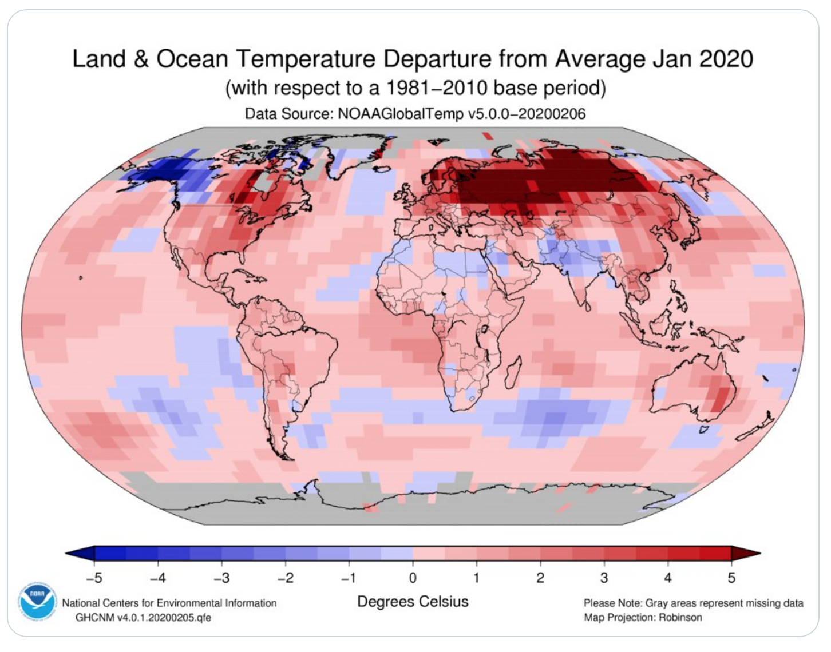
Climate Change
Is the Climate Changing?

Slide 3
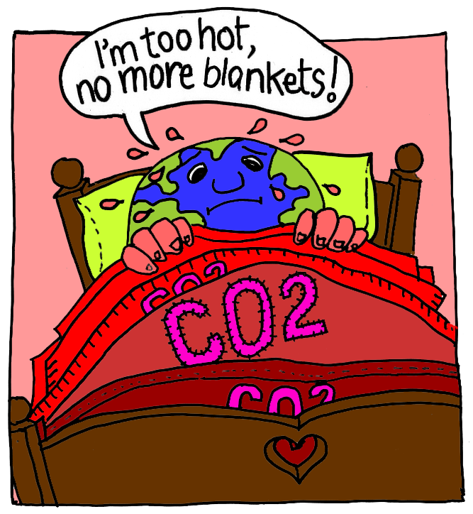
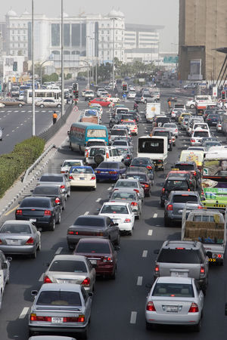

Add smokestack
What's really warming the world?
Notes:
IT’s US.
CO2 (carbon dioxide) produced by cars and power plants is acting like a blanket. The basic science has been known since the late 1800s

Slide 4
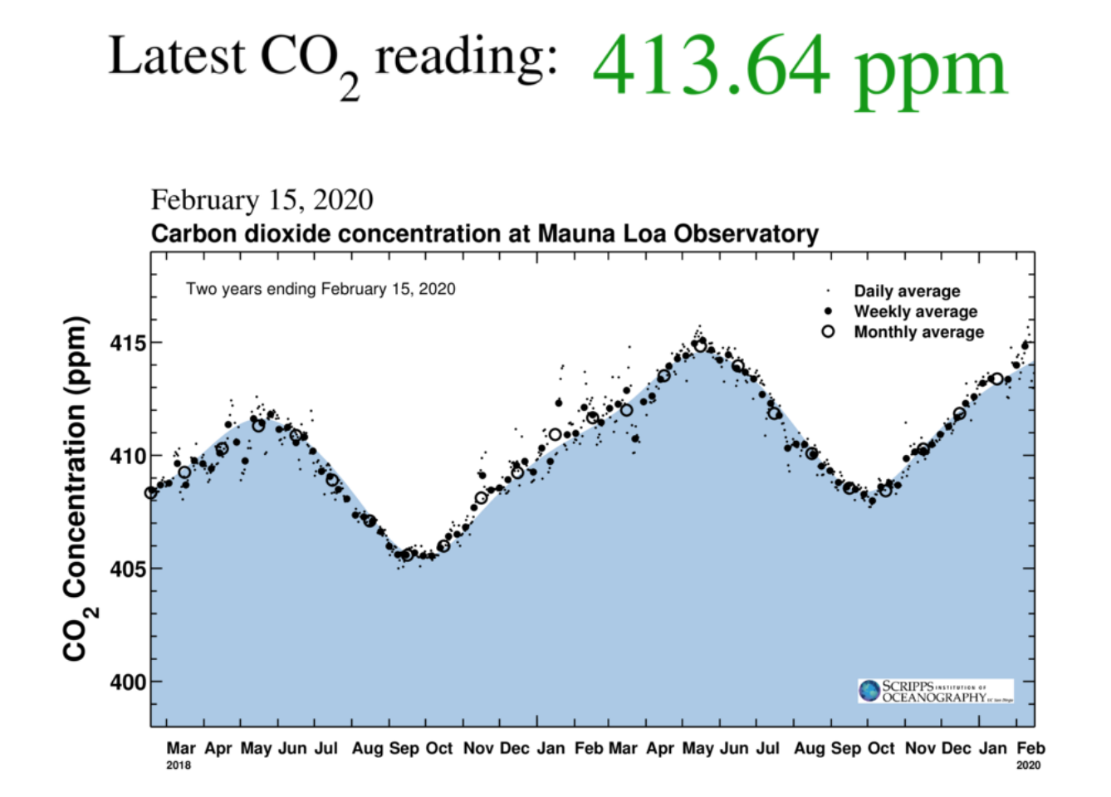
Notes:
SCIENTISTS AGREE
Current data shows that we are still adding more blankets to the feverish earth. In the 1800’s the level was 280 ppm

Slide 5
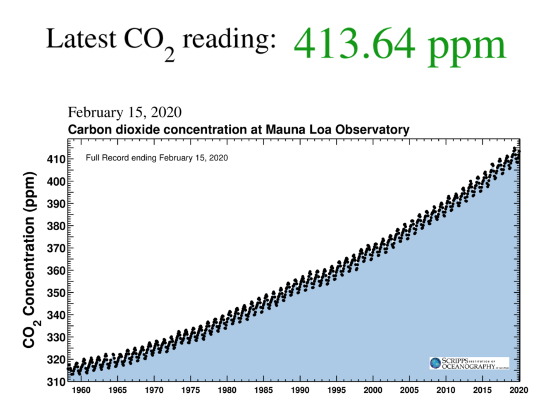

Slide 6
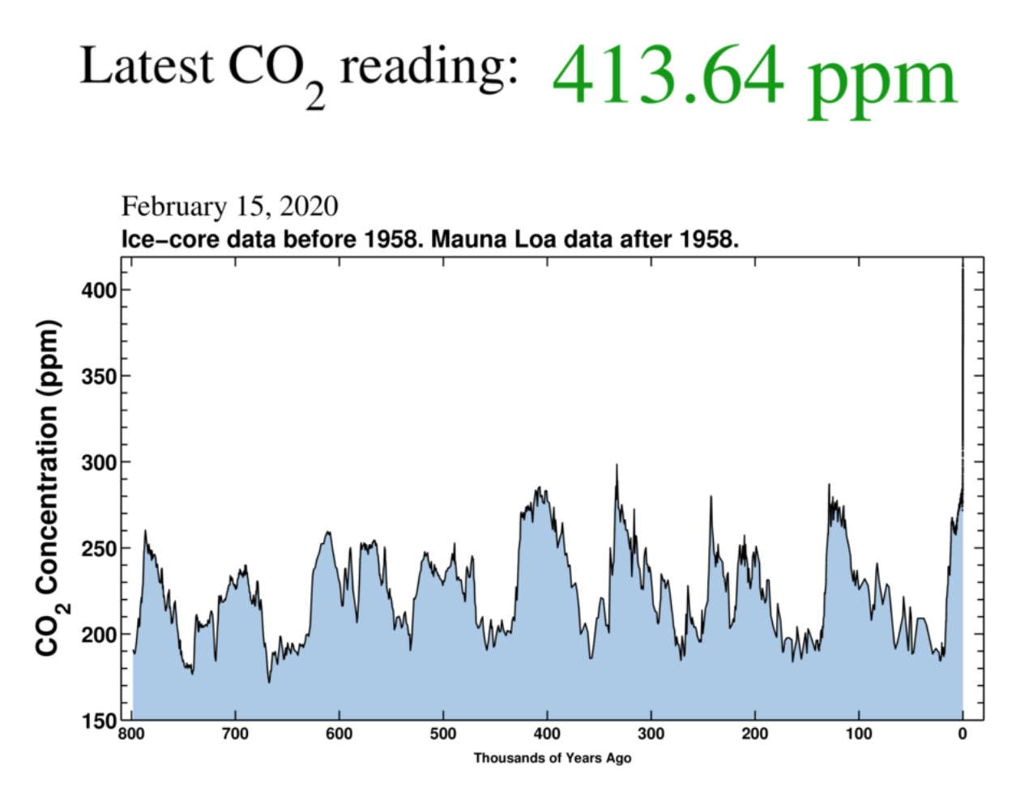
Notes:
CO2 graph going back 800,000 years
Now the scale has changed showing the past 800 thousand years.
The ups and downs represent the ice ages caused by wobbles in earth orbit
Right now we are already way above anything in the past million years

Slide 7
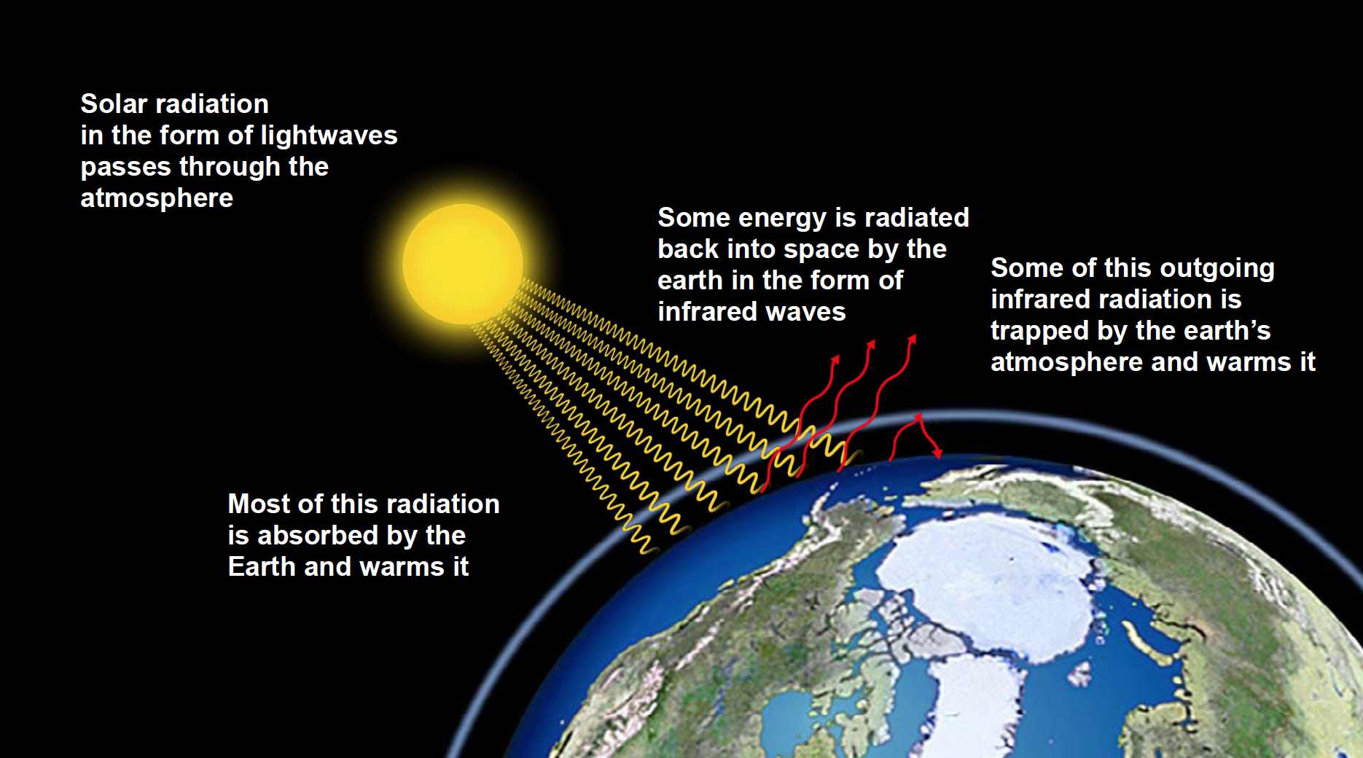
Greenhouse Effect

Slide 8
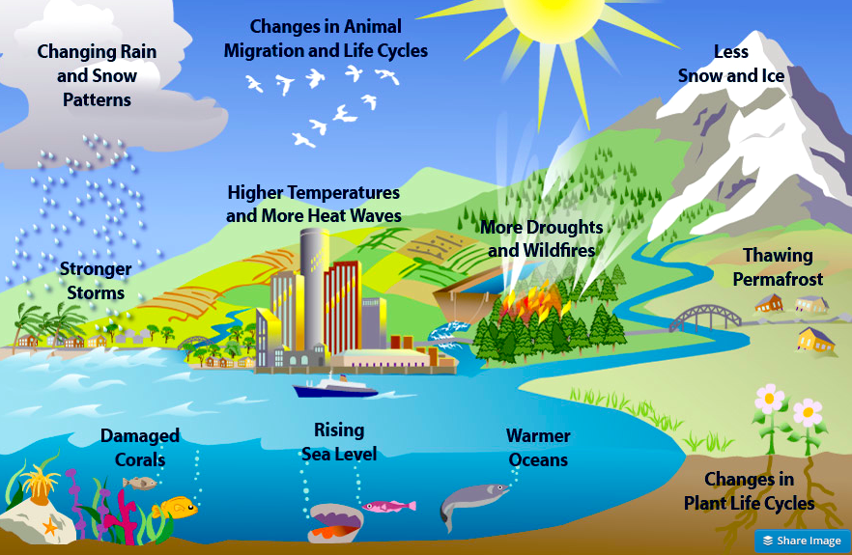
Climate Change has many effects

Slide 9
Do a few degrees matter?
Absolutely !
– we already see drastic effects with only
1 deg C = 1.8 deg F change
New IPCC Report says even 1.5 deg C is a problem but 2 deg C is MUCH WORSE

Slide 10
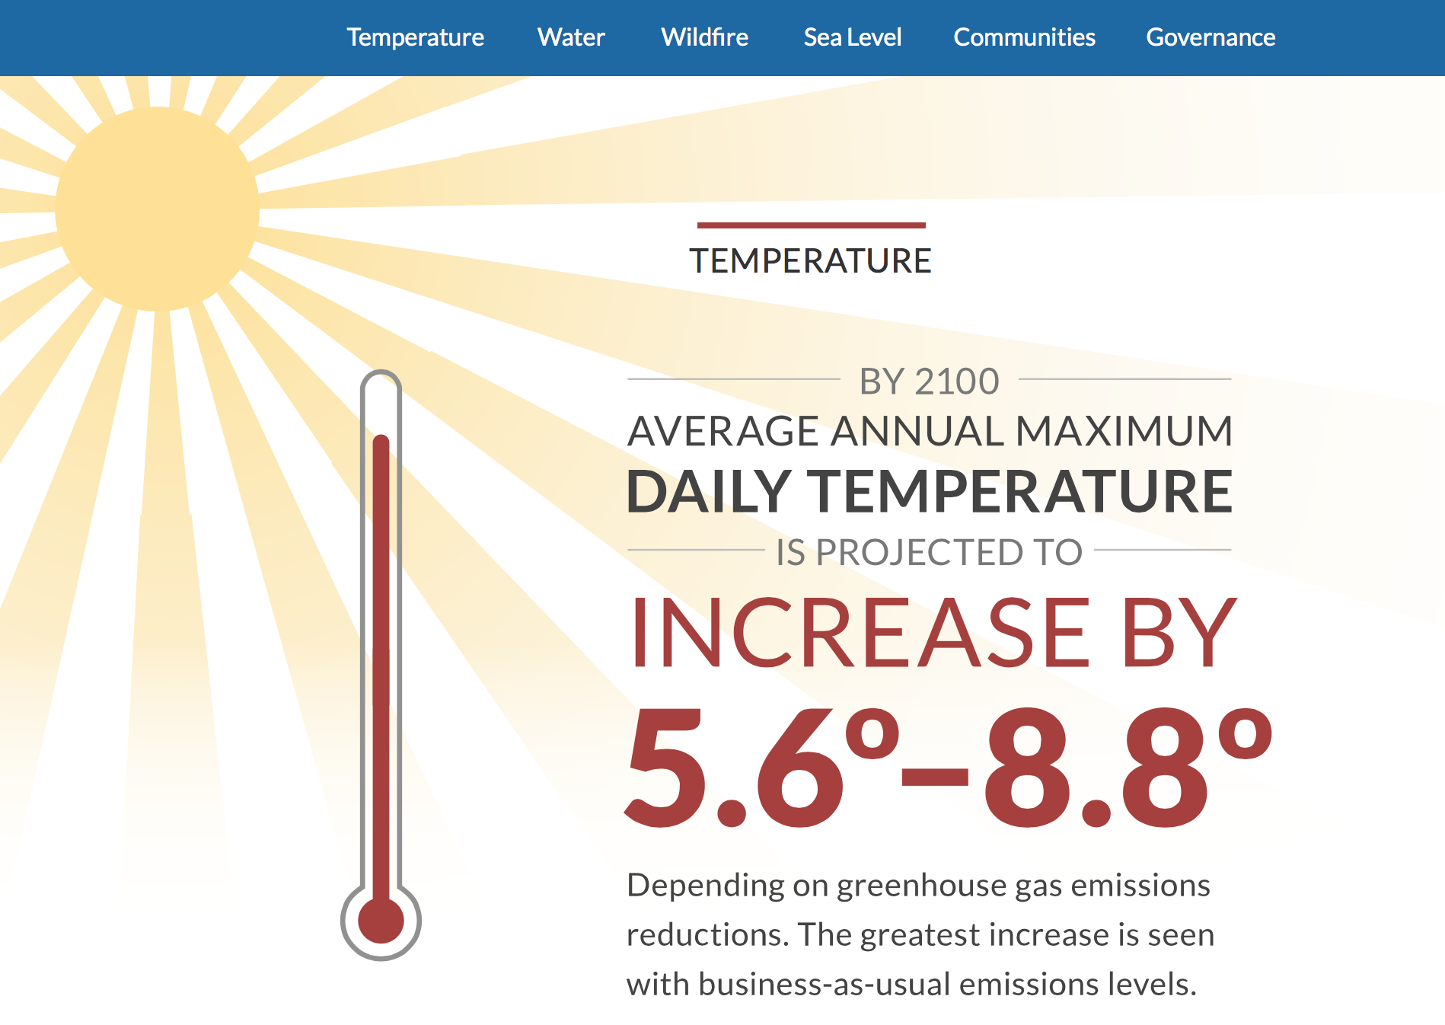
Notes:
Prediction from 4th Ca assessment is disastrous

Slide 11
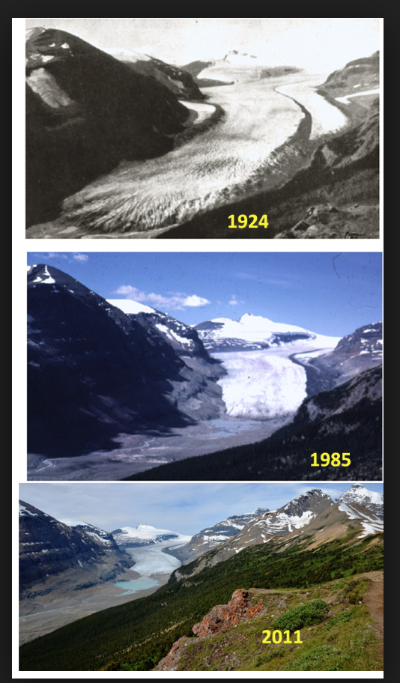
Ice is melting everywhere and sea level is rising.
Saskatchewan Glacier , Alberta

Slide 12
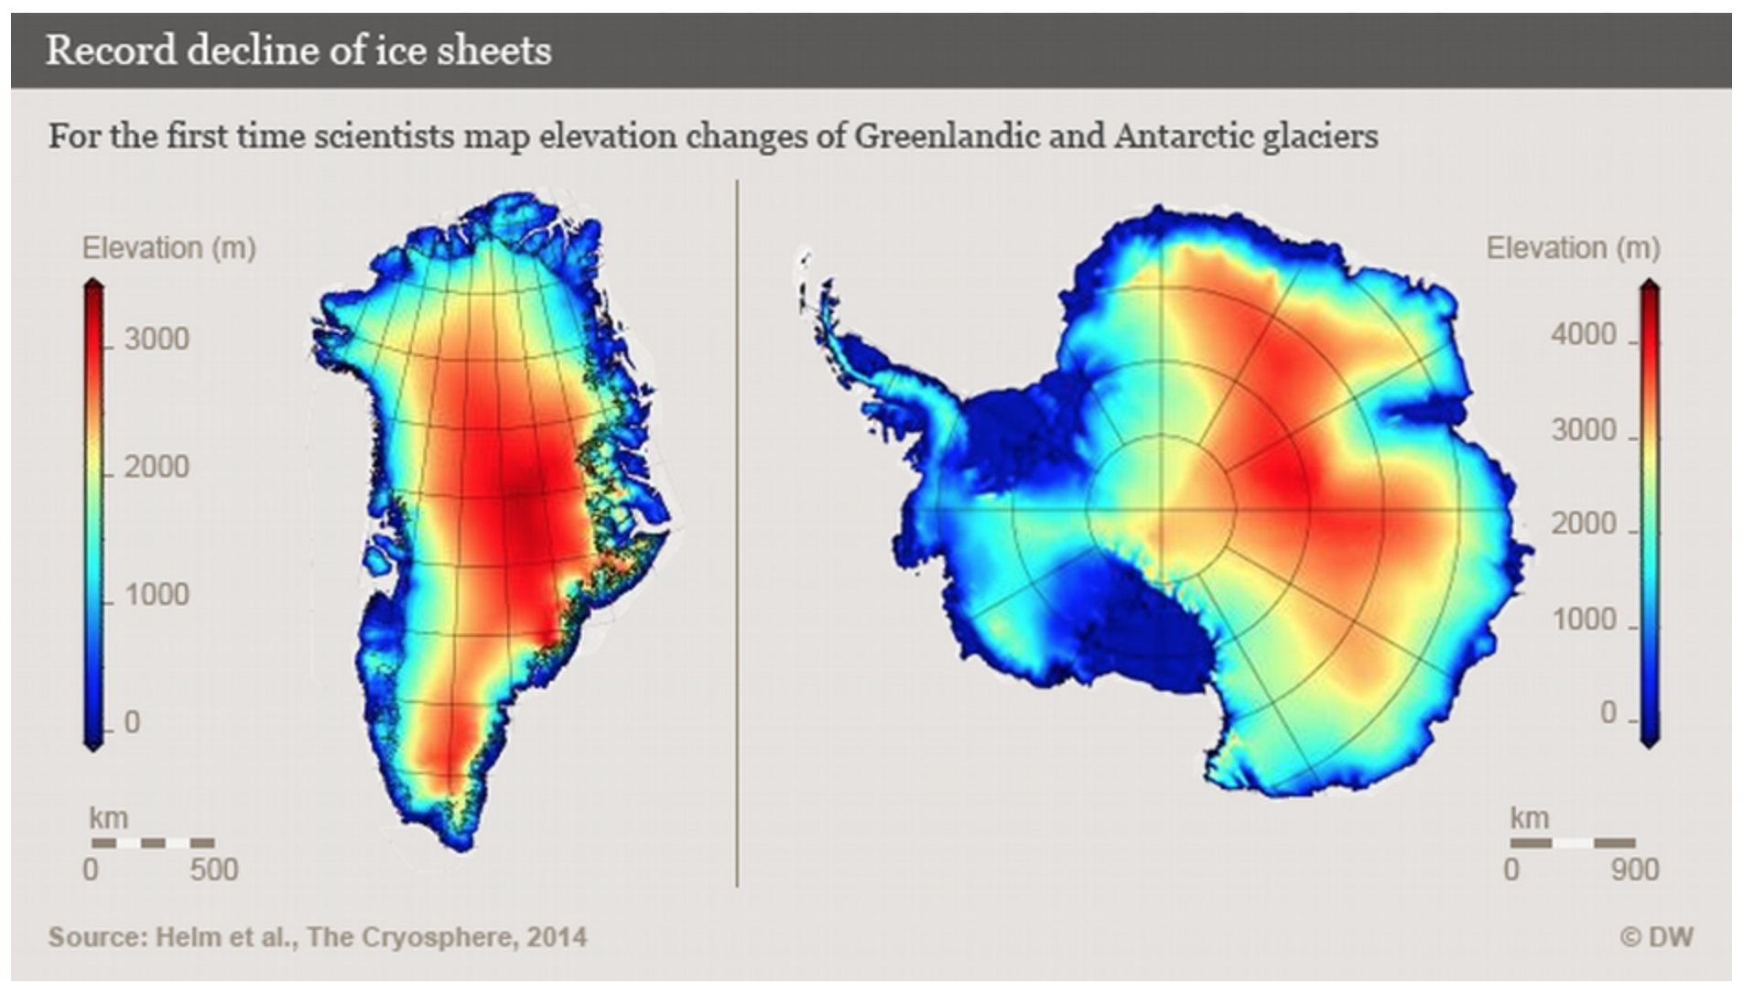
Greenland and Antarctica
Ice loss doubled in Greenland and tripled in the West Antarctic between 2009 to 2014.

Slide 13
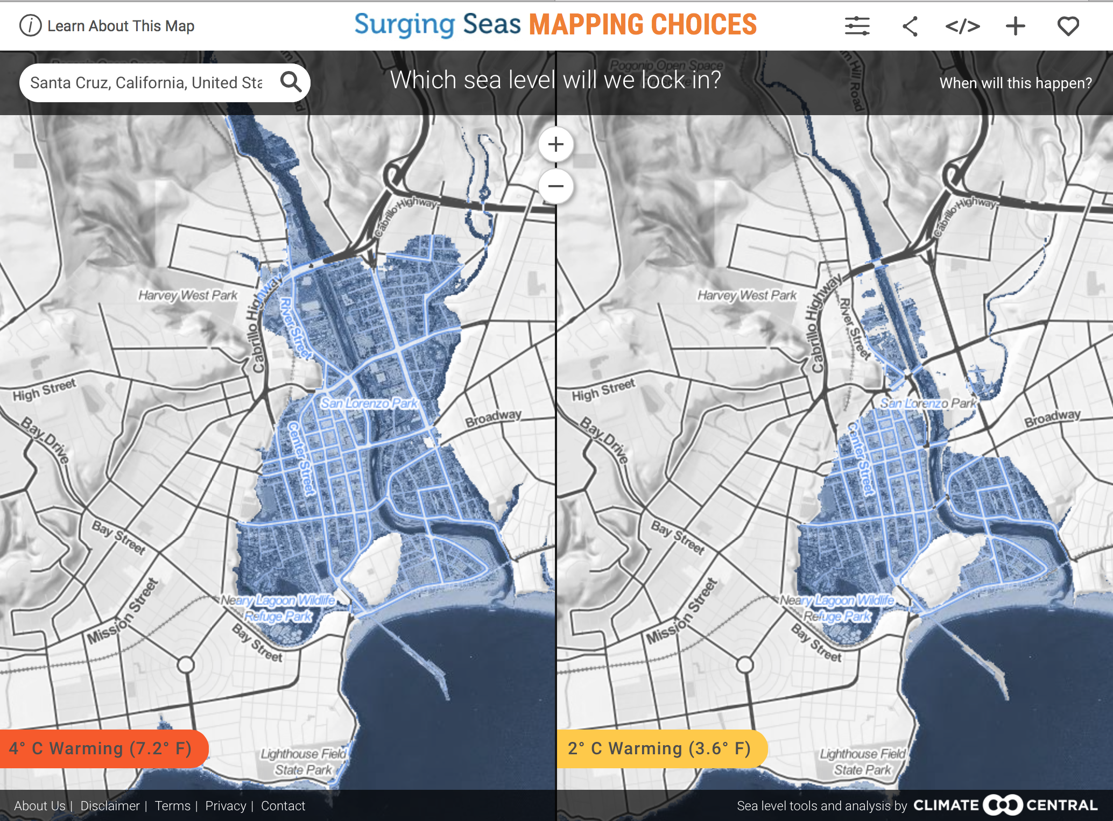



What to reduce or avoid
Notes:
We need to reduce Red meat consumption, because cows produce another grrenhouse gas Methane, and cut unnecessary driving,
buying stuff we really don’t need, and use of oil products

Slide 14


Detailed Carbon Reduction program by Paul Hawken.
Includes detailed analysis of 80 different solutions

Slide 15
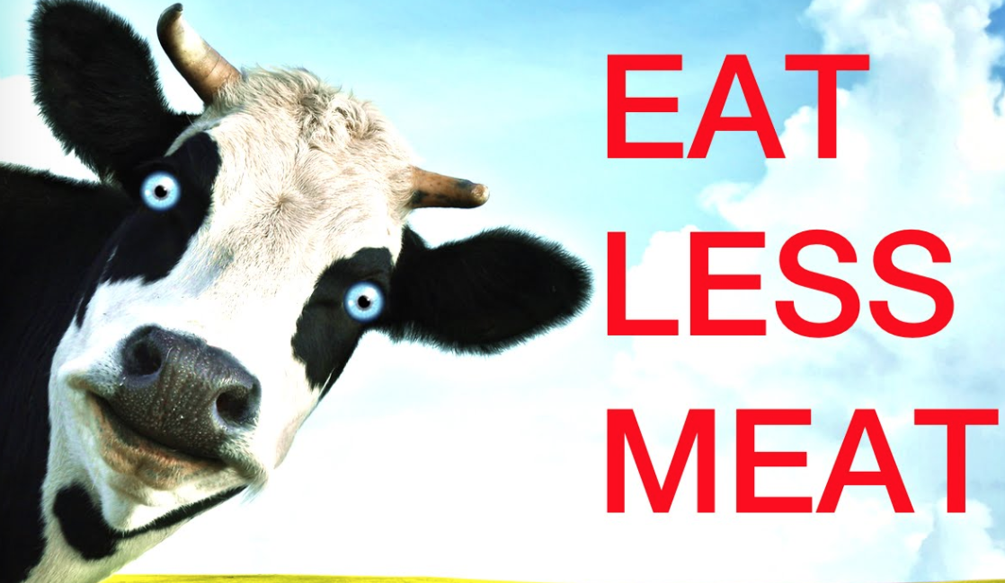
What to reduce or avoid
Buy less new stuff Drive MUCH less
Notes:
We need to reduce Red meat consumption, because cows produce another grrenhouse gas Methane, and cut unnecessary driving,
buying stuff we really don’t need, and use of oil products

Slide 16
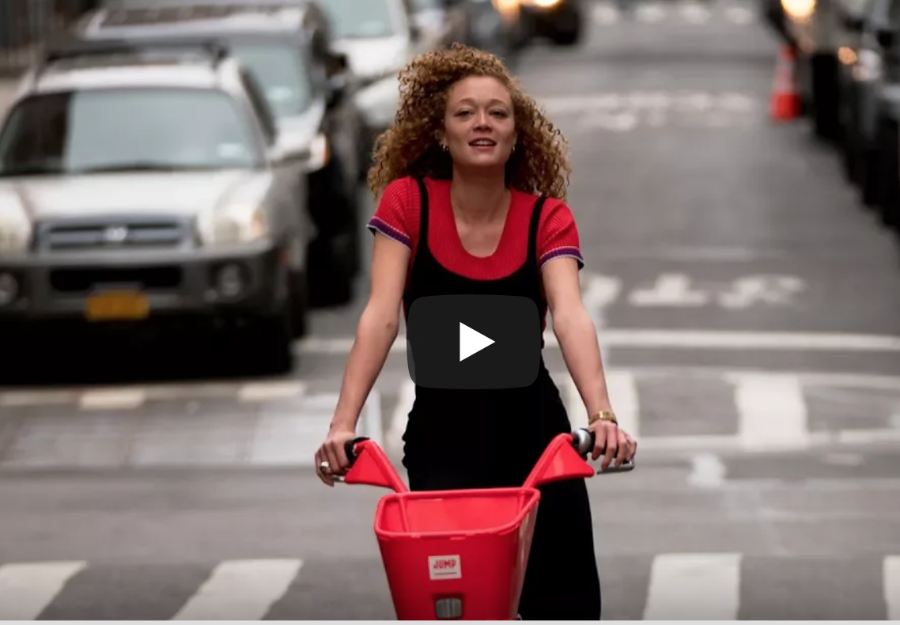


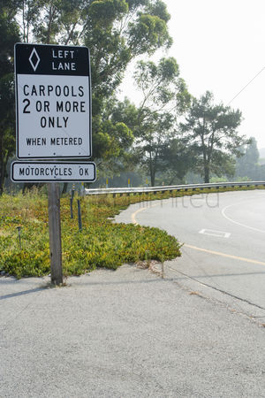

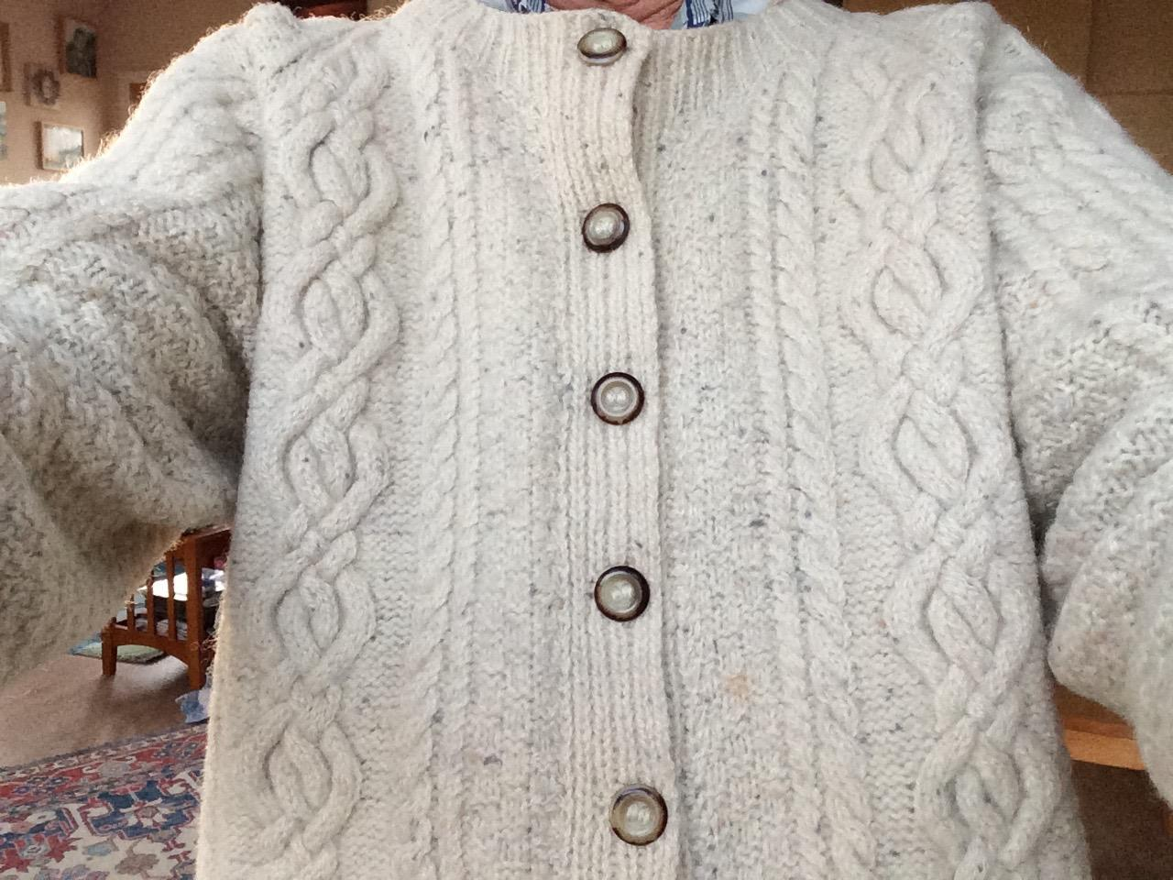

Enjoy
Notes:
Walking and biking are fun and healthy, the bus and carpools can help
In winter find that old favorite sweater , and line dried clothes smell great

Slide 17
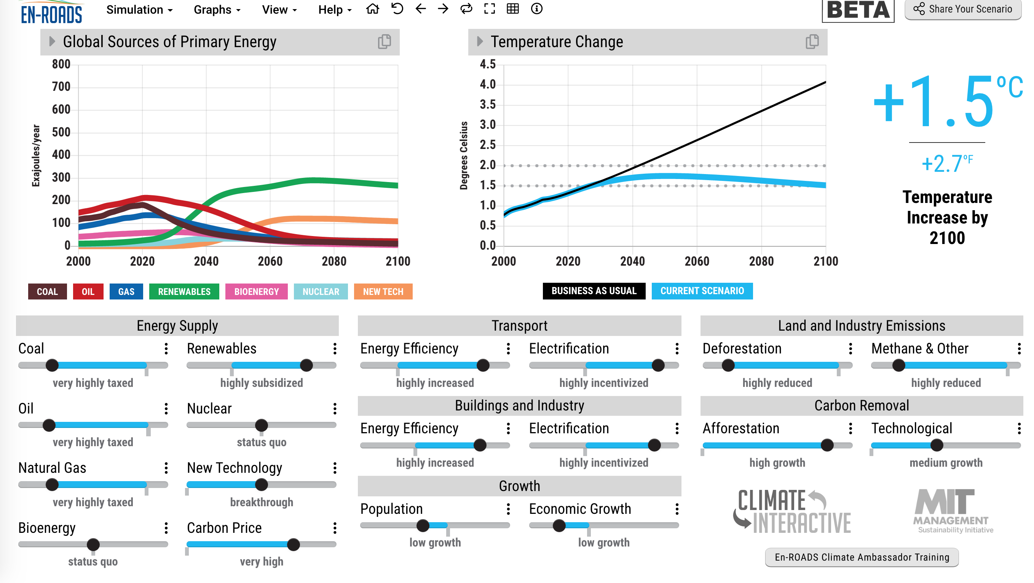

Slide 18



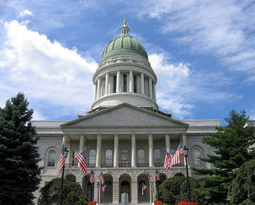
We need URGENT action by
Progress
Santa Cruz City Council, and the County Board of Supes have both passed Emergency Resolutions
Now working on electrification and other innovations.
Notes:
Lets make it happen Locally. We’ll be working with the Santa Cruz Climate Action Program staff

Slide 19
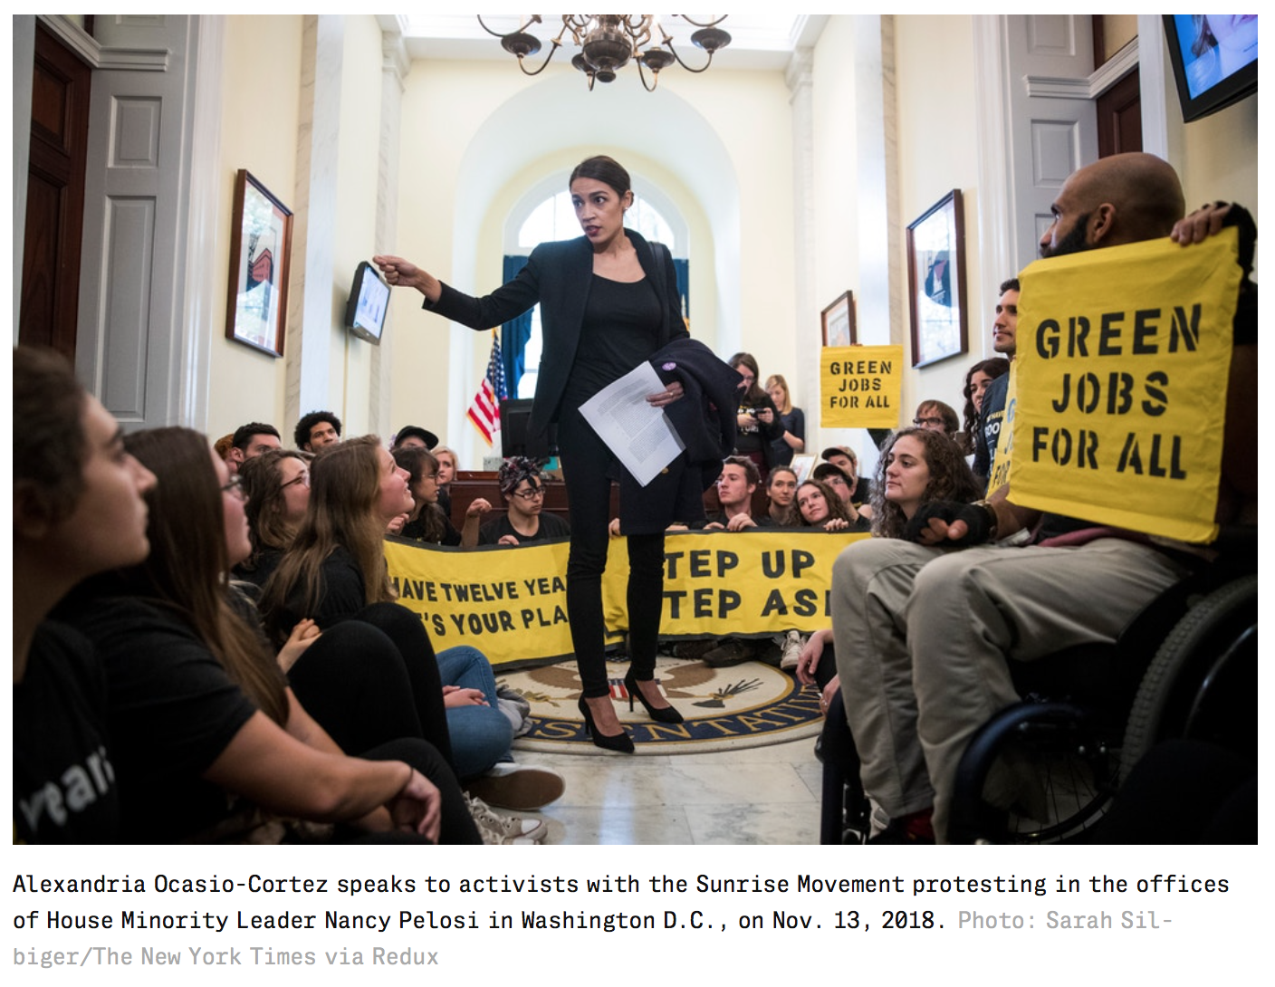
Green New Deal – Ca GND coming soon!

Slide 20
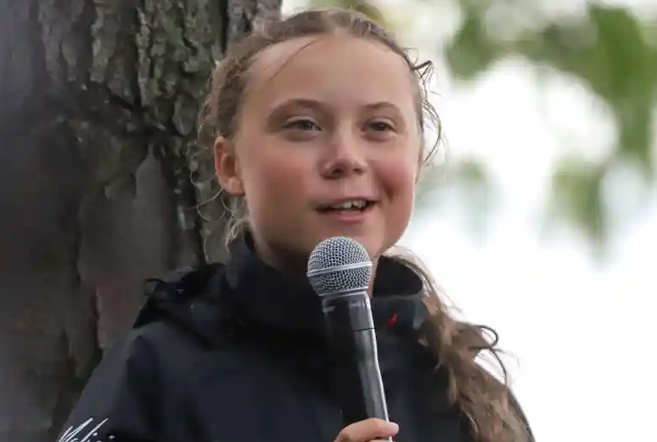
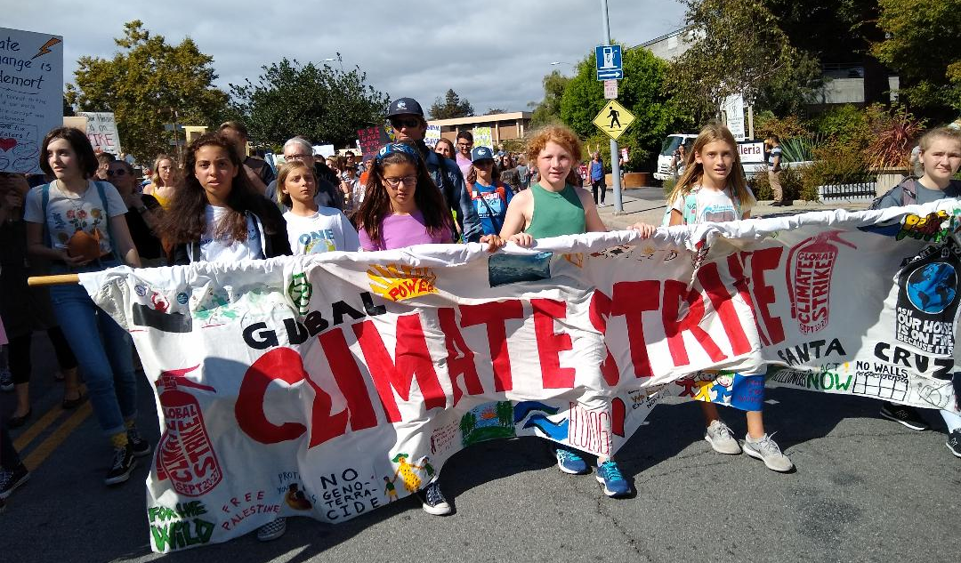
Young people worldwide are protesting. Their future is in serious jeopardy!
Climate Strike
Sep 20-27
Santa Cruz march Sep 27
Earth Day Actions Planned 2020

Slide 21
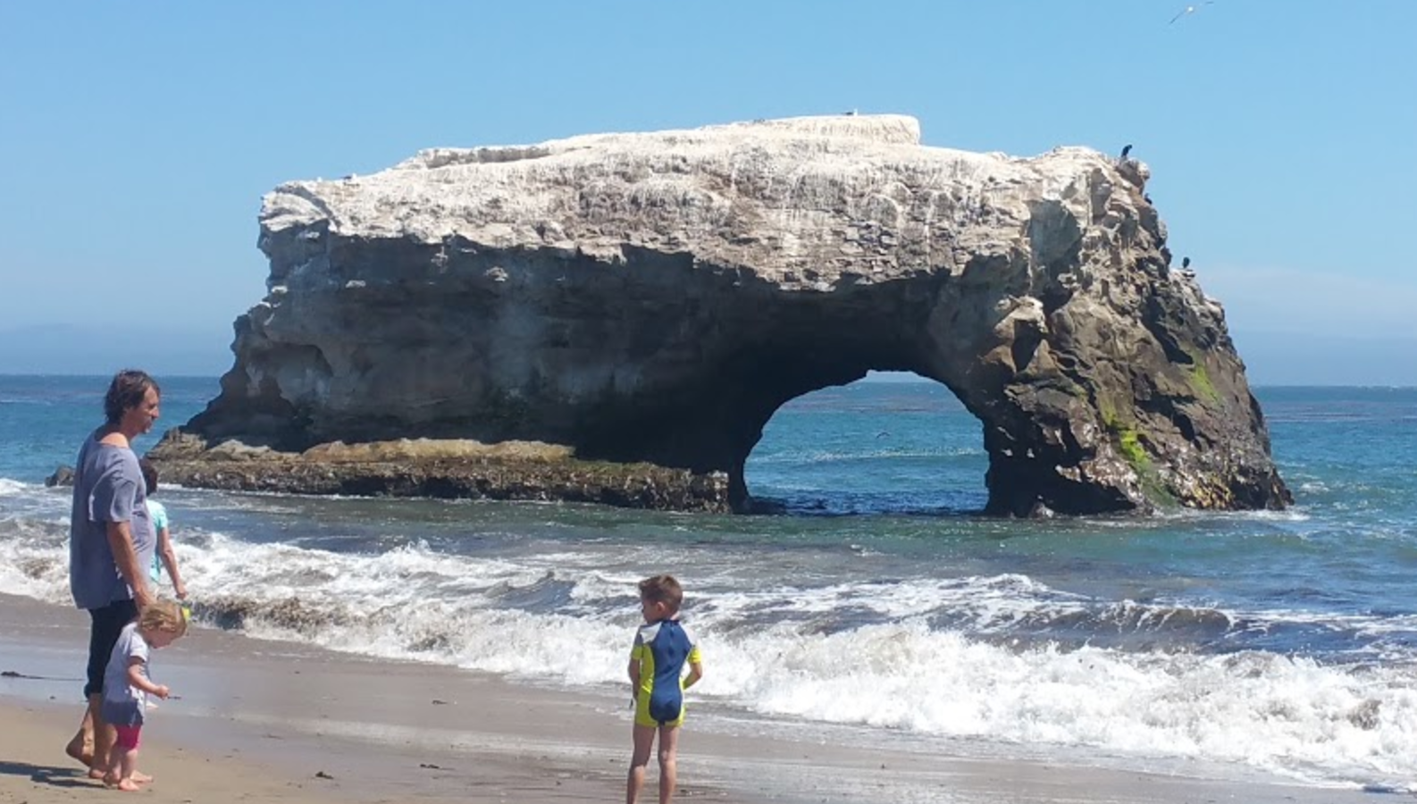
There really is HOPE!
Together we CAN do it.
For more details see https://scruzclimate.org/

