Slide 1
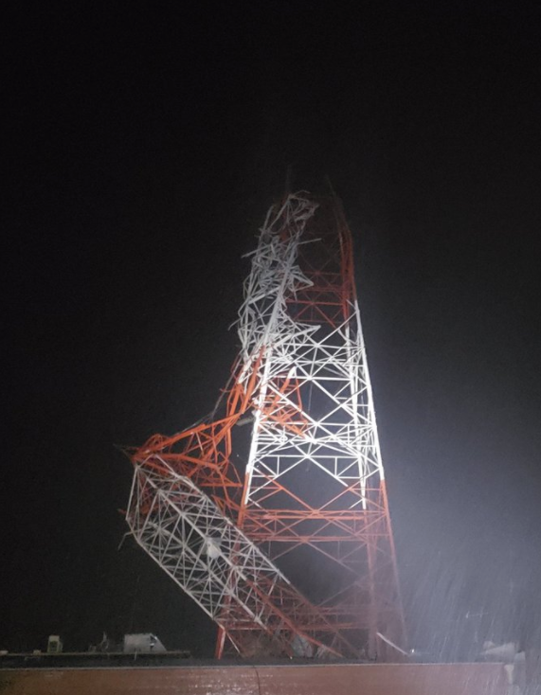
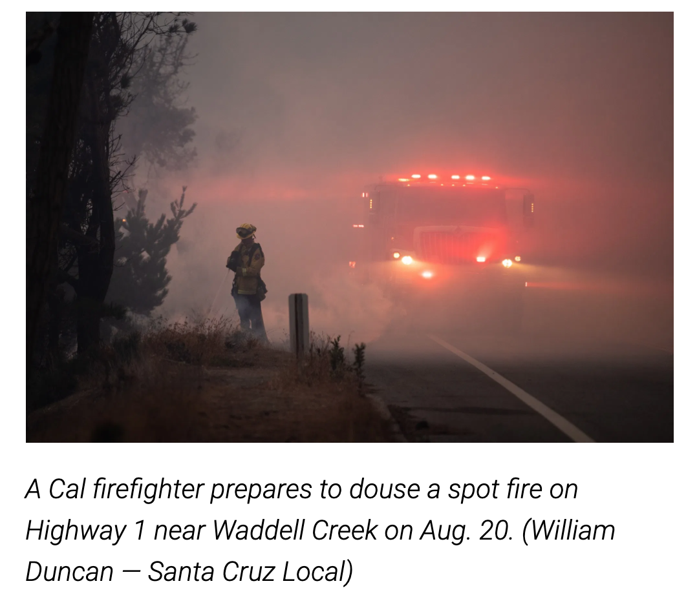
Climate CRISIS in Brief
By Pauline Seales Sep 2020
Hurricane Laura devastated parts of Louisiana
August 2020
Notes:
In California almost 1000 homes were lost in just the Santa Cruz Mountains CZU fire. There were many other fires and a hurricane in Louisiana.

Slide 2
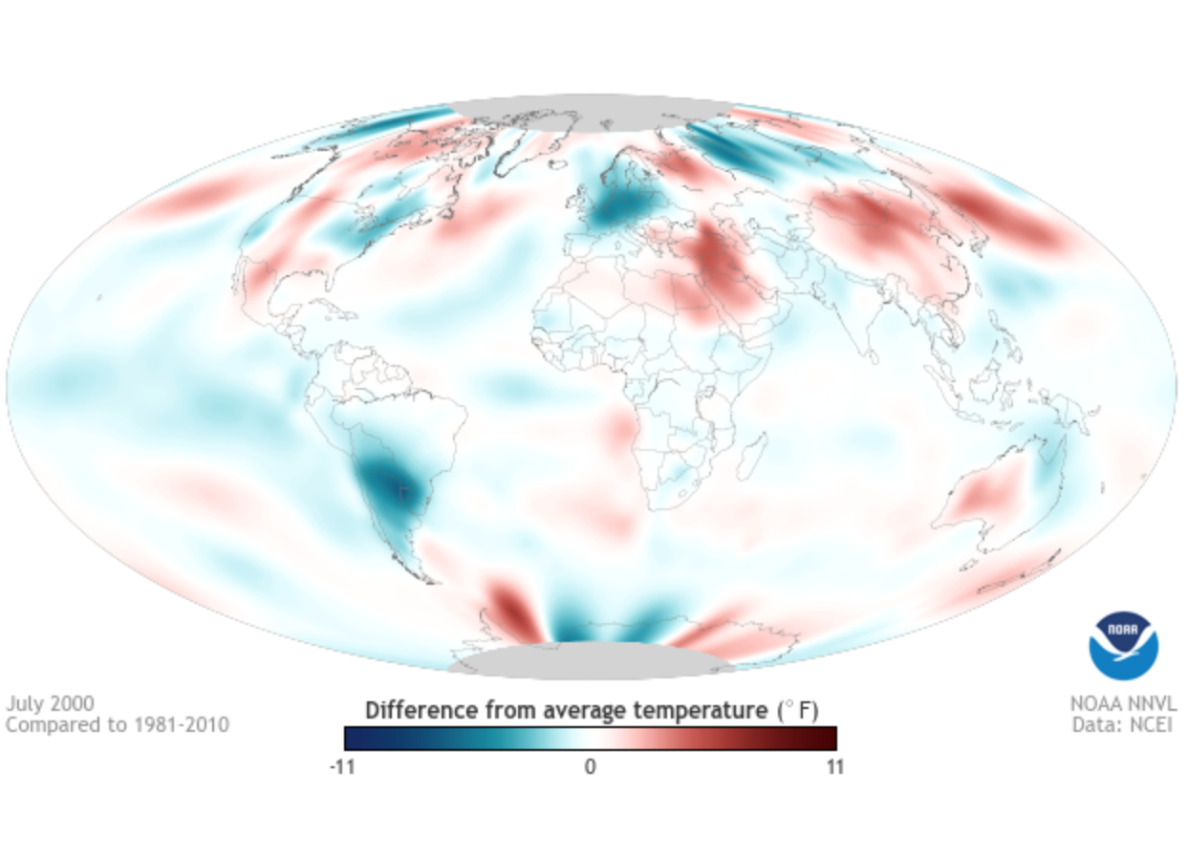
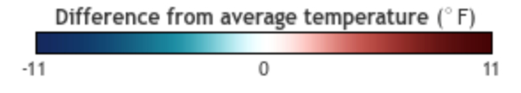
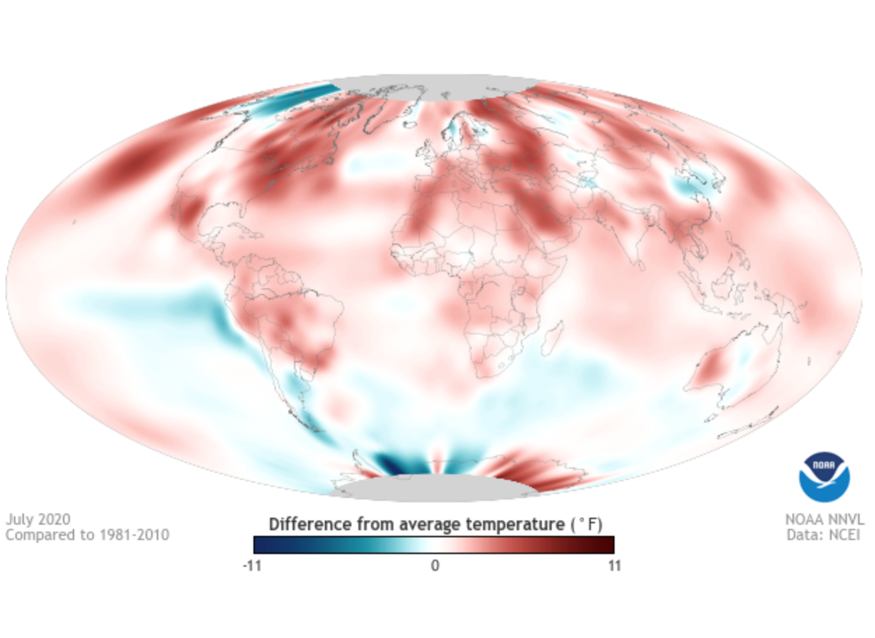
These two NOAA images show how much more the earth warmed between 2000 and 2020

Slide 3
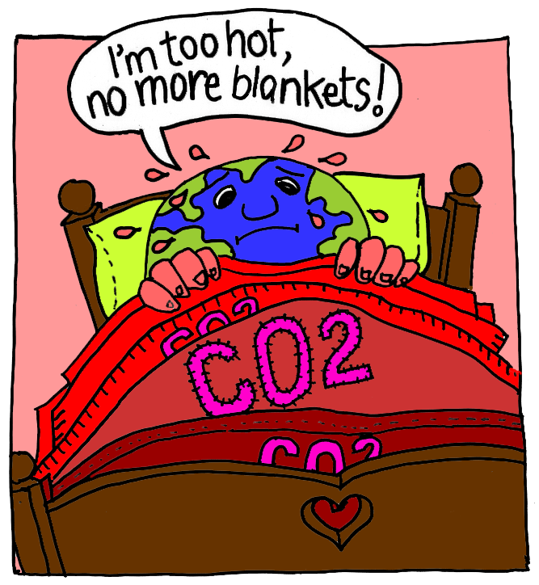
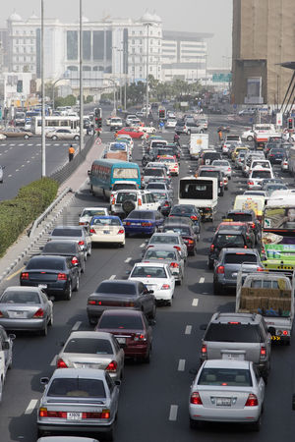

Add smokestack
What's really warming the world?
Notes:
IT’s US.
CO2 (carbon dioxide) produced by cars and power plants is acting like a blanket. The basic science has been known since the late 1800s. In CA most of the CO2 comes from vehicles. On the east coast from coal fired electricity generation.

Slide 4
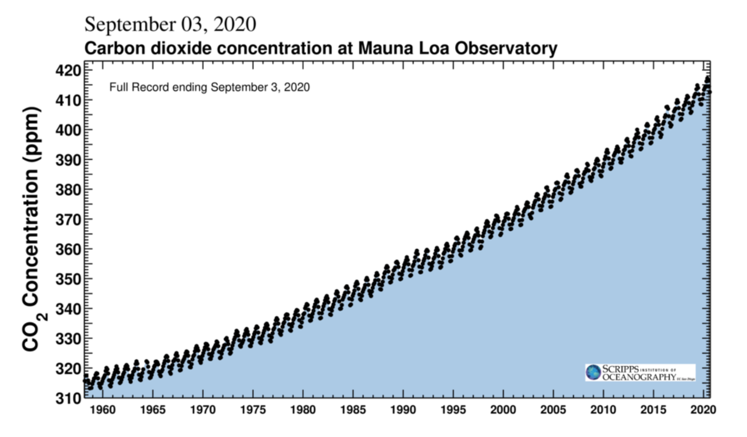
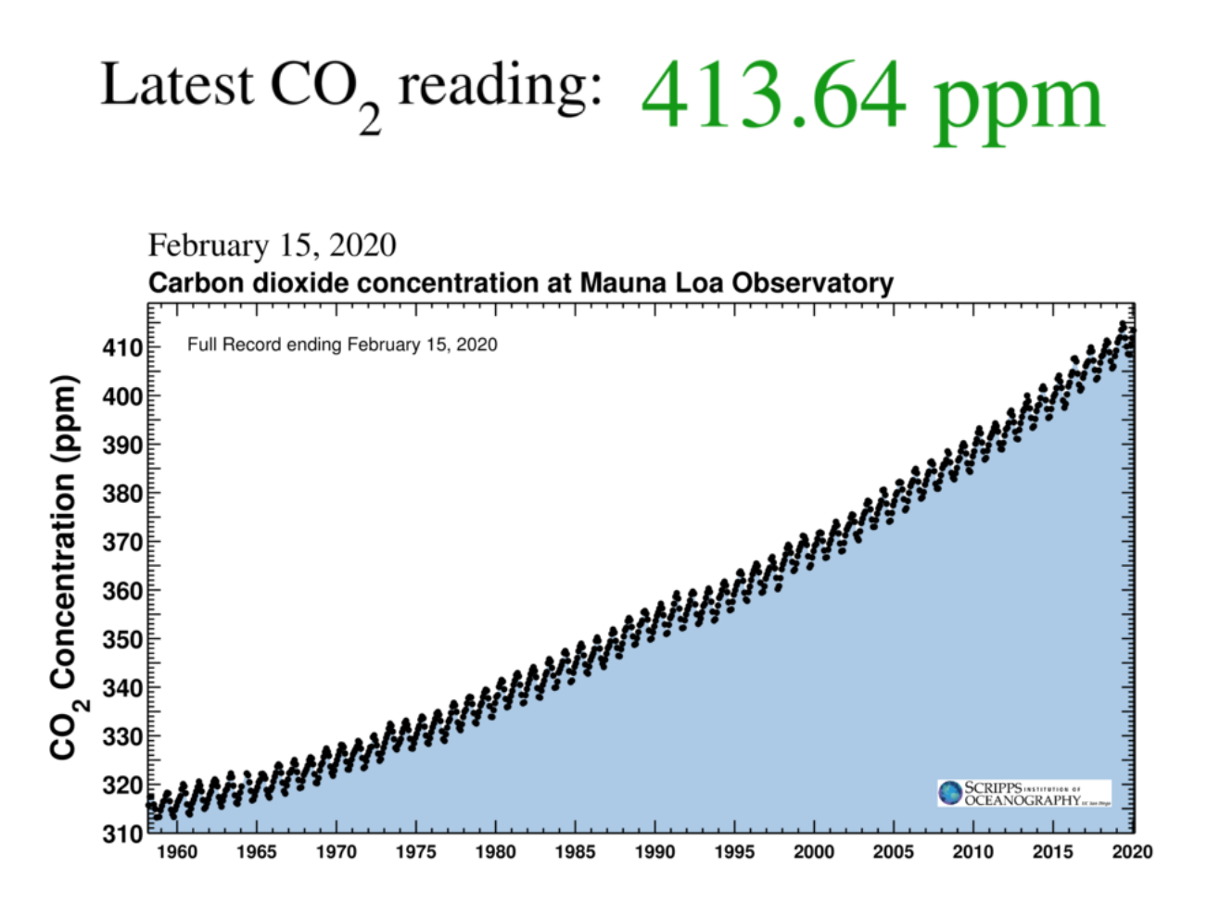
Notes:
SCIENTISTS AGREE
Current data shows that we are still adding more blankets to the feverish earth. In the 1800’s the level was 280 ppm. We are well over 410 ppm and rising.

Slide 5
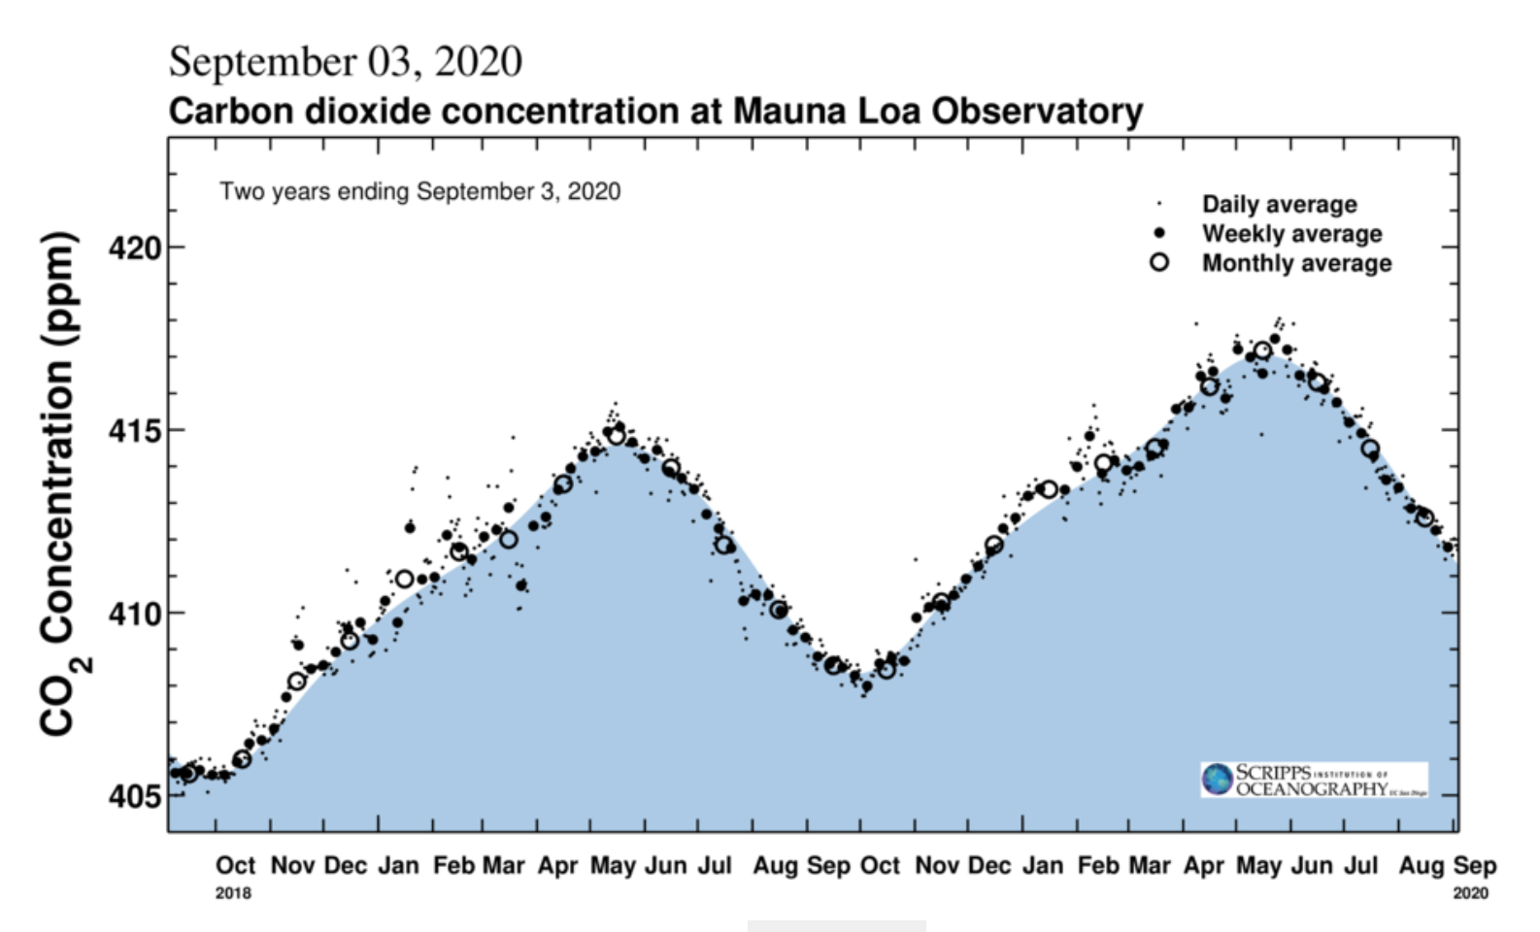
Notes:
This shows the May 2020 highest ever level of 417 ppm. The graph shows a slight glitch in Feb/march possibly due to the COVID crisis but the upward trend soon resumed

Slide 6
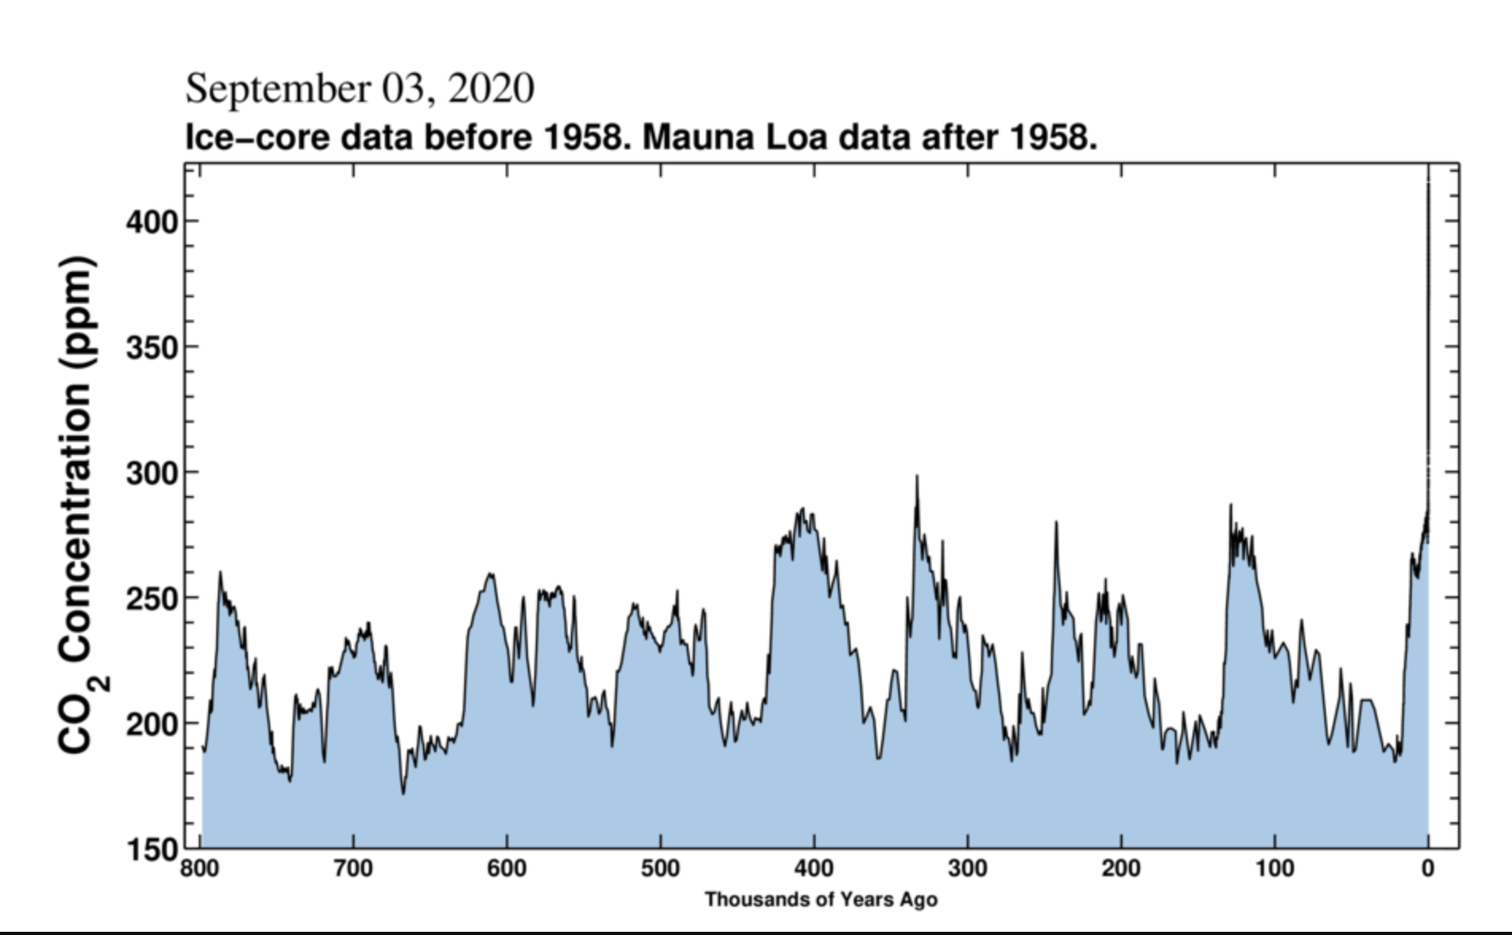
Notes:
CO2 graph going back 800,000 years
Now the scale has changed showing the past 800 thousand years.
The ups and downs represent the ice ages caused by wobbles in earth orbit
Right now we are already way above anything in the past million years

Slide 7
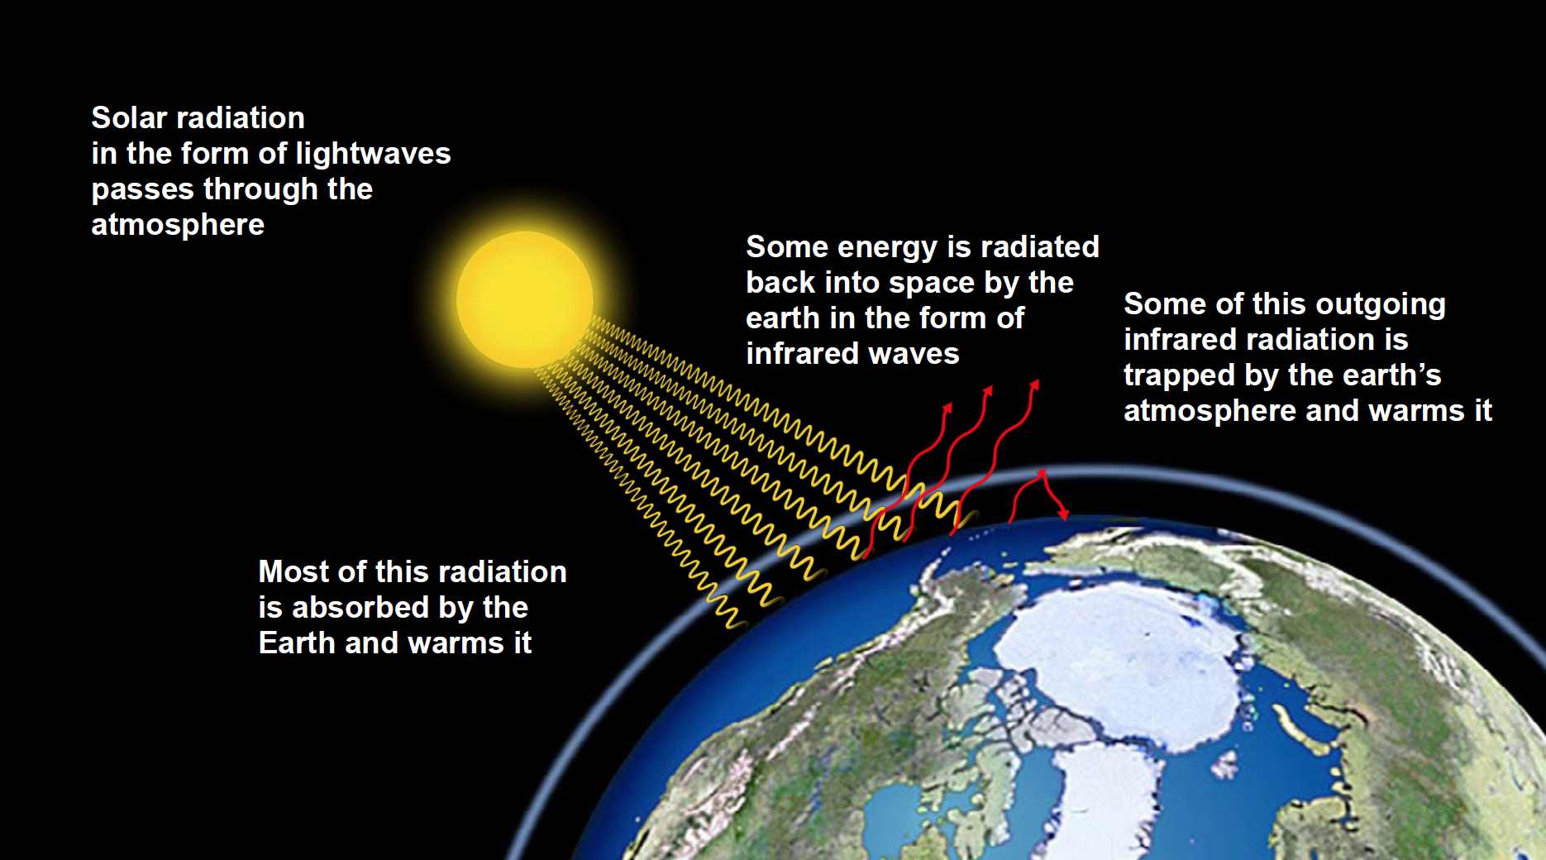
Greenhouse Effect
Notes:
High energy light rays from the sun get through the atmosphere and warm the earth. The earth emits much lower energy infra red waves which are partly scattered by the gases in the atmosphere with some returning to earth. This natural “Greenhouse Effect” has kept our planet from freezing up, but now extra gases are causing too much warming.

Slide 8
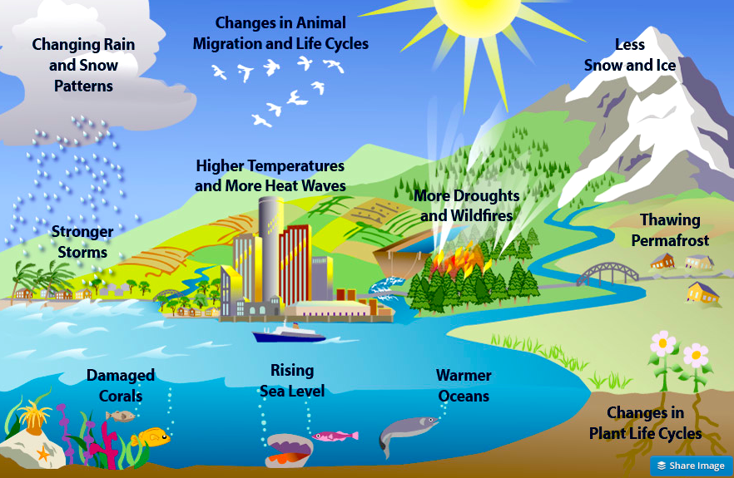
Climate Change has many effects
Notes:
Climate Change is already having many negative effects on all types of living systems.

Slide 9
Do a few degrees matter?
Absolutely !
– we already see drastic effects with only
1 deg C = 1.8 deg F change
New IPCC Report says even 1.5 deg C is a problem but 2 deg C is MUCH WORSE
Notes:
The Earth could be compared to a human being. A slight fever is not a problem usually but a higher one is serious and has to be dealt with quickly.

Slide 10
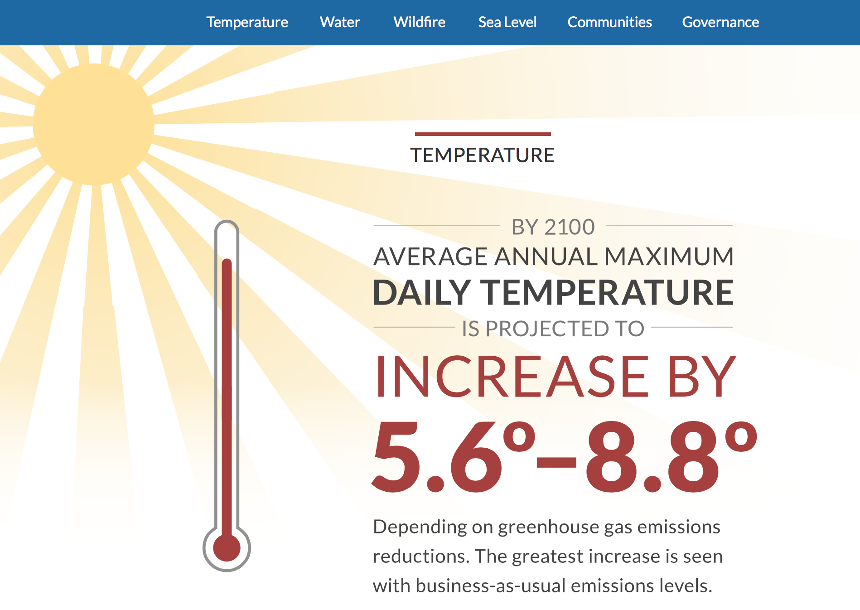
Notes:
This prediction from California state scientists rediction from 4th Ca assessment report, shows that continuing “Business-as-Usual” would be disastrous

Slide 11
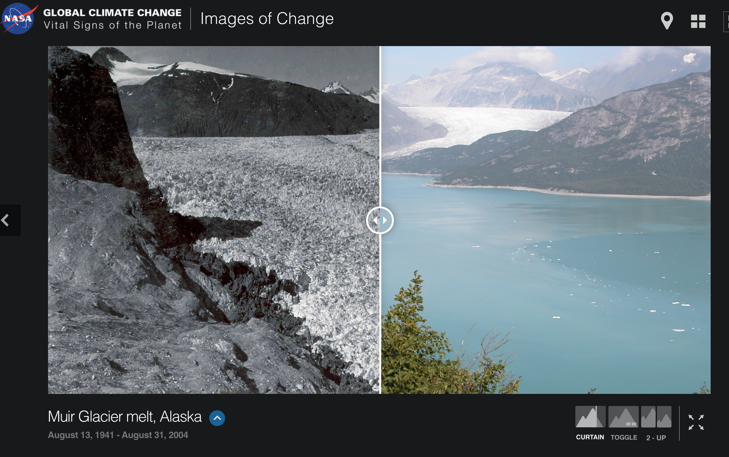
Ice is melting everywhere and sea level is rising.
Muir Glacier Alaska 1941-2004
Link to live comparison
https://climate.nasa.gov/images-of-change?id=376#376-muir-glacier-melt-alaska
Notes:
Example of a glacier photographed from the same location at different dates, showing the disappearance of the glacier. There are multiple examples world–wide.

Slide 12
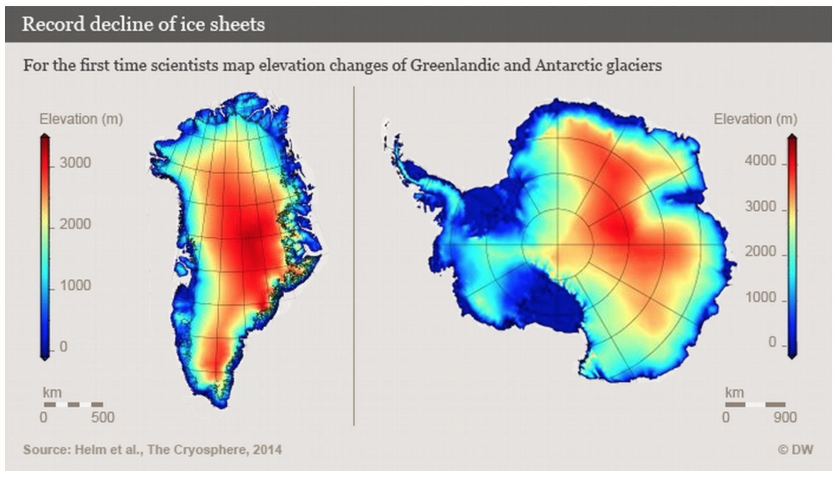
Greenland and Antarctica
Ice loss doubled in Greenland and tripled in the West Antarctic between 2009 to 2014.
Notes:
The enormous land ice sheets in Greenland and Antarctica are a special concern. Thought in the 1990’s to be too big too melt they are now melting rapidly and already raising sea level.

Slide 13
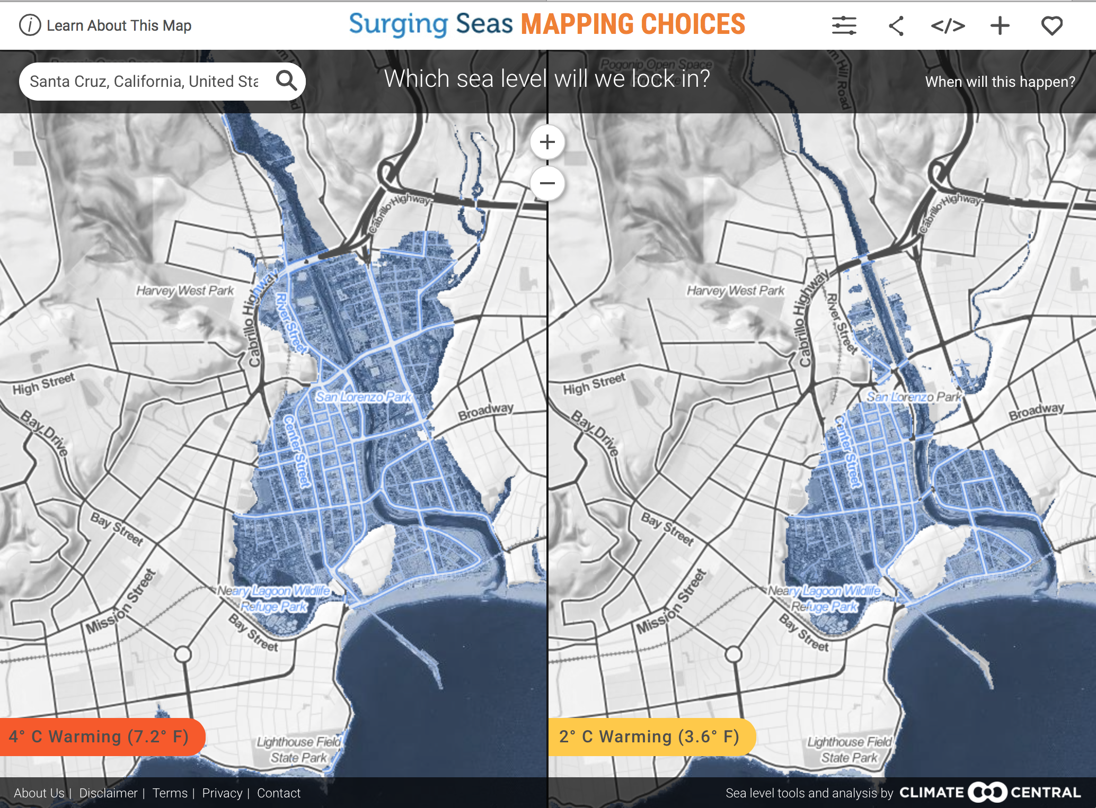



What to reduce or avoid
Notes:
Maps of Santa Cruz. The blue areas would be flooded at high tide.
Could not happen immediately
BUT only IMMEDIATE ACTION can slow the process down.
With even 2 deg C warming the entire downtown would be flooded.

Slide 14


Detailed Carbon Reduction program by Paul Hawken.
Includes detailed analysis of 80 different solutions
Notes:
This is a WONDERFUL report on solutions CURRENTLY AVAILABLE.
A recent 2020 update was just published.

Slide 15

What to reduce or avoid
Buy less new stuff Drive MUCH less
Notes:
We need to reduce Red meat consumption, because cows produce another grrenhouse gas - Methane, and cut unnecessary driving,
Also stop buying stuff we don’t need and reduce or eliminate use of Natrual Gas.

Slide 16
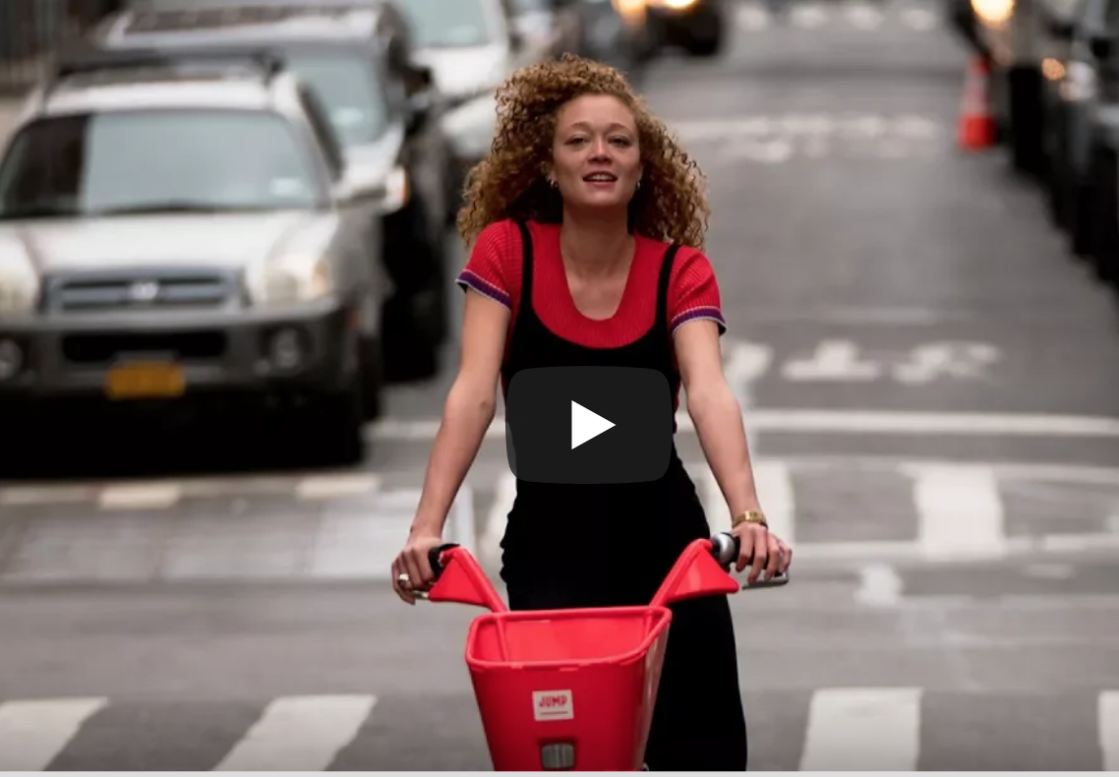


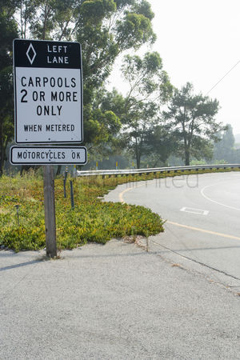



Enjoy
Notes:
Walking and biking are fun and healthy, the bus and carpools can help
Eat more vegetables and less meat (especially beef)
In winter find that old favorite sweater, and line dried clothes smell great

Slide 17
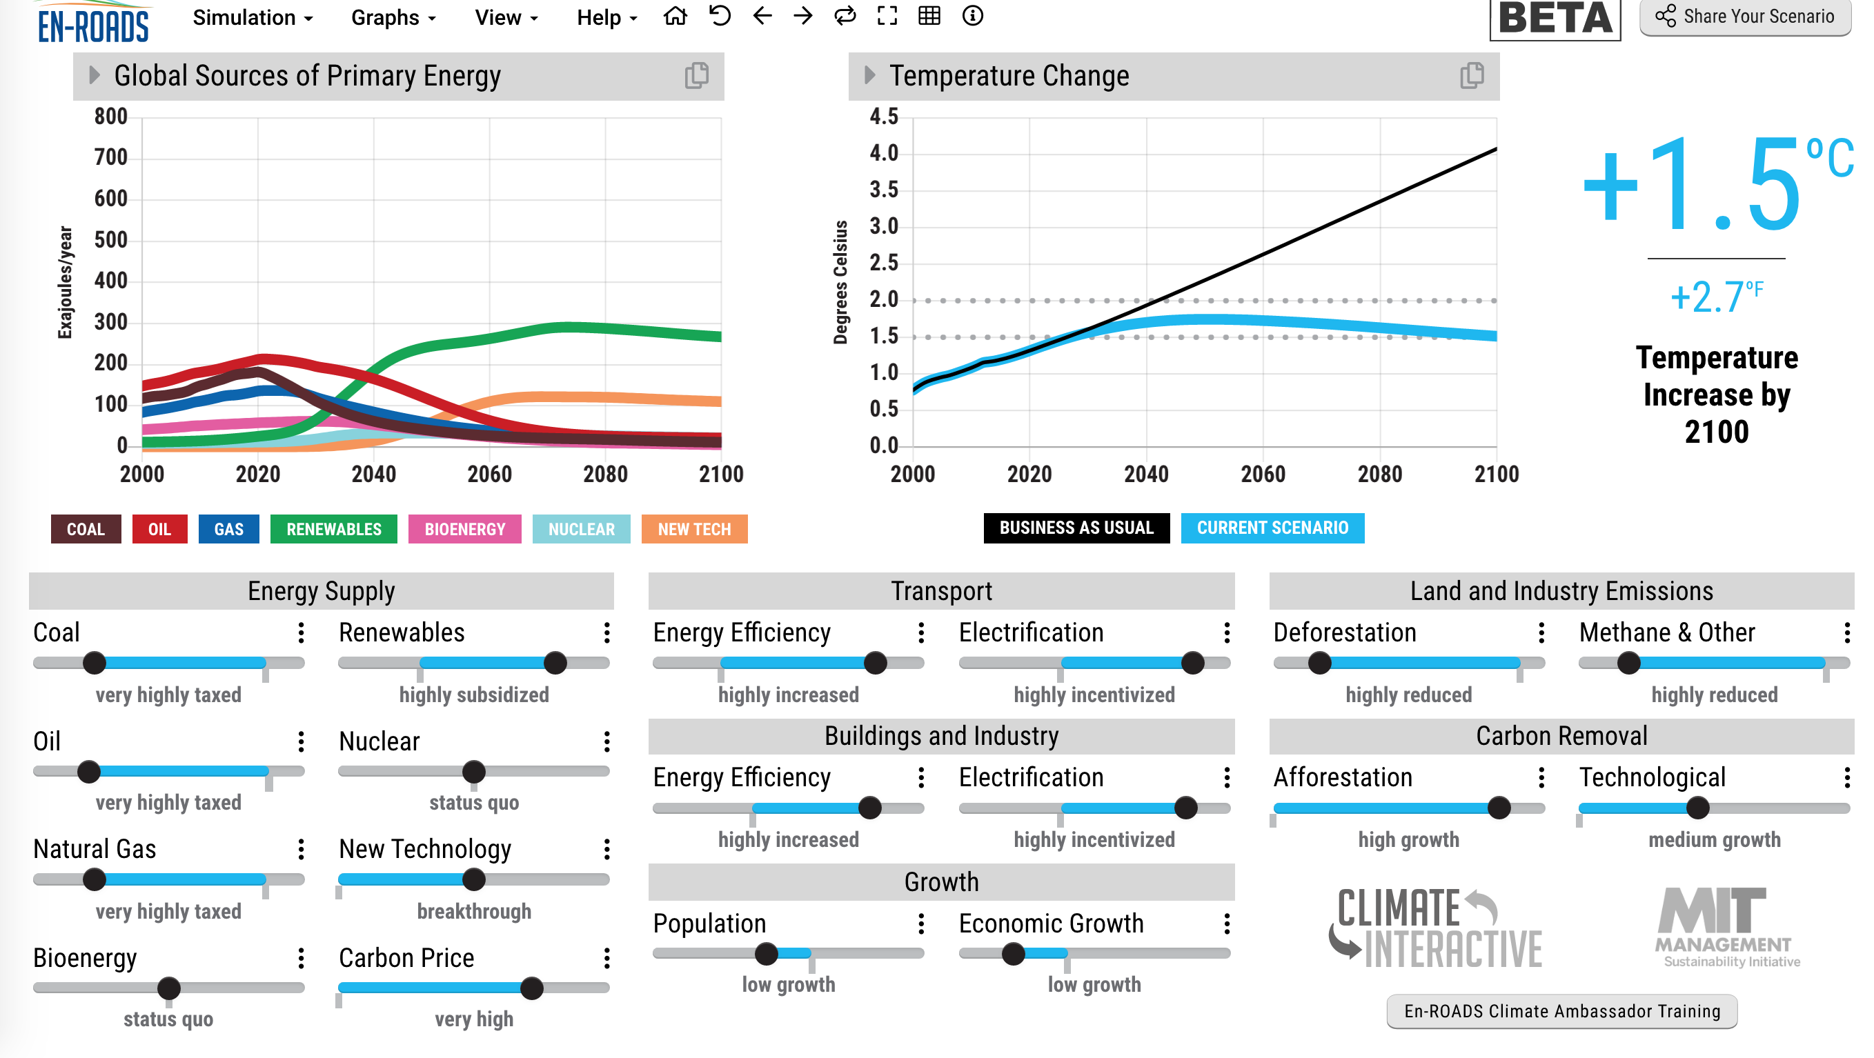
Notes:
This is an exciting new climate solutions simulator from MIT.
See lesson ENRdsLes

Slide 18




We need URGENT action by
Progress
Santa Cruz City Council, and the County Board of Supes have both passed Emergency Resolutions
Now working on electrification and other innovations.
Notes:
Lets make it happen Locally. We’ll be working with the Santa Cruz Climate Action Program staff and the County staff

Slide 19
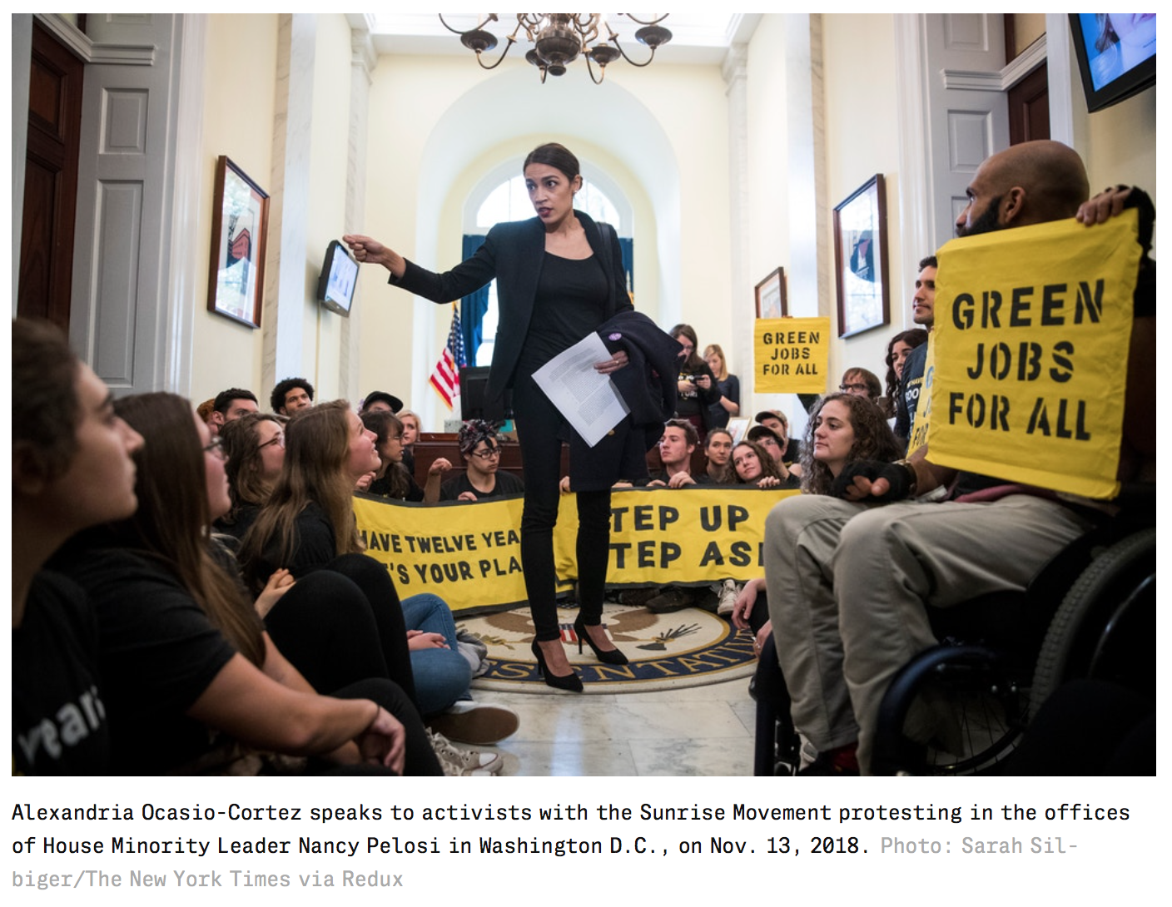
Green New Deal – Ca GND coming soon!
Notes:
Alexandria Ocasio-Cortes introduced the Green New DEAL program and locally the Romero Institute is working on a California version.
Both would address both the climate crisis and climate justice – jobs, health, housing for all.

Slide 20
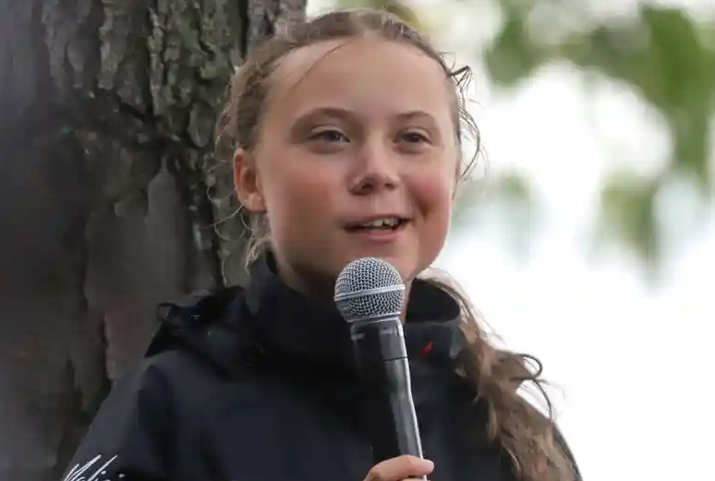
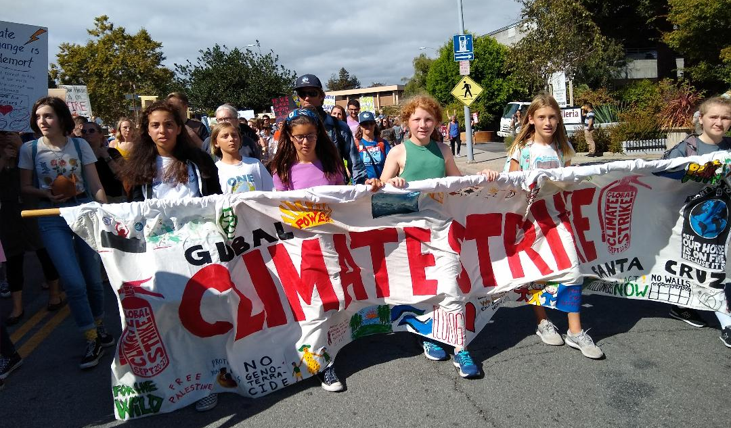
Young people worldwide are protesting. Their future is in serious jeopardy!
Climate Strike
Sep 20-27
Santa Cruz march Sep 27
Earth Day Actions ON-LINE 2020

Slide 21
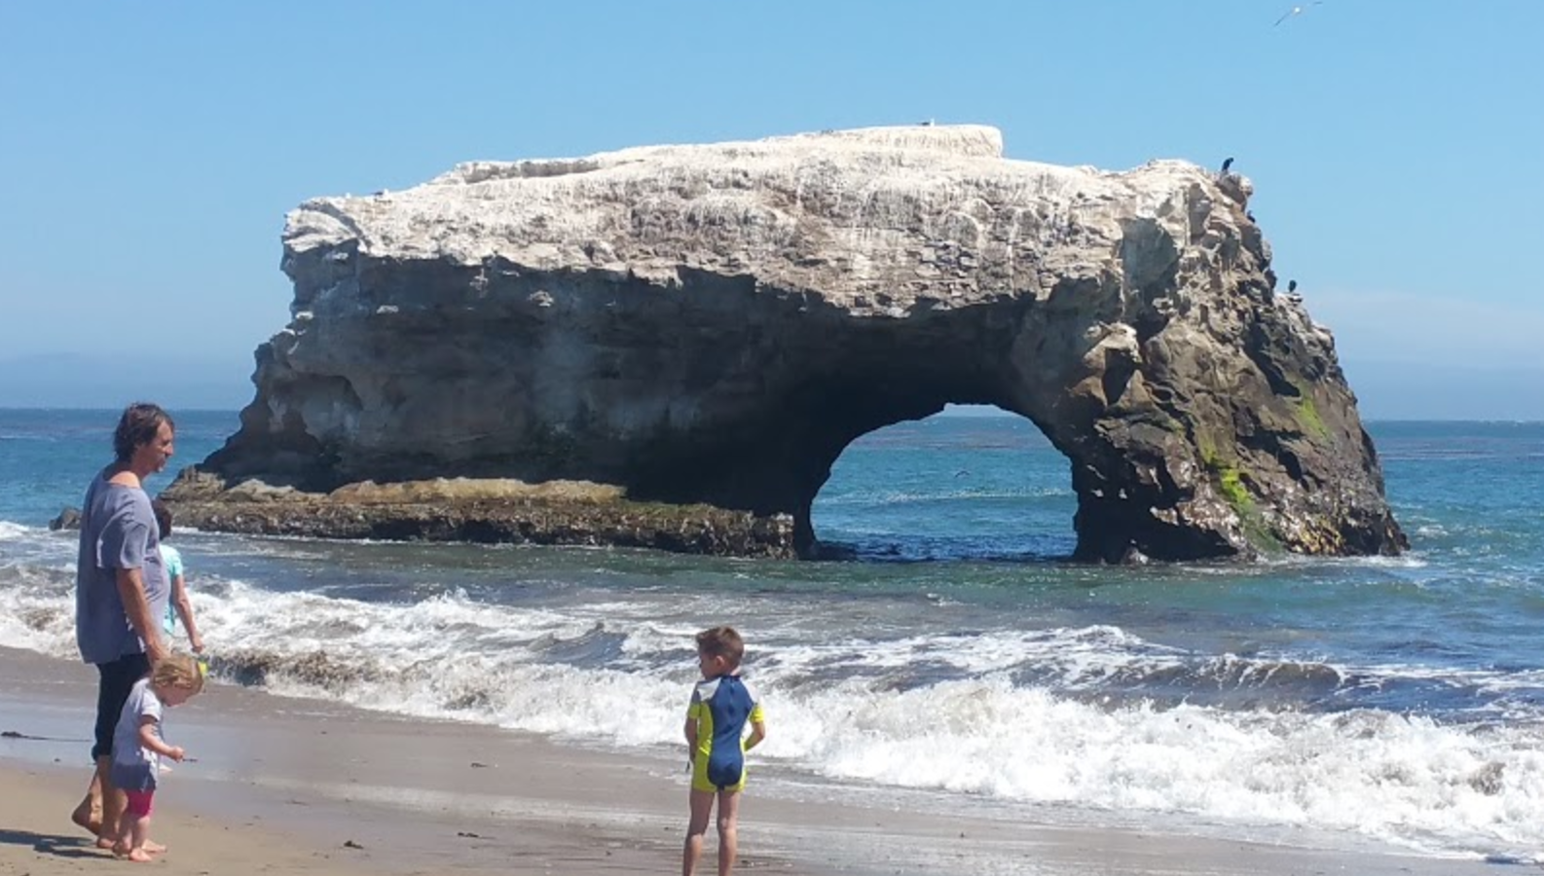
There really is HOPE!
Together we CAN do it.
For more details see https://scruzclimate.org/

