Slide 1
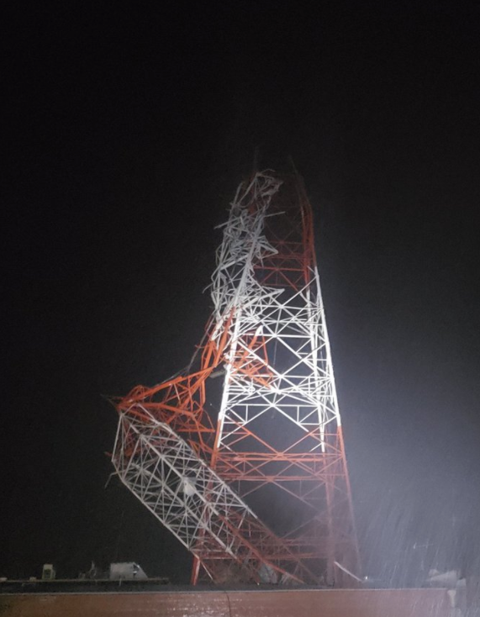
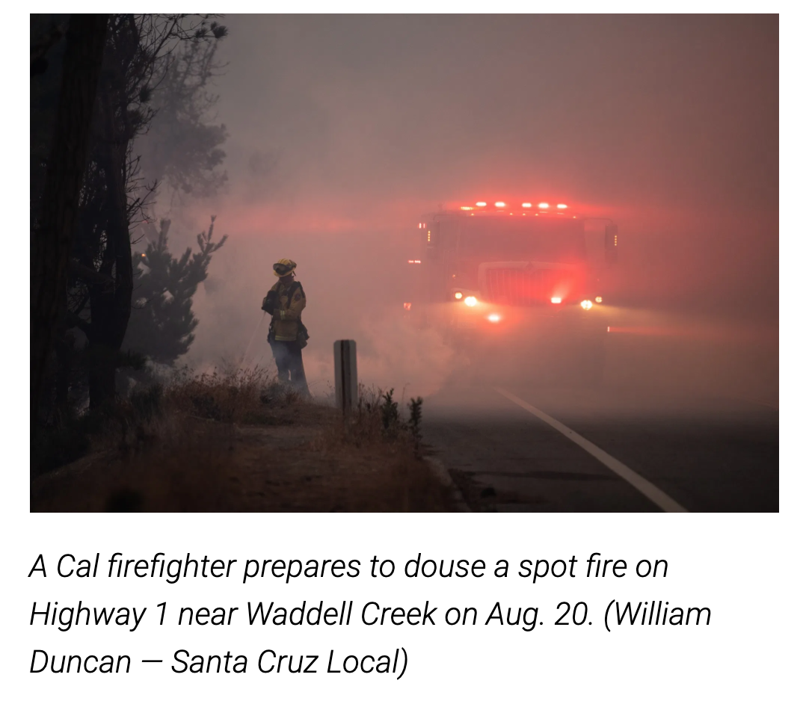
Climate CRISIS Update
By Pauline Seales Sep 2020
Hurricane Laura devastated parts of Louisiana
August 2020
Notes:
In California almost 1000 homes were lost in just the Santa Cruz Mountains CZU fire. There were many other fires and a hurricane in Louisiana.

Slide 2
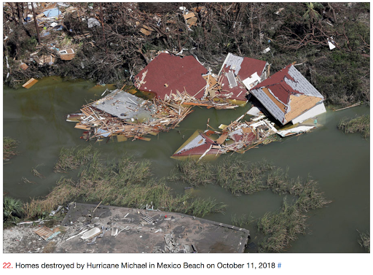
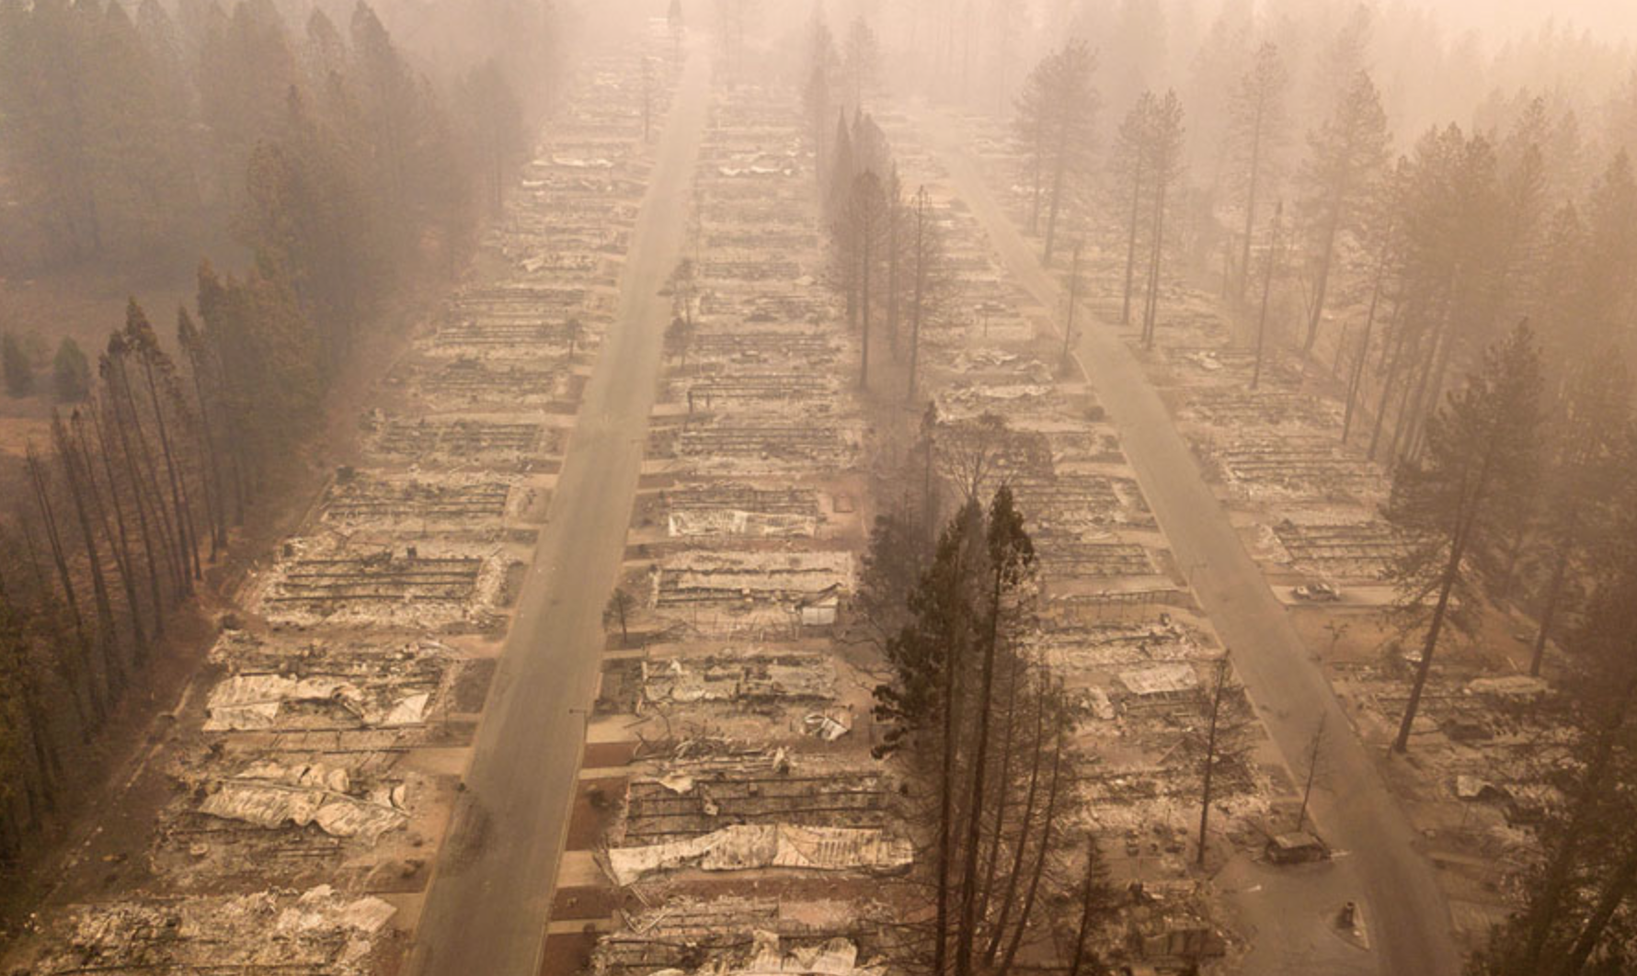
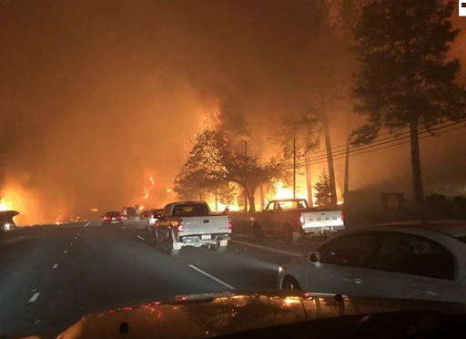
2018 fires and floods
Notes:
Top left - East coast USA Hurricane floods
Bottom Paradise Ca, fire.

Slide 3
Climate Change

Slide 4
Climate Change
          Global Warming

Slide 5
Climate Change
          Global Warming
      Climate Disruption

Slide 6
Climate Change
          Global Warming
      Climate Disruption
          Global Weirding

Slide 7
Climate Change
          Global Warming
      Emergency Climate Crisis
      Climate Disruption
          Global Weirding
Notes:
All the terms mean the saem thing

Slide 8
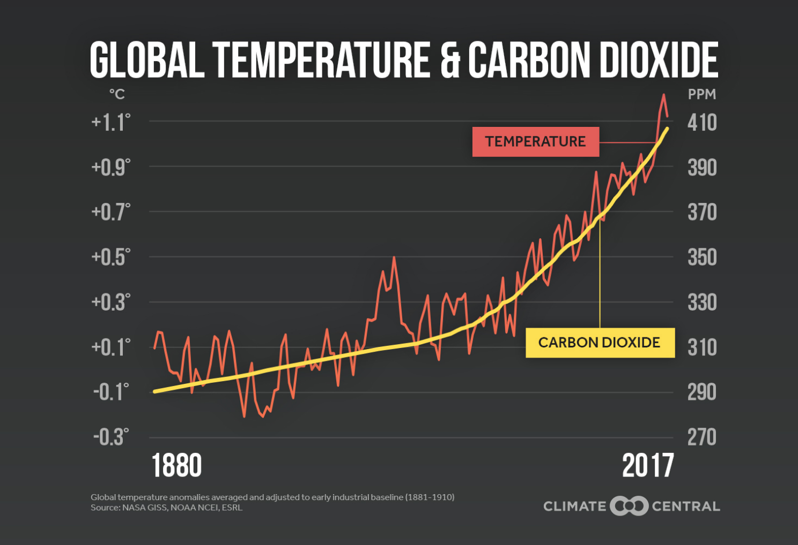
It’s getting Hotter! And there’s more CO2
Notes:
Temperature and carbon dioxide levels track – and do so back for many 1000’s of years

Slide 9
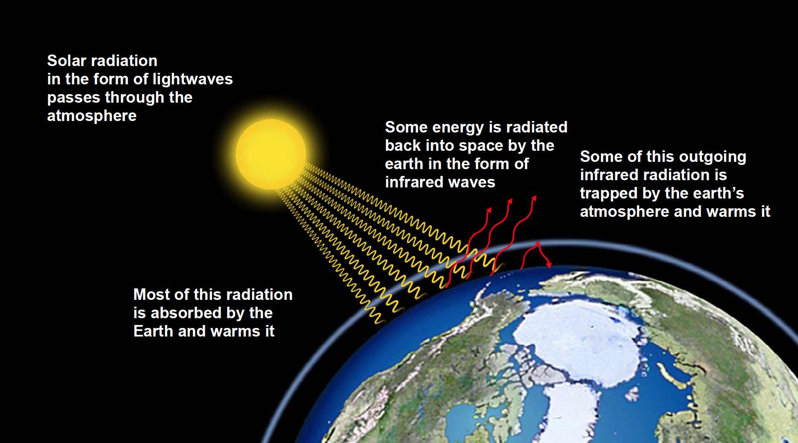
Greenhouse Effect
Notes:
igh energy light rays from the sun get through the atmosphere and warm the earth. The earth emits much lower energy infra red waves which are partly scattered by the gases in the atmosphere with some returning to earth. This natural “Greenhouse Effect” has kept our planet from freezing up, but now extra gases are causing too much warming.

Slide 10
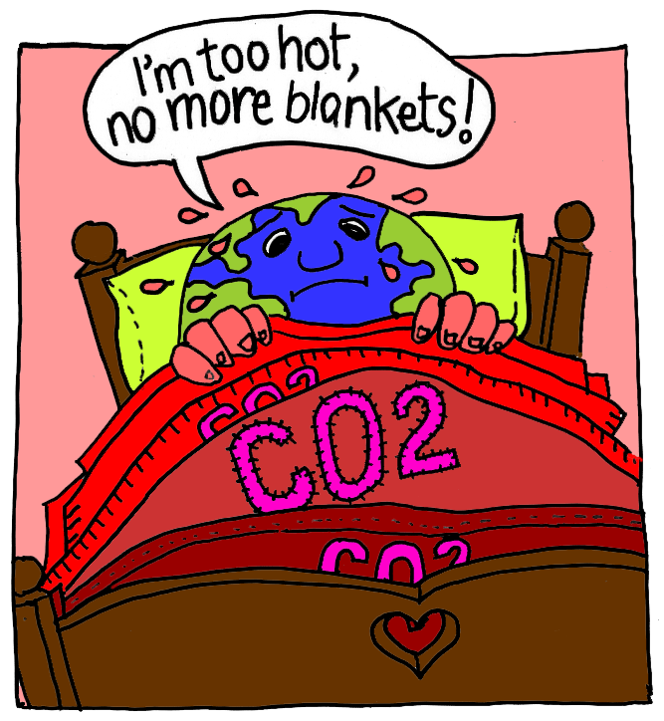
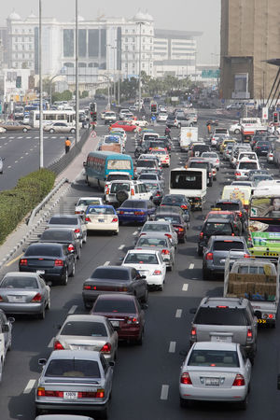

What's really warming the world?
Notes:
IT’s US.
CO2 (carbon dioxide) produced by cars and power plants is acting like a blanket. The basic science has been known since the late 1800s. In CA most of the CO2 comes from vehicles. On the east coast from coal fired electricity generation.

Slide 11
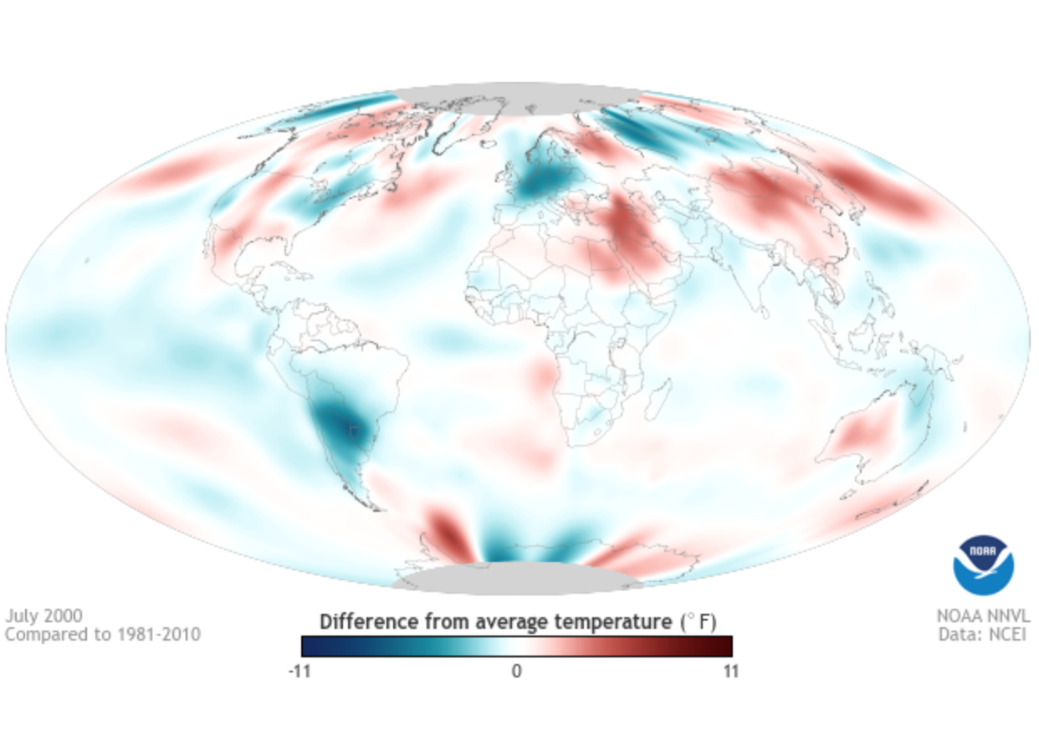
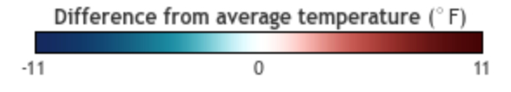
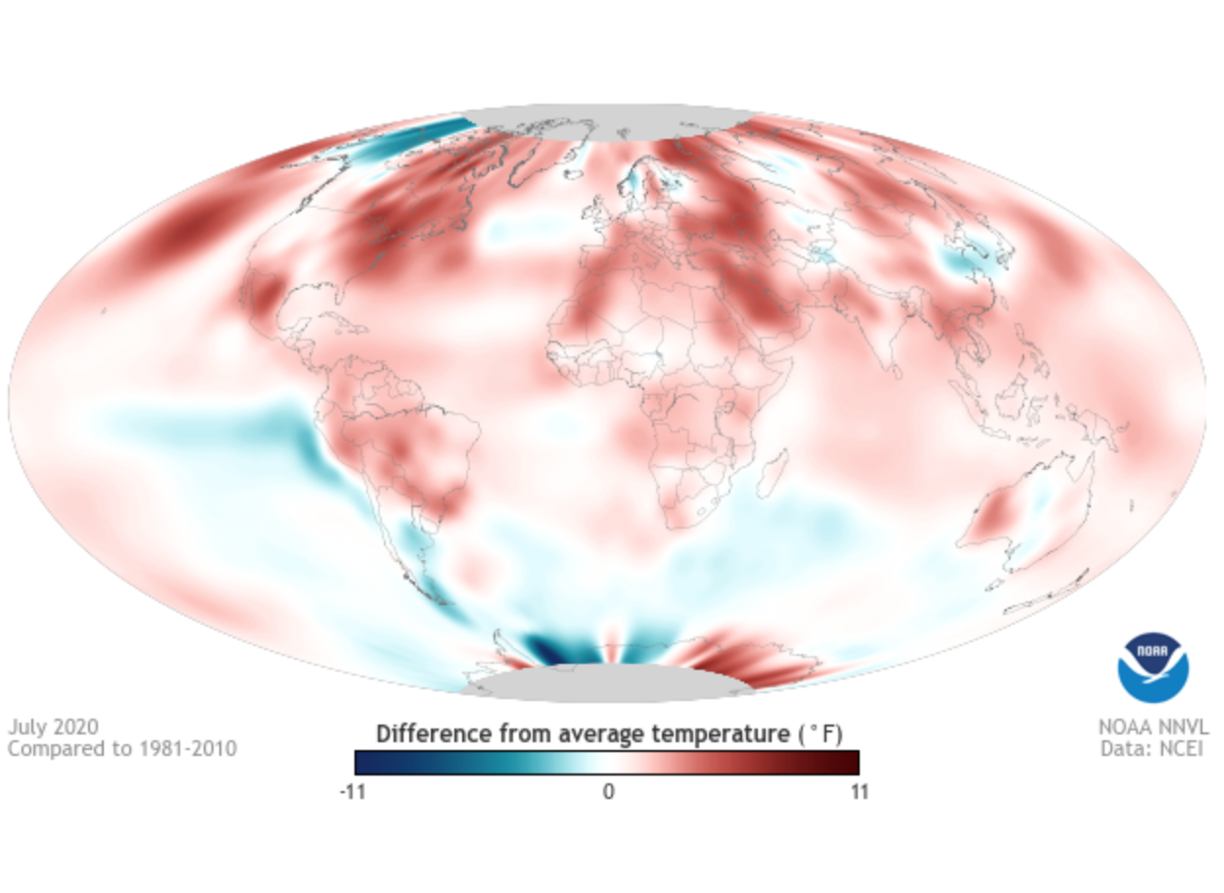
These two NOAA images show how much more the earth warmed between 2000 and 2020

Slide 12
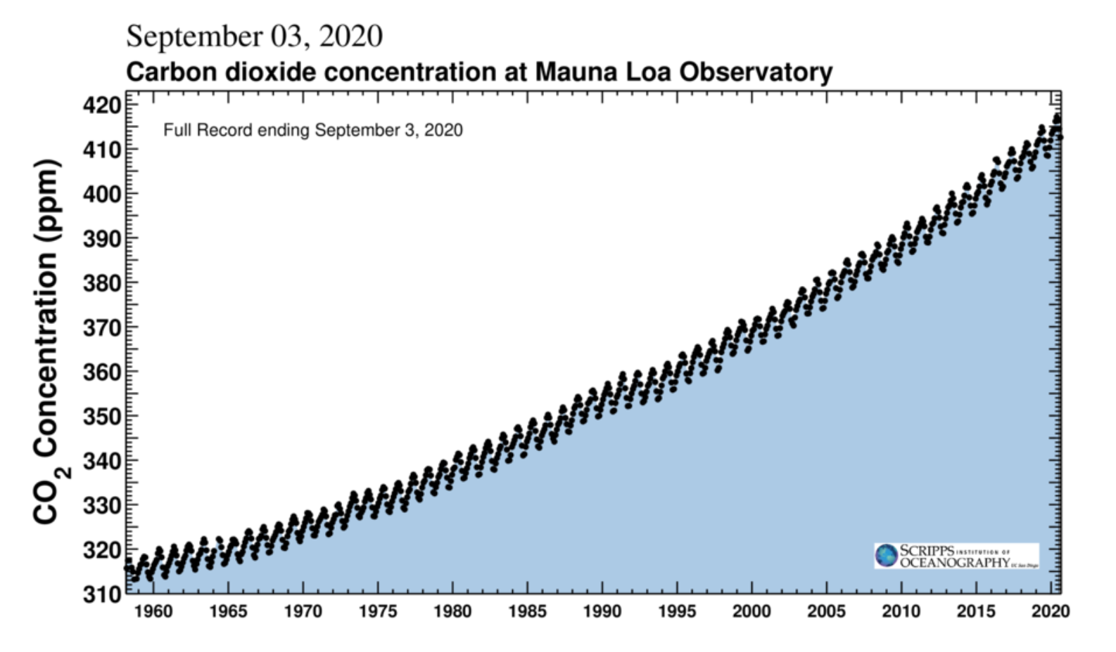
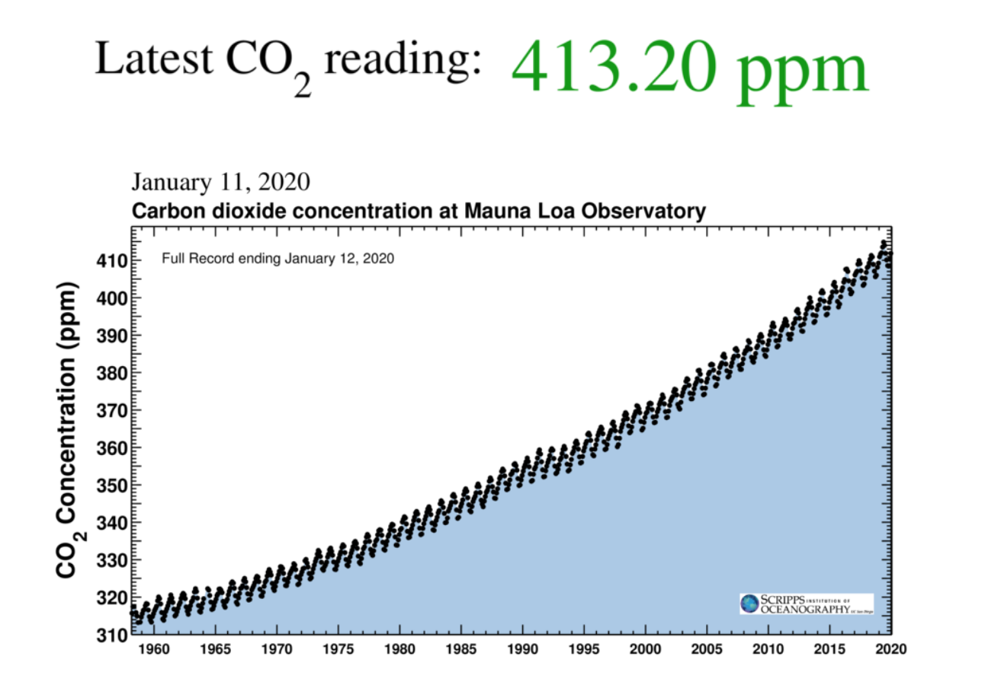
Notes:
SCIENTISTS AGREE
Current data shows that we are still adding more blankets to the feverish earth. In the 1800’s the level was 280 ppm.

Slide 13
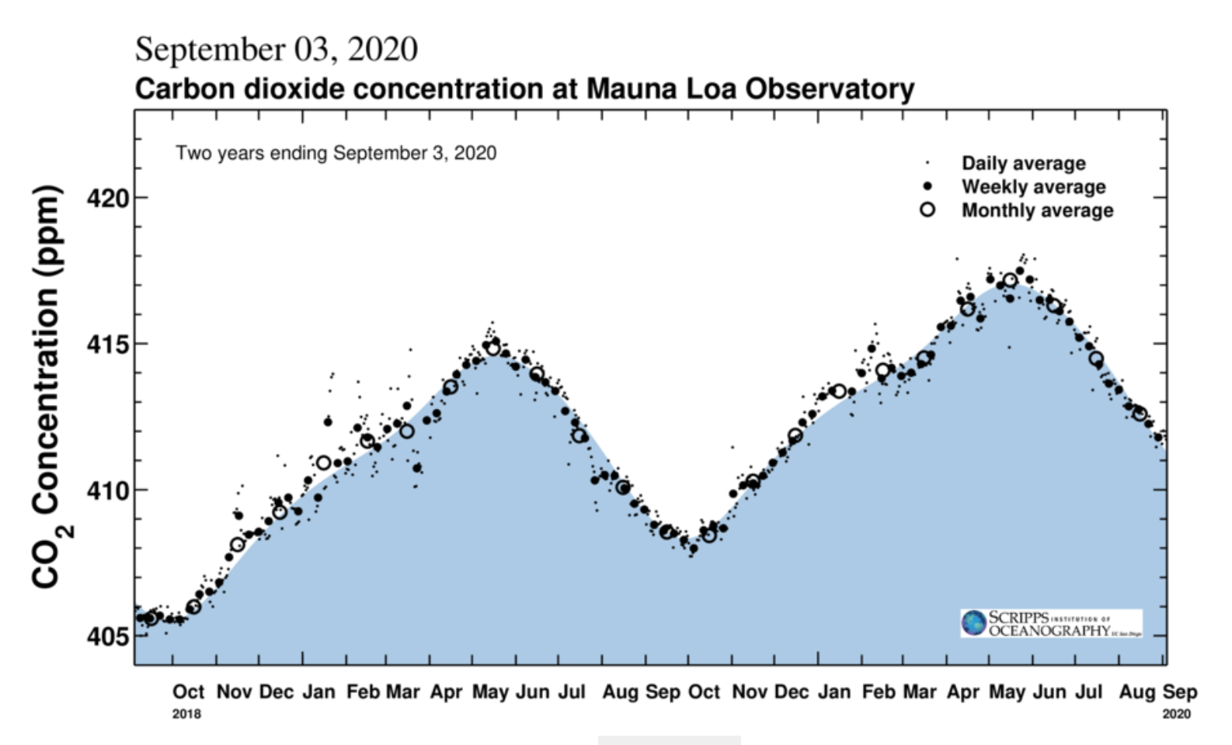
Notes:
This shows the May 2020 highest ever level of 417 ppm. The graph shows a slight glitch in Feb/march possibly due to the COVID crisis but the upward trend soon resumed

Slide 14
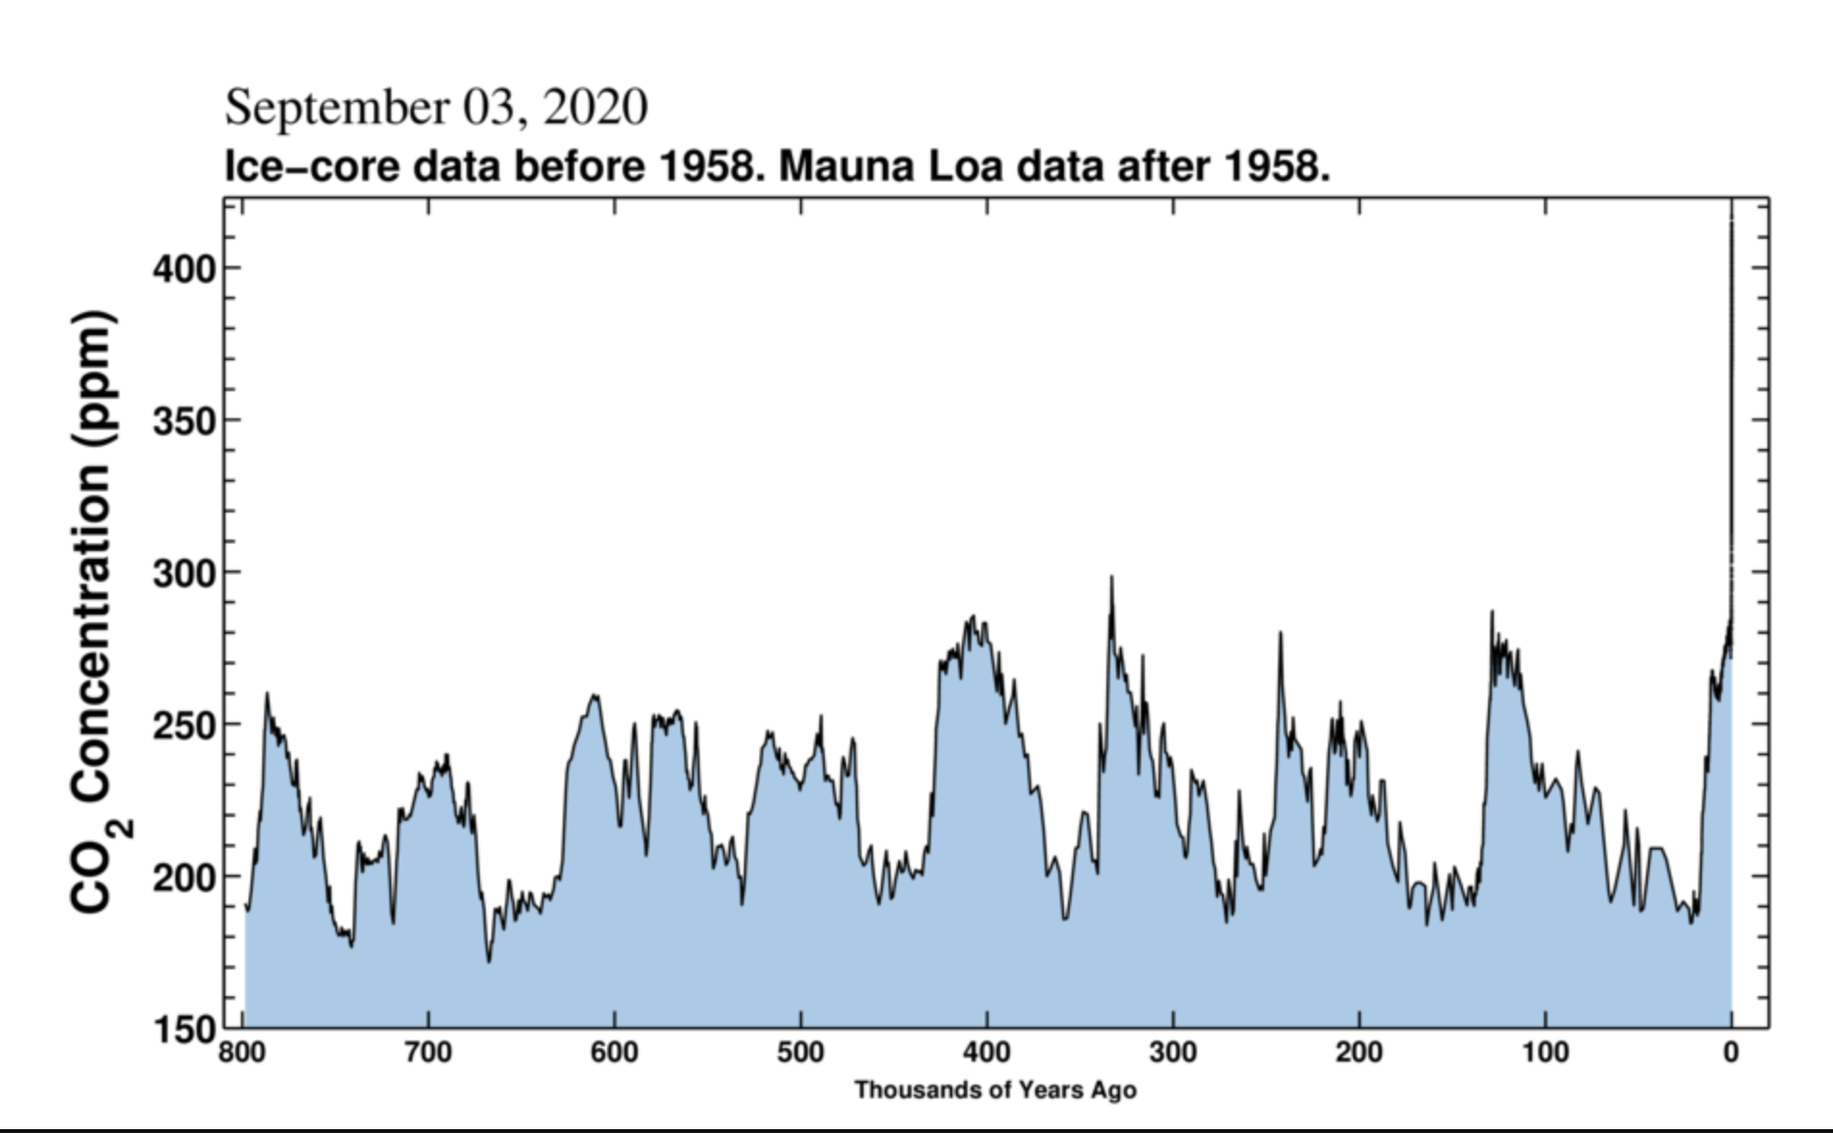
Notes:
CO2 graph going back 800,000 years
Now the scale has changed showing the past 800 thousand years.
The ups and downs represent the ice ages caused by wobbles in earth orbit
Right now we are already way above anything in the past million years

Slide 15
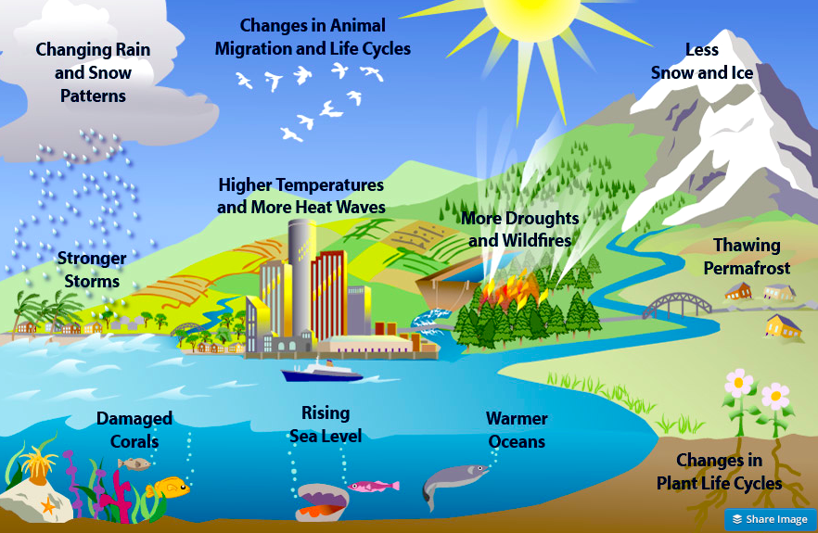
Climate Change has many effects
Notes:
Climate Change is already having many negative effects on all types of living systems.

Slide 16
Do a few degrees matter?
Absolutely !
– we already see drastic effects with only
1 deg C = 1.8 deg F change
New IPCC Report says even 1.5 deg C is a problem but 2 deg C is MUCH WORSE
Notes:
The Earth could be compared to a human being. A slight fever is not a problem usually but a higher one is serious and has to be dealt with quickly.

Slide 17
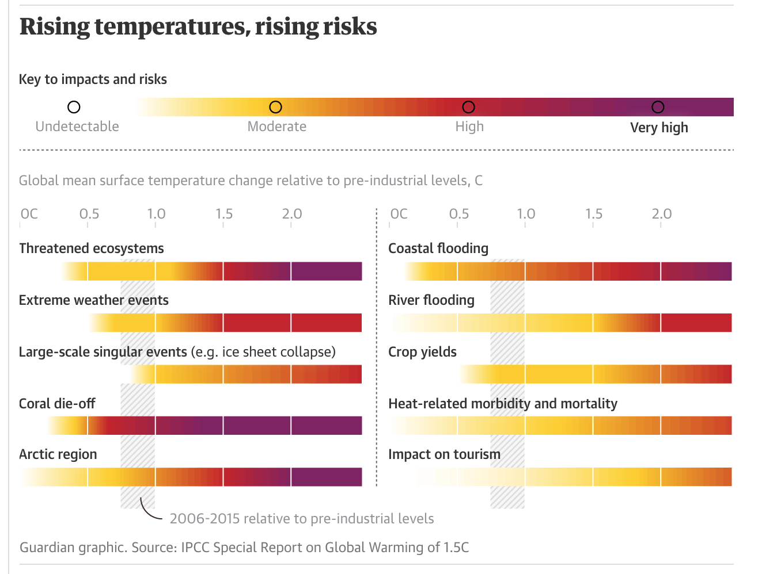
IPCC 2018 Summary
Intergovernmental Panel on Climate Change(U.N.)

Slide 18
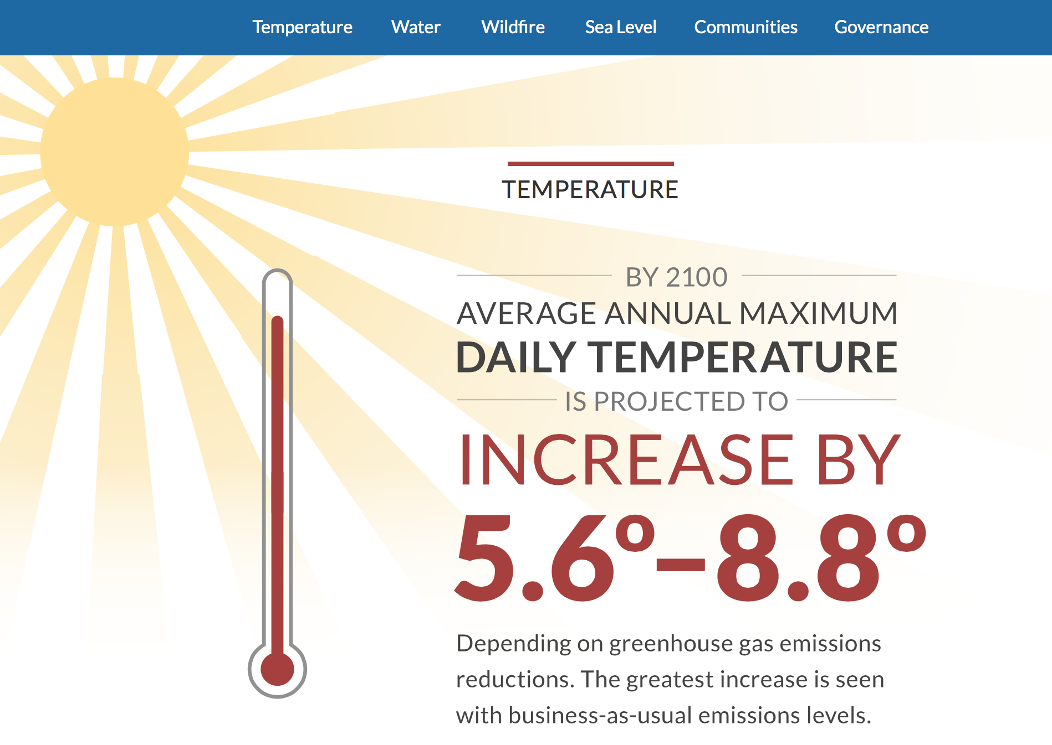
Notes:
This prediction from California state scientists rediction from 4th Ca assessment report, shows that continuing “Business-as-Usual” would be disastrous

Slide 19
But it’s NOT GAME OVER
It’s GAME ON

Slide 20
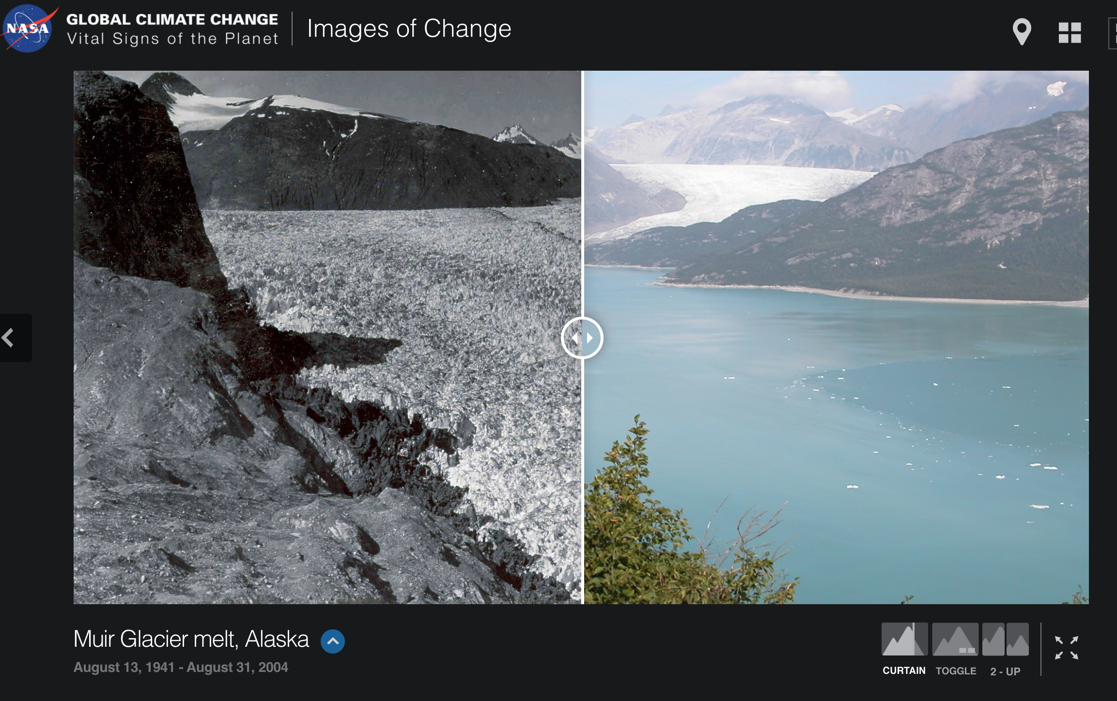
Ice is melting everywhere and sea level is rising.
Muir Glacier Alaska 1941-2004
Link to live comparison
https://climate.nasa.gov/images-of-change?id=376#376-muir-glacier-melt-alaska
Notes:
Example of a glacier photographed from the same location at different dates, showing the disappearance of the glacier. There are multiple examples world–wide.

Slide 21
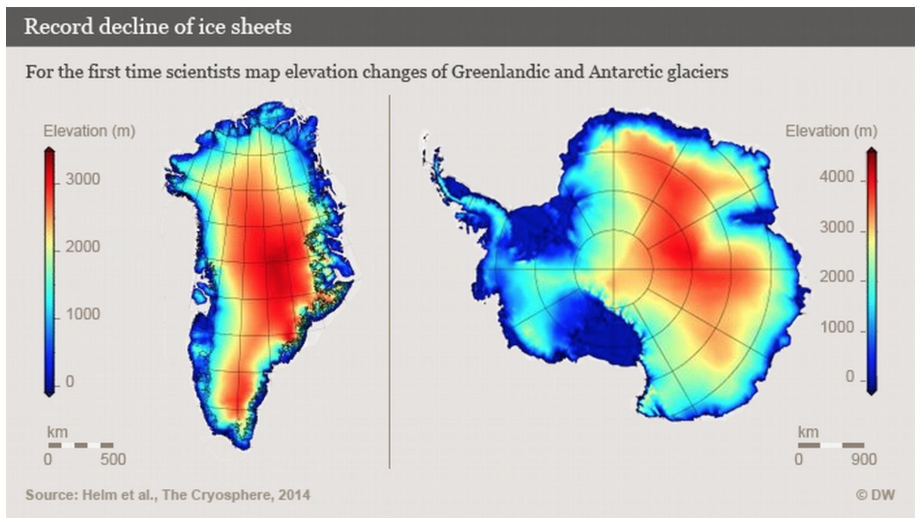
Greenland and Antarctica
Ice loss doubled in Greenland and tripled in the West Antarctic between 2009 to 2014.
Notes:
The enormous land ice sheets in Greenland and Antarctica are a special concern. Thought in the 1990’s to be too big too melt they are now melting rapidly and already raising sea level.

Slide 22
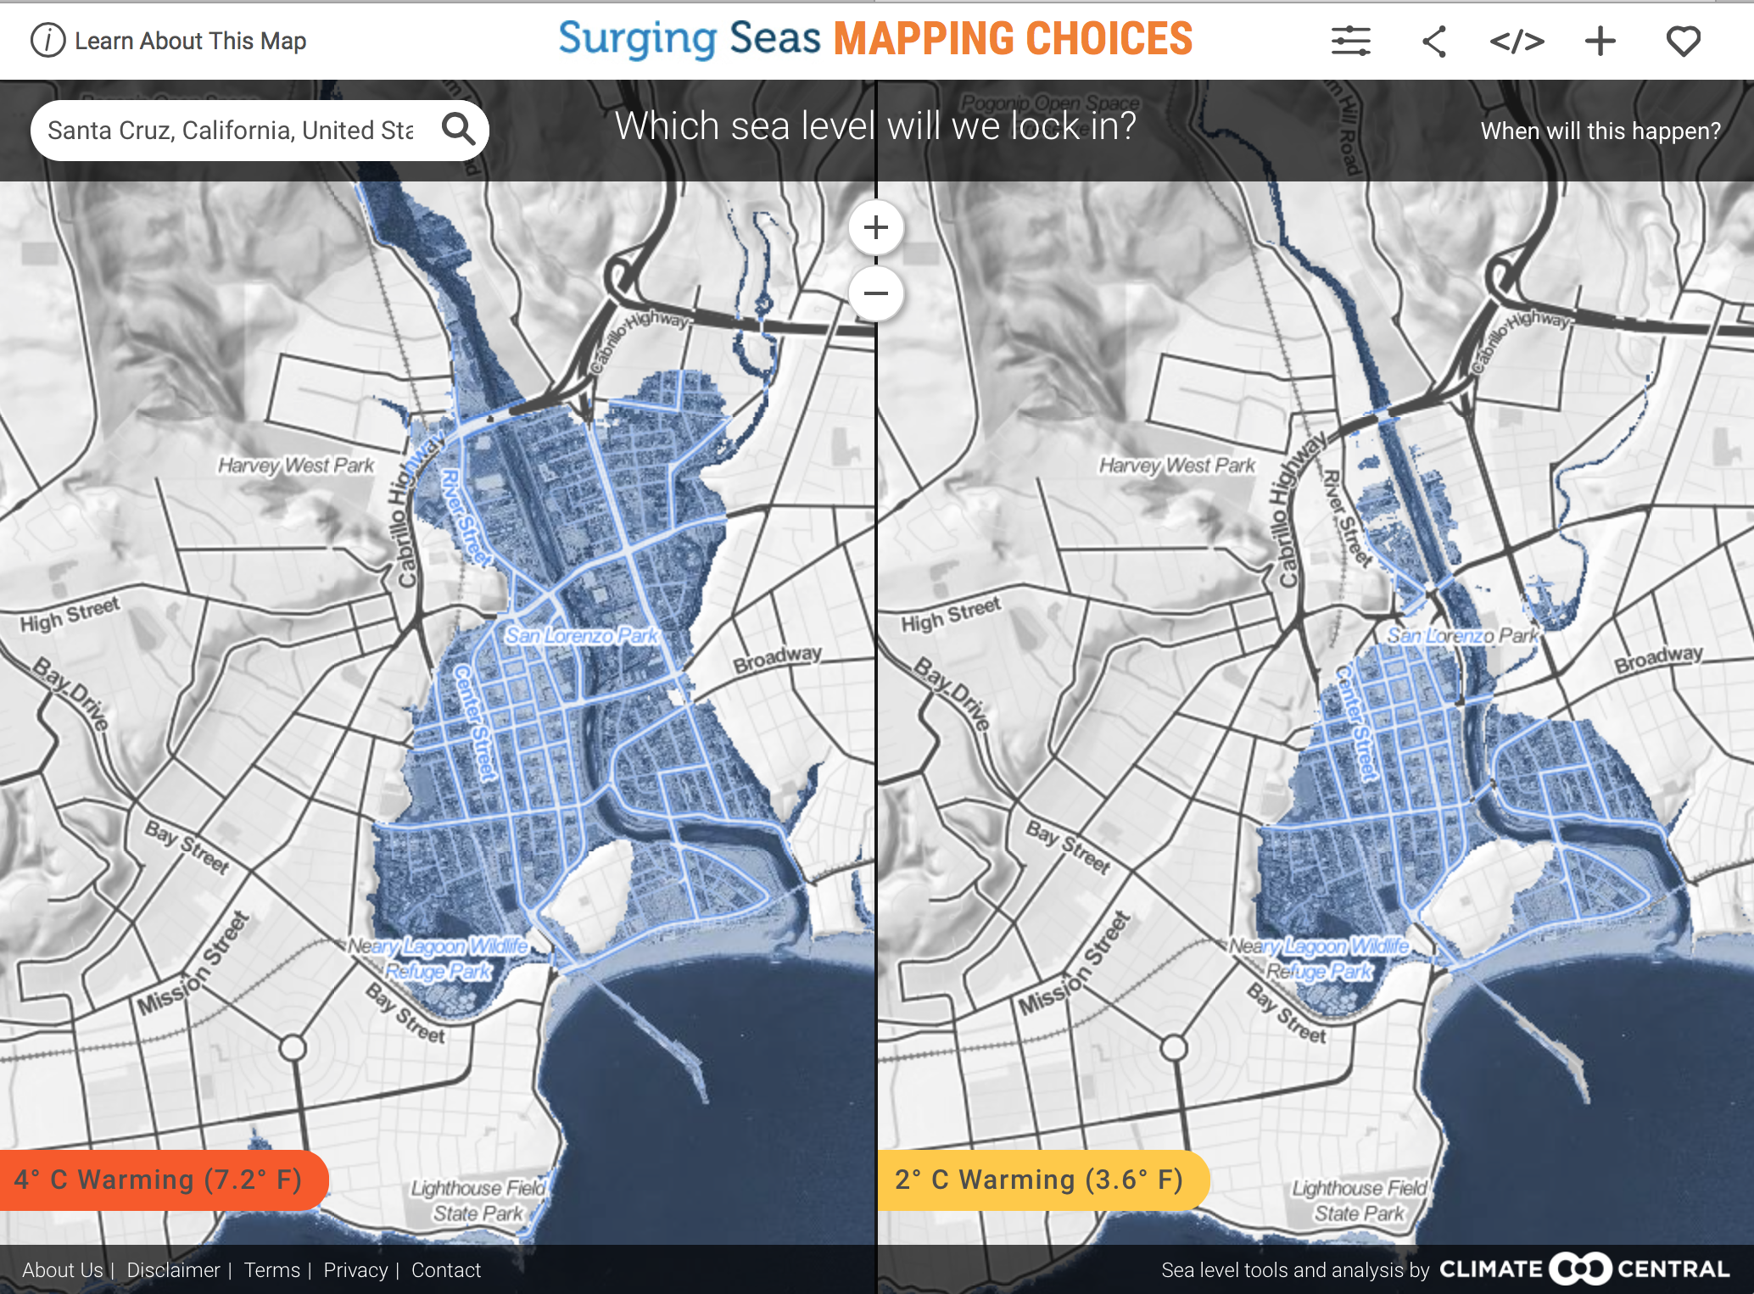



What to reduce or avoid
Notes:
Maps of Santa Cruz. The blue areas would be flooded at high tide.
Could not happen immediately
BUT only IMMEDIATE ACTION can slow the process down.
With even 2 deg C warming the entire downtown would be flooded.

Slide 23
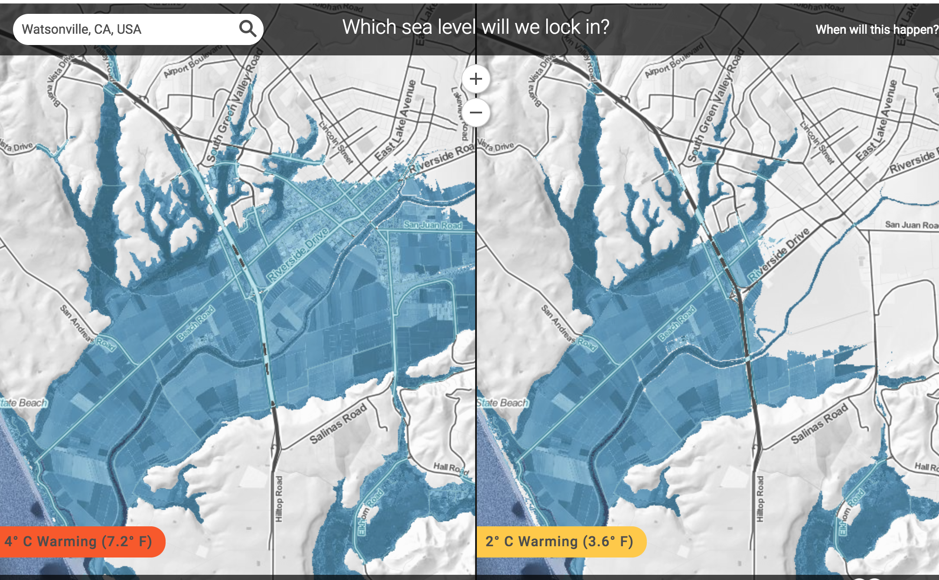
Notes:
Watsonville is a little higher above sea level but farm lands would be lost.

Slide 24
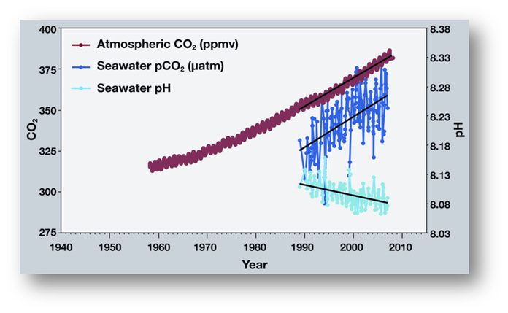
Ocean Acidification
Human made carbon dioxide is being absorbed by the oceans making them approx. 30% more acidic so far
Notes:
The trends in the atmosphere and ocean have continued with CO2 now at 400 in the atmosphere and ocean pH lower

Slide 25
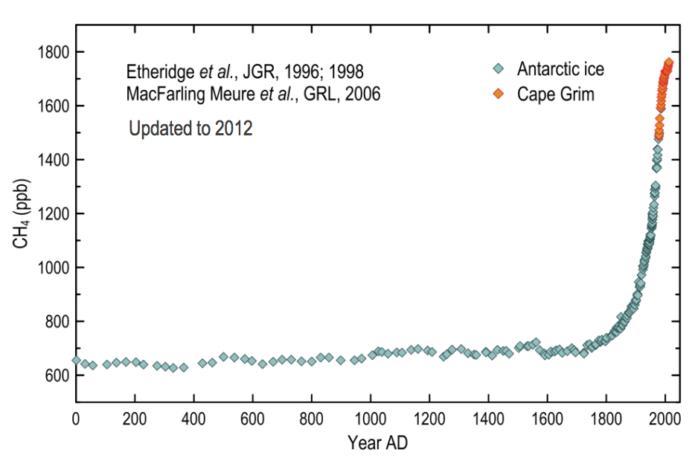
Methane levels for the past 2000 yrs
Notes:
Methane CH4 is a much stronger heat trapping gas than CO2.
It’s produced by cow emissions and also from the use of so called “Natural Gas” which is mostly Methane and leaks at many places between the “Fracked” well and the user.

Slide 26

MEAT - especially BEEF - is a HUGE PROBLEM
Changing your diet a little will help the planet a lot. Cows produce loads of methane - a super powerful greenhouse gas.
Beef production also uses more water and needs more land.
Changing to smaller amounts of meat (preferably chicken) and lots of veg is also better for your health.
Eat Less Meat

Slide 27
Climate Change Summary so Far
It’s Real
  It’s US
  Scientists Agree
  It’s BAD
  There’s HOPE!!!

Slide 28


Detailed Carbon Reduction program by Paul Hawken.
Includes detailed analysis of 80 different solutions
Notes:
This is a WONDERFUL report on solutions CURRENTLY AVAILABLE.
A recent 2020 update was just published.

Slide 29

What to reduce or avoid
Buy less new stuff Drive MUCH less
Notes:
We need to reduce Red meat consumption, because cows produce another grrenhouse gas - Methane, and cut unnecessary driving,
Also stop buying stuff we don’t need and reduce or eliminate use of Natrual Gas.

Slide 30
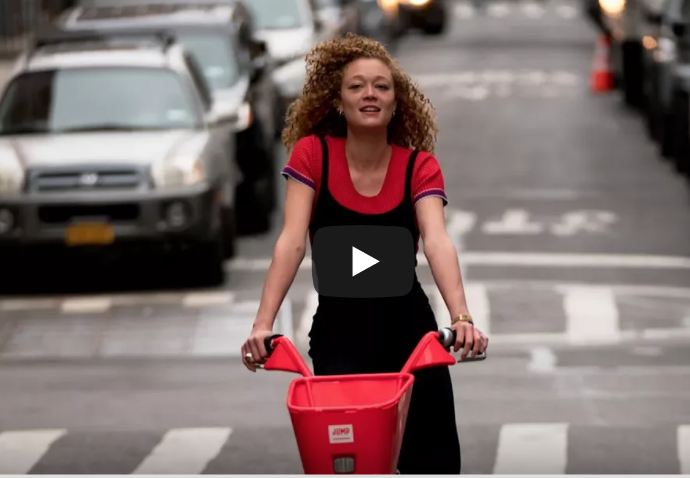


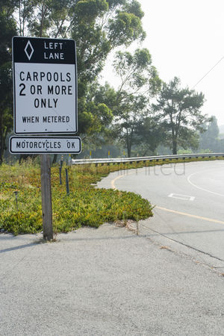
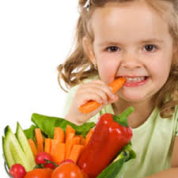


Enjoy
Notes:
Walking and biking are fun and healthy, the bus and carpools can help
Eat more vegetables and less meat (especially beef)
In winter find that old favorite sweater , and line dried clothes smell great

Slide 31
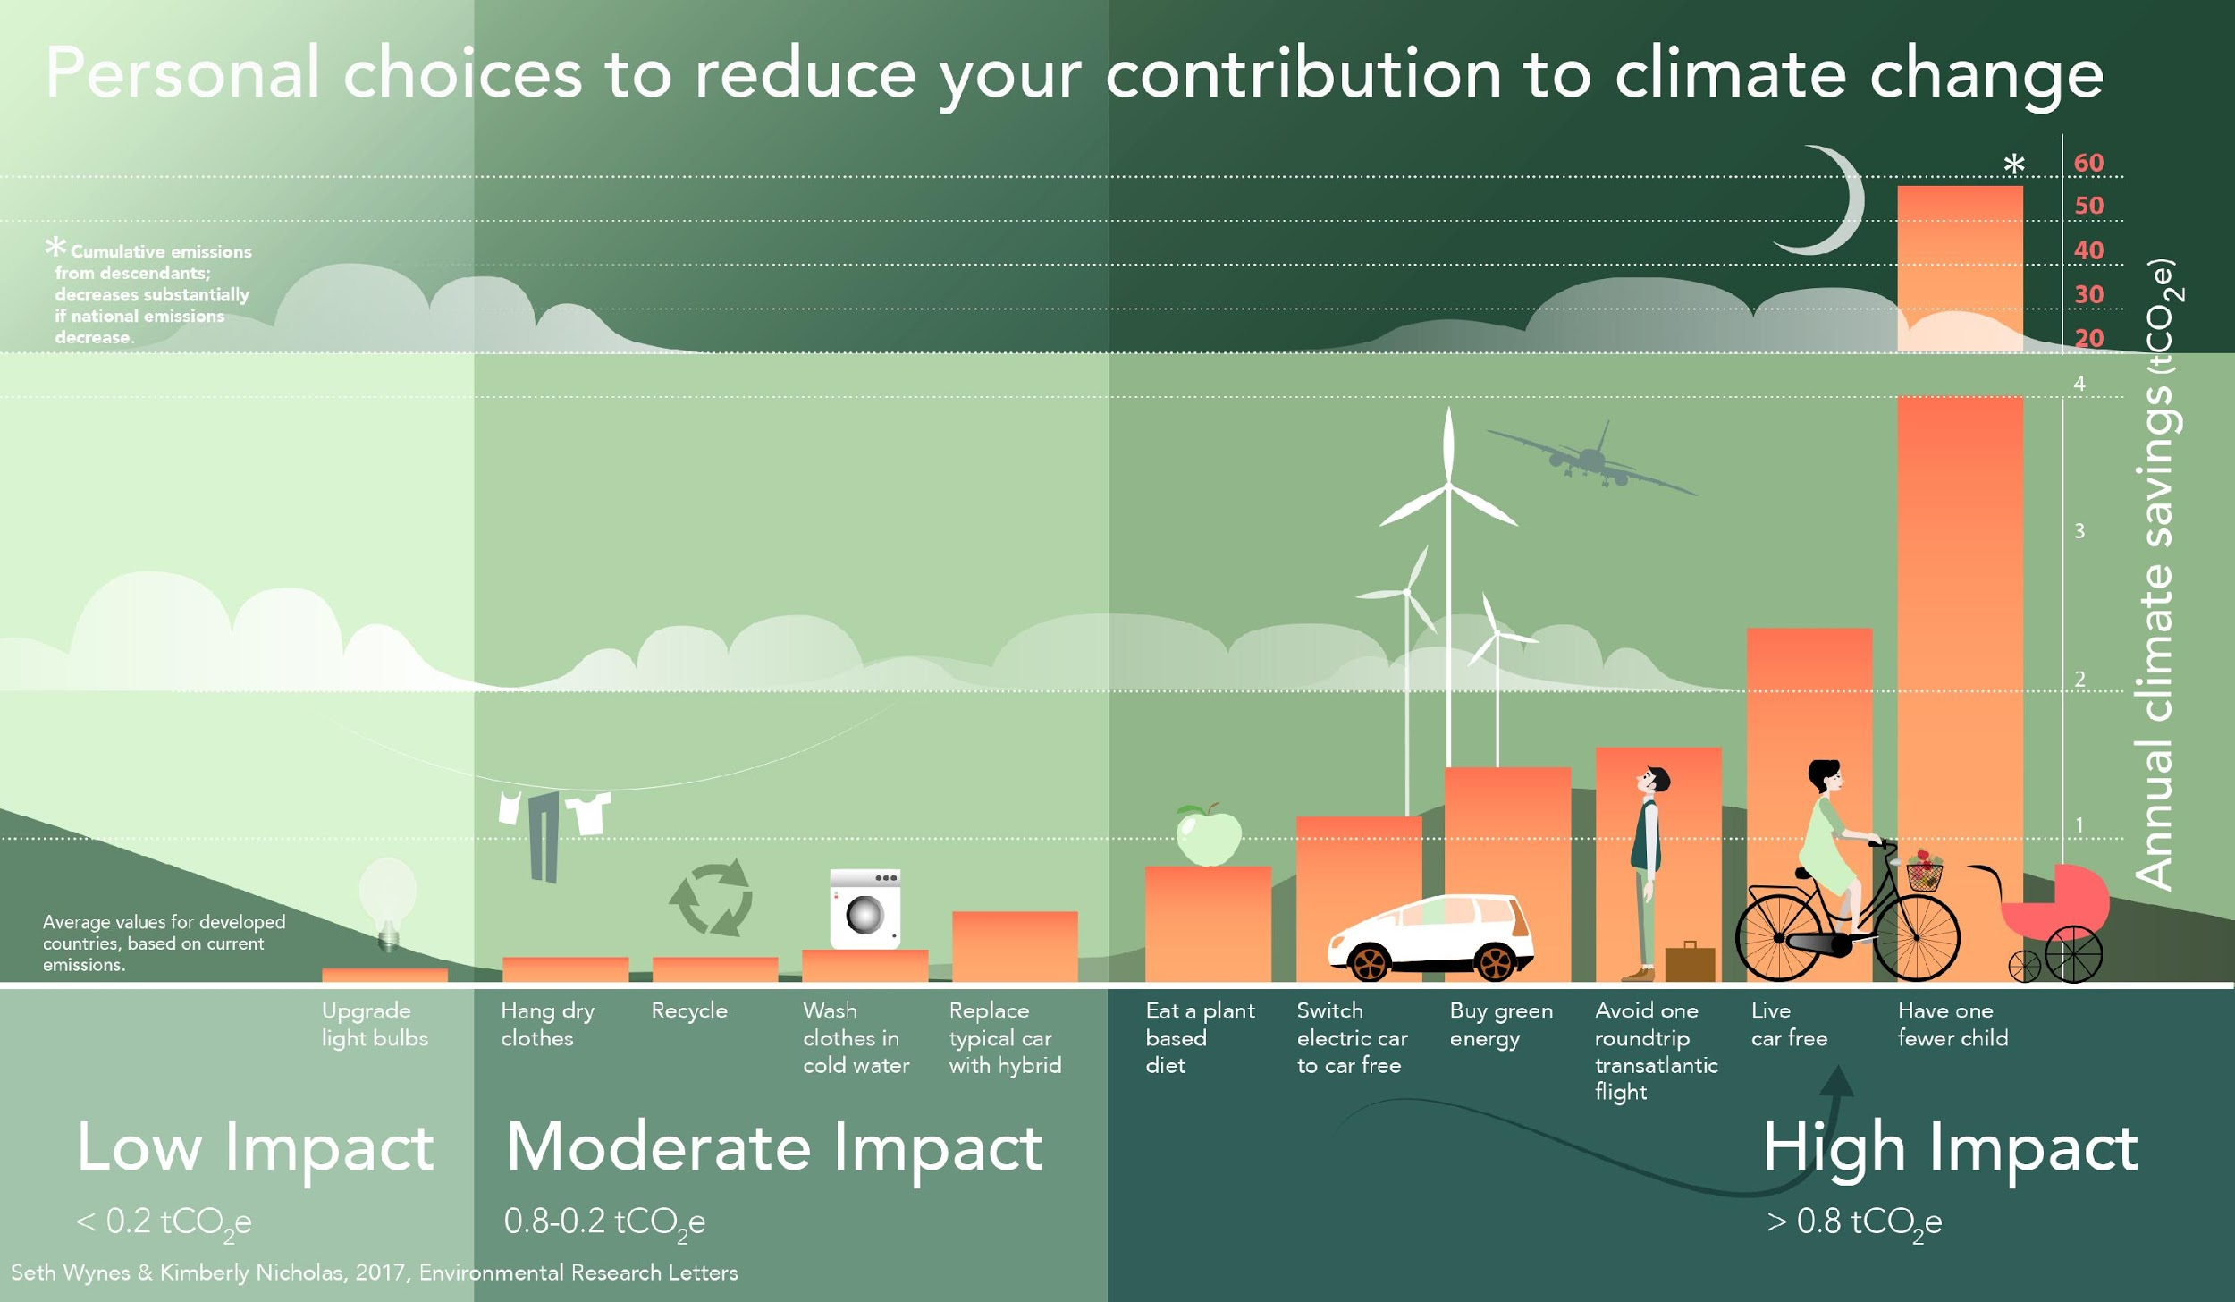
Notes:
Graphical version of lifestyle changes that can help. Reducing flying and having less children are important.

Slide 32




We need URGENT action by
Progress
Santa Cruz City Council, and the County Board of Supes have both passed Emergency Resolutions
Now working on electrification and other innovations.
Notes:
Lets make it happen Locally. We’ll be working with the Santa Cruz Climate Action Program staff

Slide 33
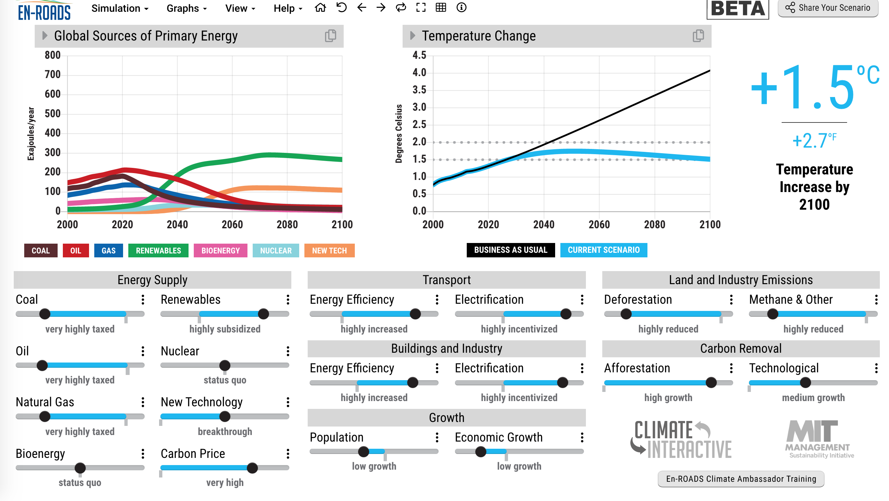
Notes:
This is an exciting new climate solutions simulator from MIT.
See lesson ENRdsLes

Slide 34
Local action on Transportation
Campaign for Sustainable Transportation works tirelessly to change the
Business as Usual” auto centric culture.
  Opposing new parking garage – not needed
  Opposing highway widening
  Working for real solutions – bus passes, bus on shoulder etc.
  Supporting safer biking, walking etc.

Slide 35
Normal political mode Emergency mode
Crisis constrained by business as usual | Crisis embraced with urgency by all
No urgent threat perceived, time of response not important | Known escalation beyond control if immediate action not taken
The crisis is one of many issues | The crisis is of highest priority
Budgetary restraints | All available resources devoted to the emergency
Slow rate of change, systemic inertia | Rapid transition & scaling up
Based on material by The Climate Mobilization (TCM)

Slide 36
Normal political mode Emergency mode
Targets & goals determined by political tradeoffs Politics is adversarial & divisive | Critical targets and goals not compromised Collaborative and effective leadership
Based on material by The Climate Mobilization (TCM)

Slide 37
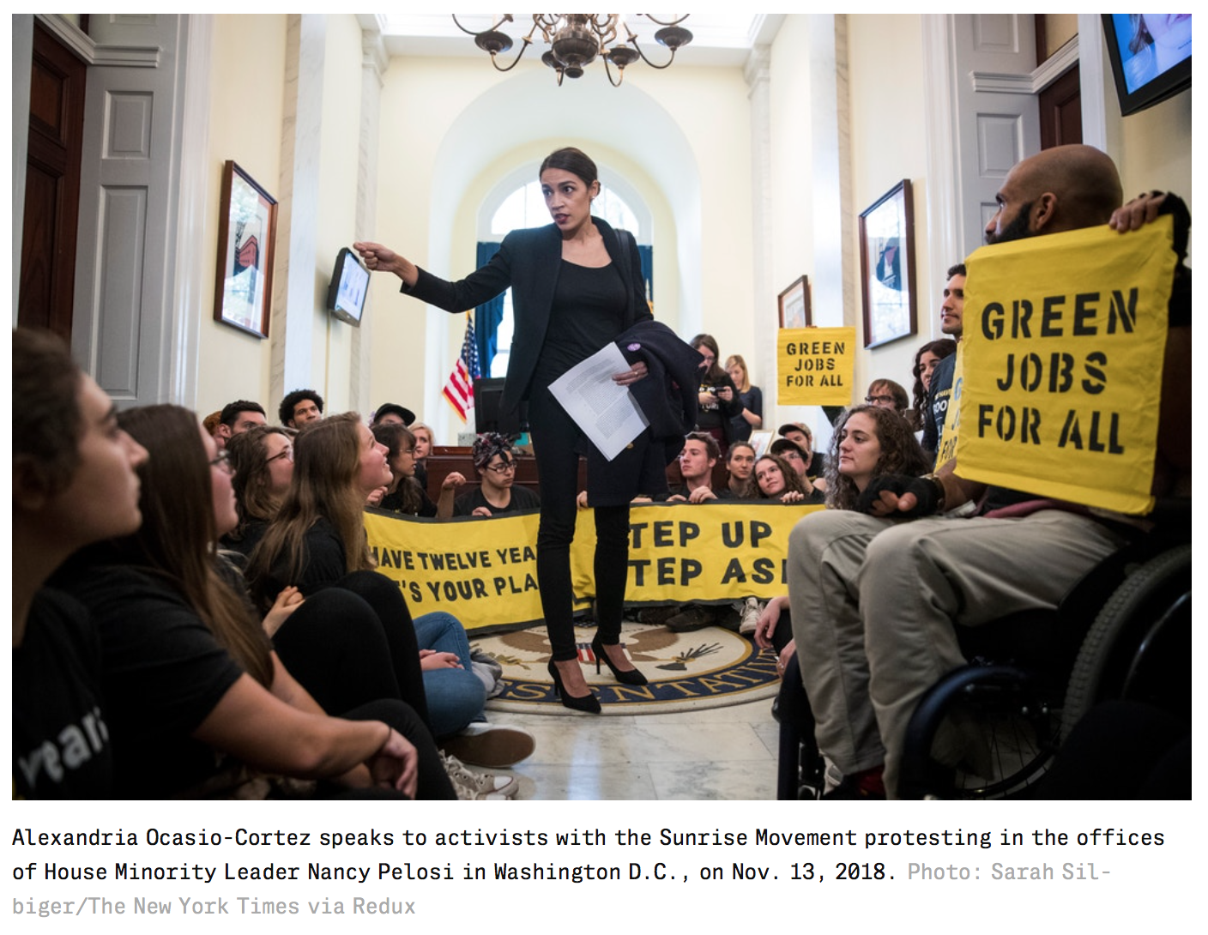
Green New Deal
Notes:
Alexandria Ocasio-Cortes introduced the Green New DEAL program and locally the Romero Institute is working on a California version.
Both would address both the climate crisis and climate justice – jobs, health, housing for all.

Slide 38


Slide 39


Slide 40


Slide 41


Slide 42


Slide 43


Slide 44
Good News
Feb 11 Congressman Jimmy Panetta agreed to back the Green New Deal Thanks Jimmy!
To Finance it we need PUBLIC BANKING.
CA AB 857 passed Oct 2019
- co-authored by Mark Stone
Let him know we appreciate his support.

Slide 45
California Green New Deal
We cannot afford to wait for the federal government.
We are the most populous state in the USA and the 2nd highest GHG emitter
We need to act now. Write or call your representatives or visit their offices.
The 2020 bill proposal AB 1839 needs to be changed to a much more aggressive schedule.

Slide 46
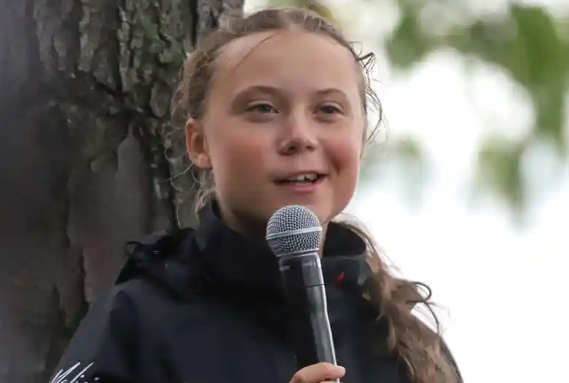
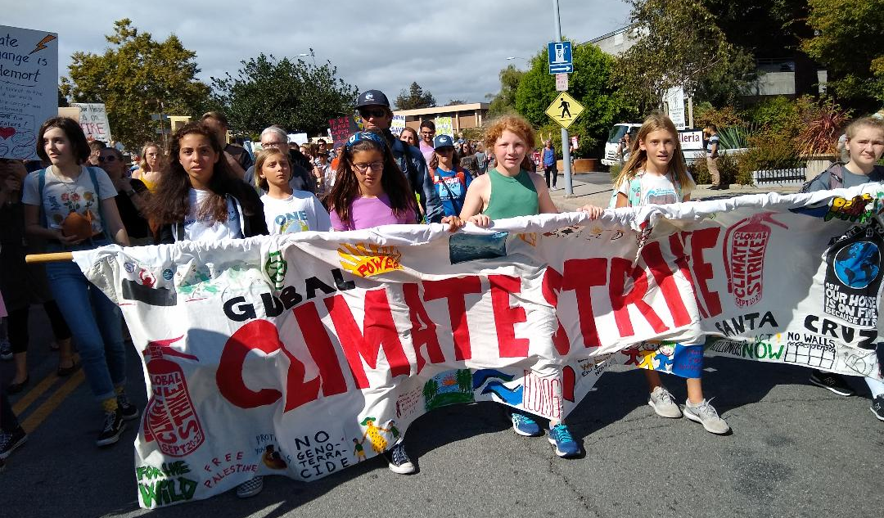
Young people worldwide are protesting. Their future is in serious jeopardy!
Climate Strike
Sep 20-27
Santa Cruz march Sep 27

Slide 47
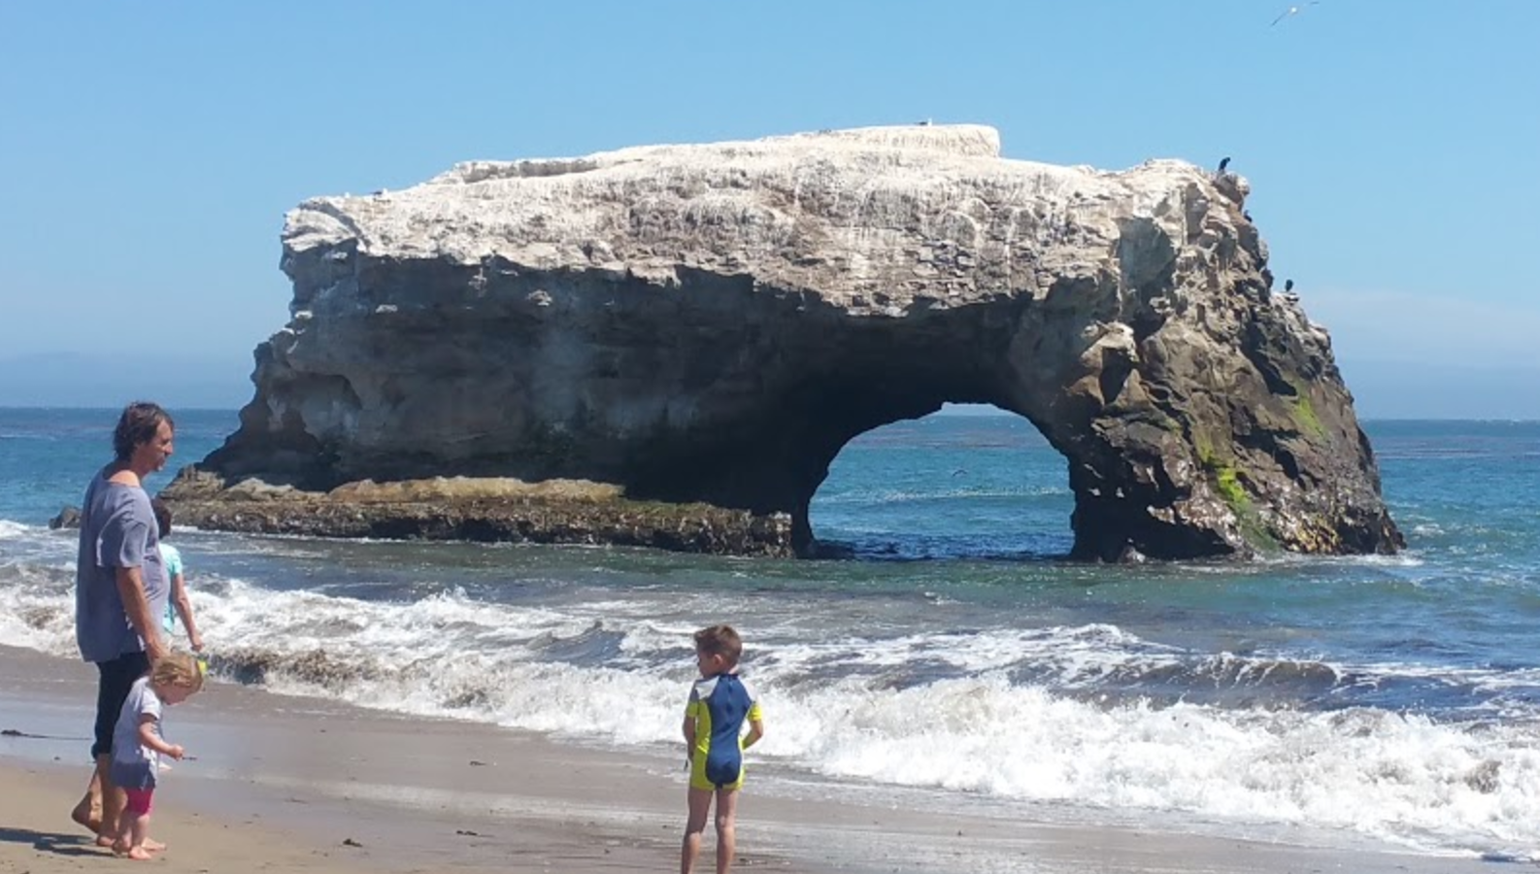
There really is HOPE!
Together we CAN do it.
For more details see https://scruzclimate.org/

