Slide 1




Climate Action Simulation
Notes:
Dear Facilitator, these slides can support your facilitation of the Climate Action Simulation roleplaying game, which complements the En-Roads simulation model. You may pick and choose from these slides and adjust them to suit your audience and setting.
Script: Welcome everyone! I am [introduce yourself] and I’ll be facilitating the Climate Action Simulation today.
These slides were last updated in May 2022.

Slide 2

Atmospheric CO₂ is higher than any time in that last 800,000 years, and levels are increasing faster than any time in millions of years.
Source: NASA
Notes:
Script: Atmospheric CO2 is higher than at any time in the last 800,000 years, and levels are increasing faster than at any time in millions of years.
Sources: NASA Jet Propulsion Laboratory https://climate.nasa.gov/
CO2 level end of May 2022 – 422 ppm - https://keelingcurve.ucsd.edu/

Slide 3

Global Temperature Change from Preindustrial (°C)
°F
2.7
1.8
Historical Dataset:
0.9
0
-0.9
Source: C-ROADS
Notes:
Script: This graph shows a closer look at the last 170 years. Measuring from 1850, which is often used to approximate temperature in pre-industrial times, surface temperature has increased approximately 1 degree C, or 1.8 degrees F.
Sources: C-ROADS, using data from NASA GISS Surface Temperature Analysis (GISTEMP v4, 2020) and Met Office Hadley Centre HadCRUT5 (2020)
Updated: March 2022
Ask about energy usage during this time Coal-Oil Steam engines-> cars-> planes

Slide 4
Total Annual Global Greenhouse Gas Emissions by Gas
Source: C-ROADS
Notes:
Script: Carbon dioxide is not the only thing that is contributing to climate change. There are also several other greenhouse gases. Here you see the relative contribution from different gases. In black and green you can see the contribution that CO2 makes from fossil fuels and land use, then in light blue is methane (CH4), then nitrous oxide (N2O), and the F-gases (fluorinated gases). Agriculture contributes 50% of global methane (CH4) emissions and 60% of global nitrous oxide (N2O) emissions. Heavy industry and manufacturing, as well as consumer goods, are sources of N2O and F-gases.
Sources: C-ROADS (Climate Interactive)
Updated: September 2020

Slide 5
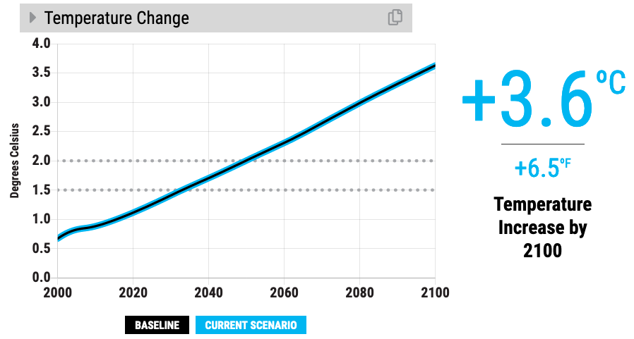

Baseline scenario
Our climate goals (1.5ºC to 2ºC)
Notes:
Script: If we continue business as usual, we estimate that temperature change will reach 3.6 degrees Celsius by 2100. That’s 6.5 degrees Fahrenheit. Compare the bold line to the dotted lines where our climate goals (2 degrees C and 1.5 degrees C) are on the graph.
Updated: November 2020

Slide 6
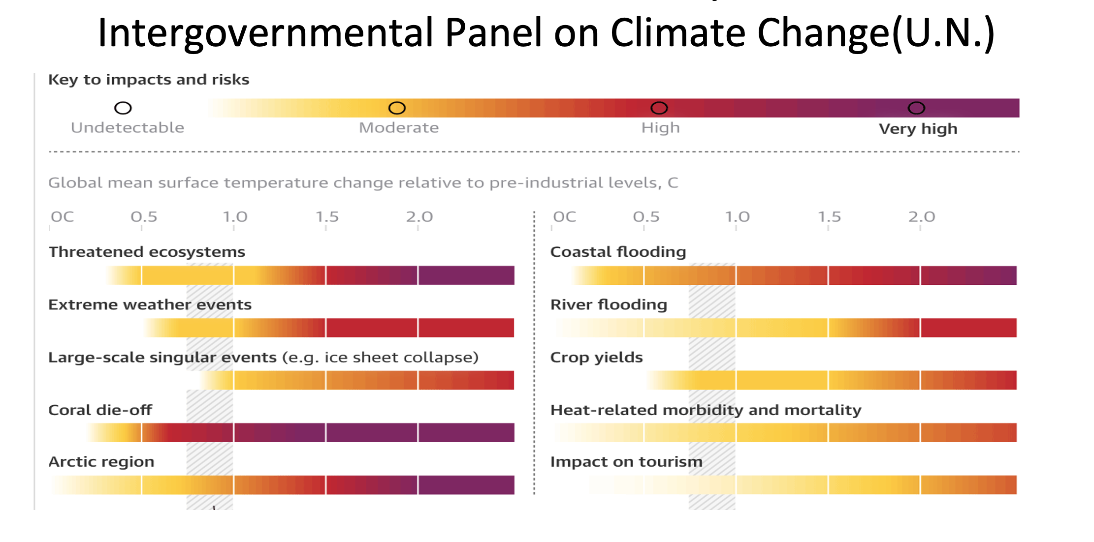
Impacts and Risks -> 1.5C -> 2.0C
Notes:
We’re seeing lots of problems already
By 1.5C things will be worse
By 2C it would be DRASTICALLY worse and accelerating

Slide 7
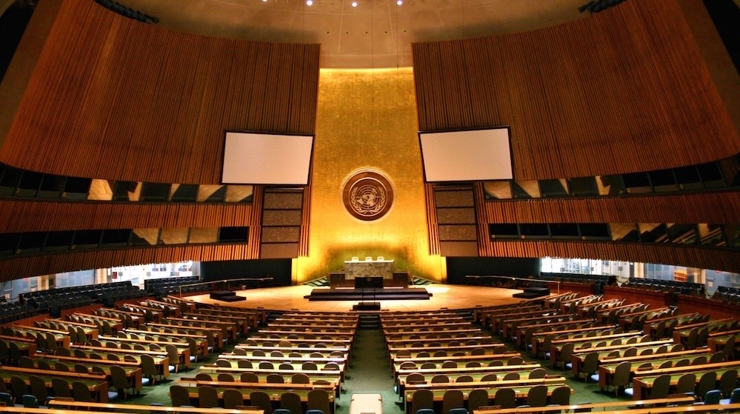
Welcome to the
UN Climate Action Summit
Notes:
Note - Open the roleplaying period. Enter the room as the UN Secretary General, and deliver your opening speech! (example speech from UN Secretary General Antonio Guterres: https://youtu.be/P8M-2gSm3bs)

Slide 8
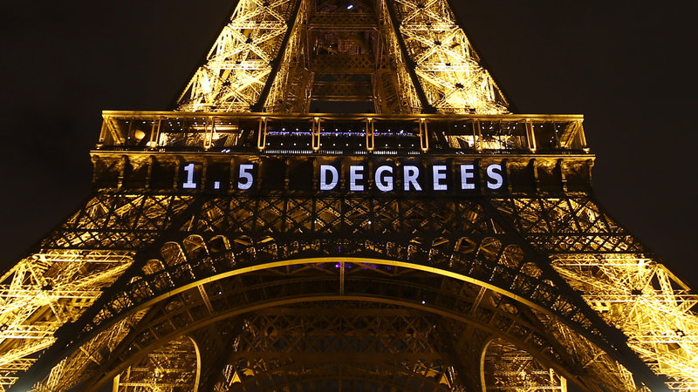
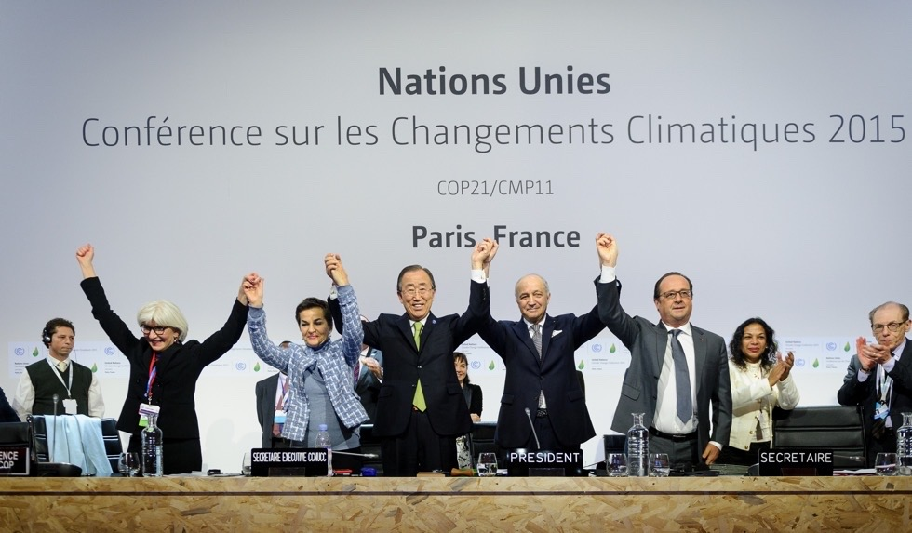
Our Goal Today
Limit global warming to less than 2ºC, and as close to 1.5ºC as possible, above pre-industrial levels.
Notes:
Sources:
https://www.npr.org/sections/thetwo-way/2015/12/12/459502597/2-degrees-100-billion-the-world-climate-agreement-by-the-numbers
https://www.nature.com/articles/d41586-020-00834-7

Slide 9
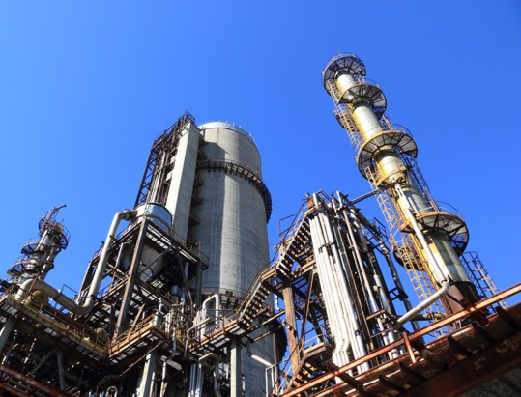
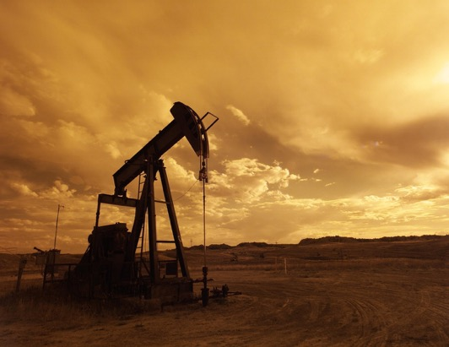



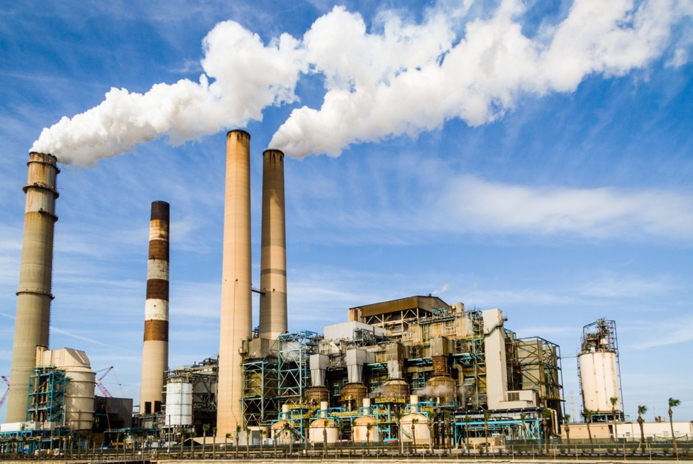
Conventional Energy
Largest energy suppliers in the world:
  Coal
  Oil
  Gas
  Nuclear
  Electric Utilities
Notes:
Note - Introduce the groups in the room.

Slide 10
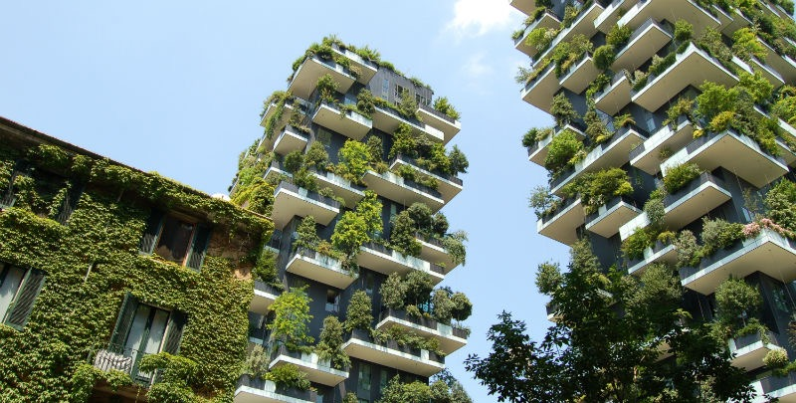



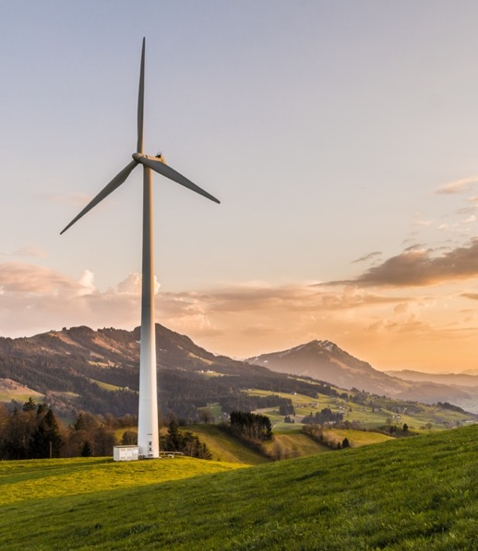
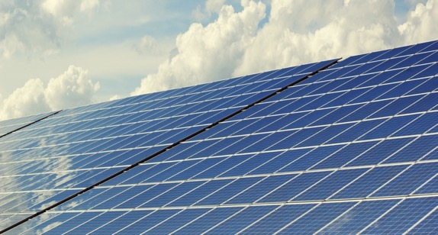
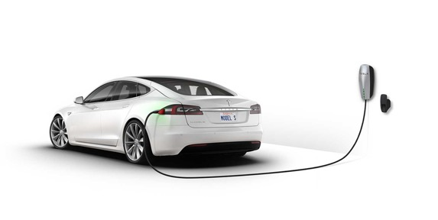
Clean Tech
Global leaders in clean tech:
  Wind, Solar, and other renewable energy sources
  Energy storage, electric vehicles
  Energy efficiency, green buildings
  Technological carbon removal
  New energy for the future

Slide 11
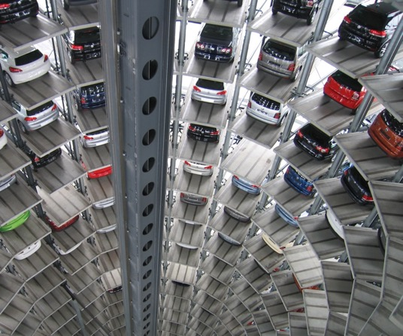
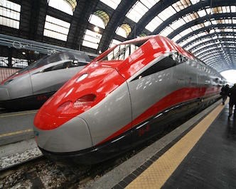


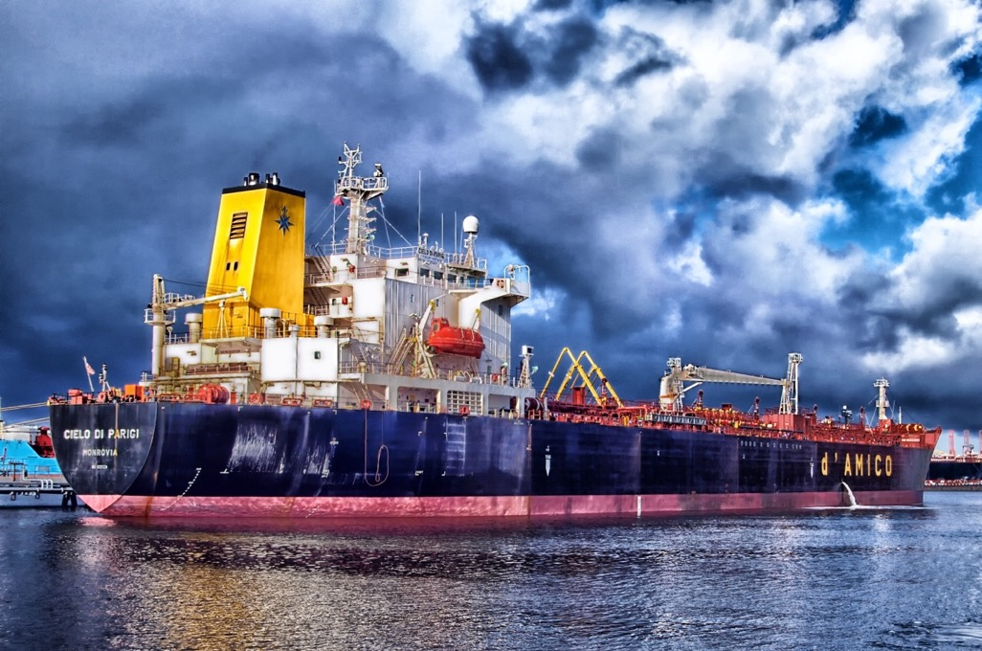
Industry & Commerce
Largest energy consuming corporations:
  Automakers, Airlines, Shipping & Freight, Other Transport
  Construction
  Industrial machinery
  Manufacturing
  Consumer products
  High tech

Slide 12
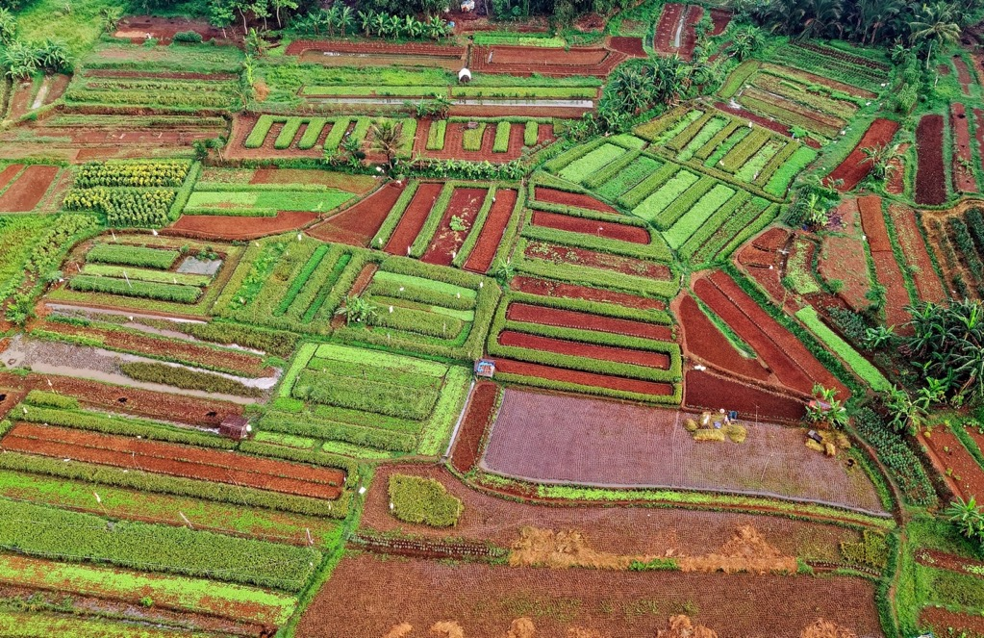



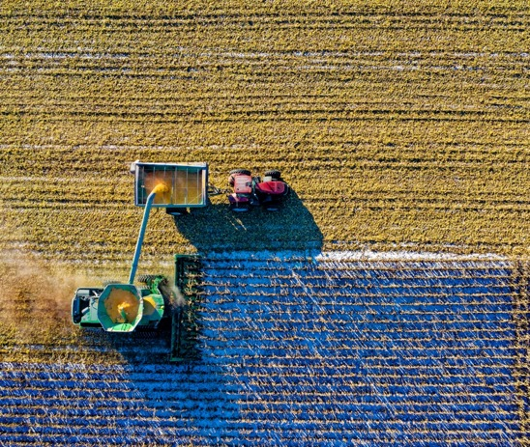
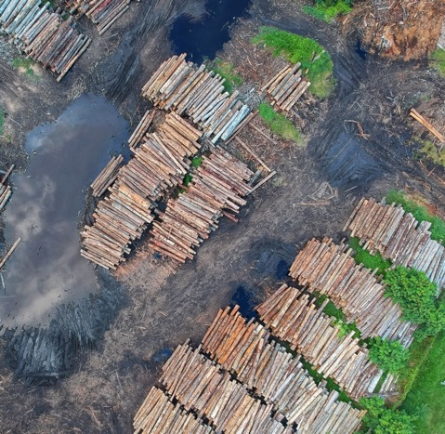
Land, Agriculture, & Forestry
Global alliance of:
  Food & agriculture companies
  Large landowners and farmer advocacy groups
  Logging companies
  Land conservation groups

Slide 13




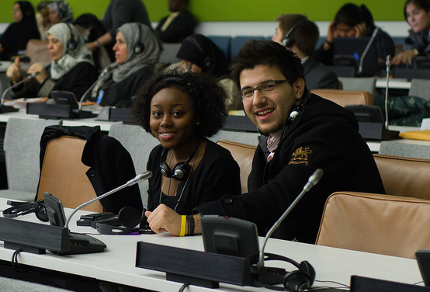
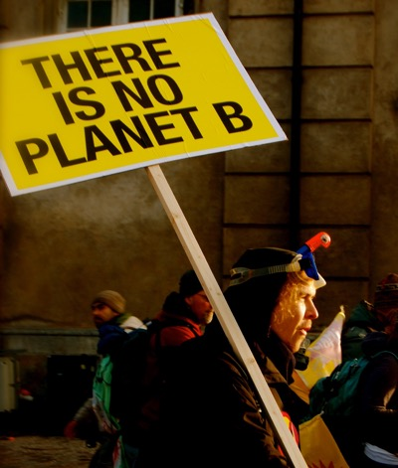
Climate Justice Hawks
Leading environmental nonprofits
Climate justice organizations
Grassroots & youth movements
Global citizens from communities harmed by climate change

Slide 14




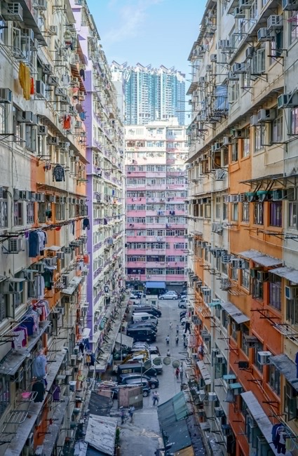
World Governments
Government leaders from around the world representing:
  Developed countries – EU, USA, Canada, etc.
  Rapidly developing countries – China, India, etc.
  Small island nations

Slide 15
Demo of En-Roads Simulation
Simplified Global simulation
Black graph line shows Business as Usual – the current path
We can change the projection by moving the 18 sliders
4. Change right graph to Net emissions by Gas – temp stays!!
4. Some of these solutions interact!! (ex NG)
5. Assumptions / more details / equity etc. (methane)
https://en-roads.climateinteractive.org/scenario.html?v=22.5.1
Notes:
Control Panel Demo https://en-roads.climateinteractive.org/scenario.html?v=22.5.1.

Slide 16
Process in Stakeholder Teams
Each team may propose one action in round 1.
You may propose to:
Add a solution tby changing one of the 18 levers in En-ROADS
You can explain WHY your solution be supported :
effectiveness in lowering Global Temp
timeliness – how quickly it acts
Multi-solving
Equity
We will review the impact of your proposed actions in En-ROADS.

Slide 17
Multisolving Lens
Consider:
A near-term co-benefit from your proposal. How can you address more than one problem with one action?
How might you ensure that marginalized communities are not disproportionately burdened and/or left out of opportunities to address and act on climate change?

Slide 18
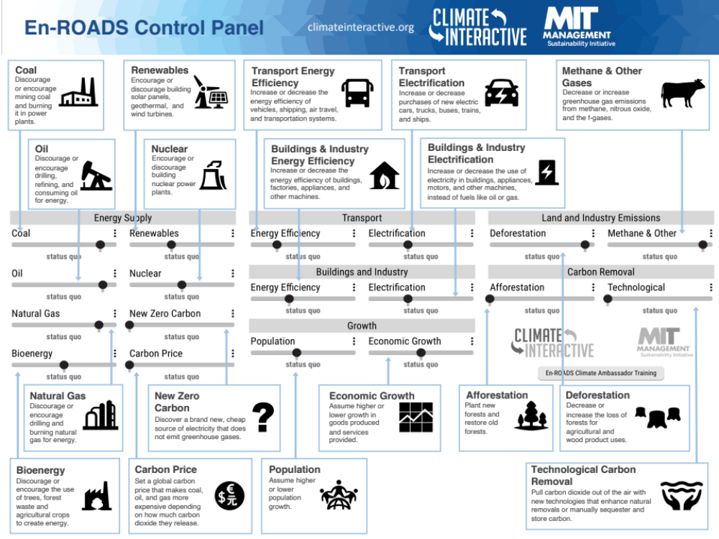
Notes:
Note – Use the En-ROADS control panel guide to help orient participants to their decision variables e.g., 18 levers. Use this time to also briefly orient people to the actual En-ROADS simulator, and show how this Guide relates to the En-ROADS simulator.

Slide 19
Overall Process
Break for round 1 Stakeholder team meetings – 15 min.
Each team will send up a delegate to make a 2-minute speech to propose one action per round.
We will input each action into En-ROADS and evaluate the results together. This round closes when every team has offered one solution.
Plenary rounds end when we achieve our climate goals or run out of time.

Slide 20
Round 1 Team Meeting
(10-15 minutes)
Start by looking over the En-ROADS control panel.
Try circling the 3-4 actions you most strongly support
    An “action” is any change one of the 18 levers in En-ROADS
2. Talk with your team to form your overall strategy
3. Discuss with your team to reach an agreement on your first action, including details – e.g., level of change, start year
4. Select your delegate and prepare a 2-minute speech
Notes:
Note - Change the (time) for each of the sections in the following slides per your game timing

Slide 21
Round 1 Team Meeting (10-15 minutes)
For each proposal, consider these questions:
    What are your vital interests?
    What is a co-benefit from your proposal?
    Can you solve more than one problem with one solution?
    How do you ensure that vulnerable communities are not disproportionately affected by your proposal?

Slide 22
Round 1
Plenary Presentations
(10-15 minutes)

Slide 23

2nd Team Meeting & Negotiations
(15-20 minutes)
1. Discuss follow-up actions as a team
2. Negotiate with other groups and lobby them to change their position if necessary

Slide 24
Round 2 Team Meeting
(10-15 minutes)
For each proposal, consider these questions:
    What is politically feasible?
    What do you need from the other groups?
    What can you offer them?

Slide 25
Round 2
Plenary Presentations
(10-15 minutes)

Slide 26
Round 2/3
Teams continue proposing actions
But on this round each team proposes 2 actions
  OR chooses to cancel one action by another team
  An additional Lightning Round will be done if it’s still needed and there is sufficient time

Slide 27
Reflection
How are you feeling?
Think of something you would love about being part of this sort of future.
Take one minute of silence to reflect on your experience.

Slide 28
Debriefing Discussion
What surprised you?
What were your key insights?
What will you take away from today, and how can you apply what you learned to the real world?
Notes:
Note – These are the three basic guiding questions to lead the debriefing discussion. You may choose your own and follow up with more detailed questions. We provide some options for Additional Discussion Questions in the Facilitator’s Guide.

Slide 29
Looking ahead
We have the tools
Solar and wind are growing and getting cheaper
Corporations are investing in clean tech
Countries and states are stepping up
The general public is becoming more educated and engaged

Slide 30
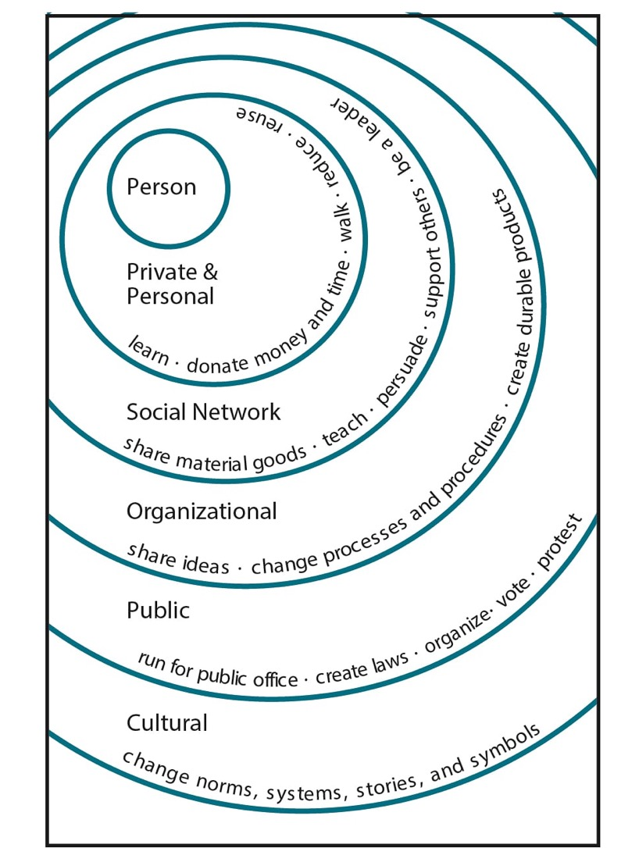
What can you do?
Illustration by Elise Amel
Notes:
Source: https://www.theguardian.com/environment/climate-consensus-97-per-cent/2017/may/19/study-inspiring-action-on-climate-change-is-more-complex-than-you-might-think

Slide 31
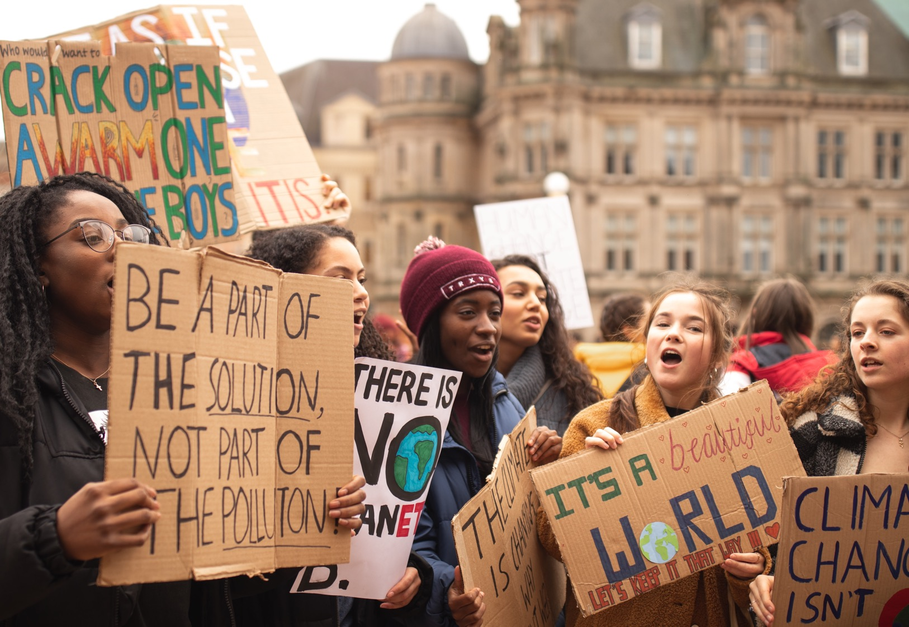

September 2019: Over 7 million people in 185 countries
Global Climate Strikes
Notes:
Sources:
https://unsplash.com/photos/7SE389kUVGw
https://350.org/7-million-people-demand-action-after-week-of-climate-strikes/

Slide 32
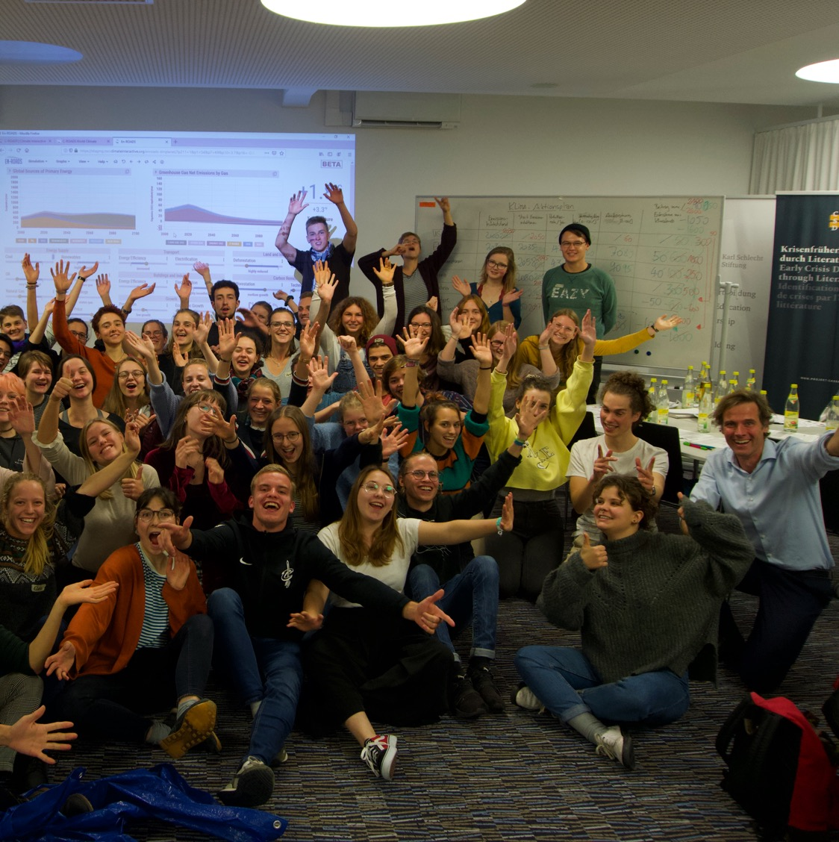
Thank You!
Visit: climateinteractive.org

Slide 33
Appendix

Slide 34

Companies are starting to take action
Clothing brand H&M has promised to double its energy efficiency
by 2030
Over 260 of the world’s largest companies have committed to using 100% renewable electricity by 2050, with an average target date of 2028
Microsoft has pledged to be carbon negative by 2030, removing more carbon than it emits
Notes:
Sources:
https://blogs.microsoft.com/blog/2020/01/16/microsoft-will-be-carbon-negative-by-2030/
https://www.there100.org/technical-guidance
https://hmgroup.com/media/news/general-2017/h-m-joins-international-initiative-to-enhance-energy-productivit.html
Photos:
https://unsplash.com/photos/PQmXUxmfR44
https://unsplash.com/photos/_h0xG4s6NFg
https://pixabay.com/images/id-1712699/
https://unsplash.com/photos/_h0xG4s6NFg
Updated: October 2020

Slide 35
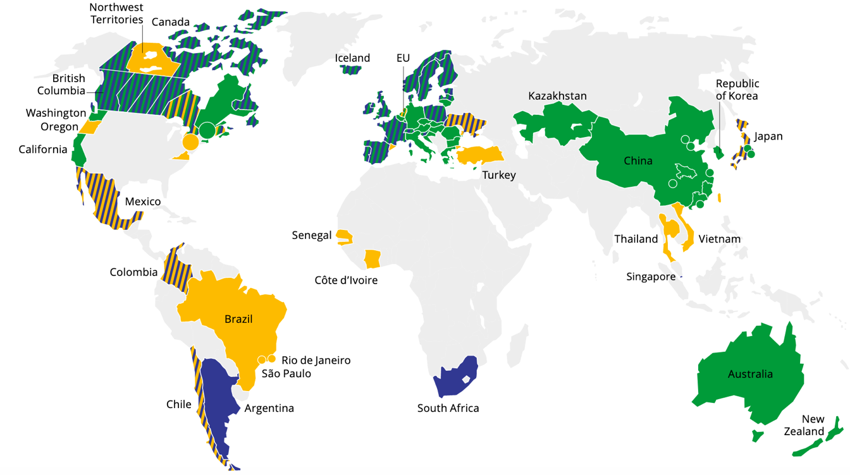
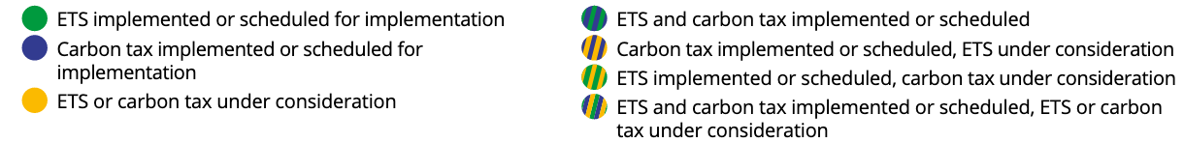

Carbon prices are being enacted around the world
Current or planned carbon pricing covers 22% of global emissions
80+ jurisdictions (regional, national or sub-national) have implemented or are considering carbon prices
Source: World Bank, 2020
Notes:
Sources:
https://carbonpricingdashboard.worldbank.org/map_data and World Bank Group. (2019). State and Trends of Carbon Pricing 2019. Washington, DC: World Bank. https://openknowledge.worldbank.org/handle/10986/31755
Notes:
ETS = Emissions Trading System
Notes from World Bank’s “State and Trends of Carbon Pricing 2019”: “The large circles represent cooperation initiatives on carbon pricing between subnational jurisdictions. The small circles represent carbon pricing initiatives in cities. Note: Carbon pricing initiatives are considered “scheduled for implementation” once they have been formally adopted through legislation and have an official, planned start date. Carbon pricing initiatives are considered “under consideration” if the government has announced its intention to work towards the implementation of a carbon pricing initiative and this has been formally confirmed by official government sources. The carbon pricing initiatives have been classified in ETSs and carbon taxes according to how they operate technically. ETS not only refers to cap-and-trade systems, but also baseline-and-credit systems as seen in British Columbia and baseline-and-offset systems as seen in Australia. The authors recognize that other classifications are possible."
Updated: September 2020

Slide 36
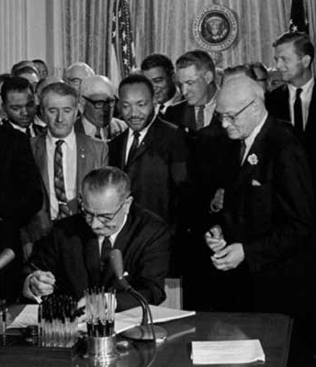

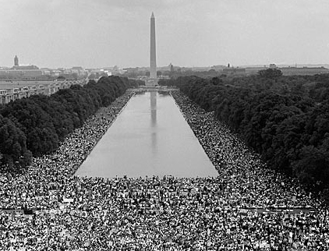
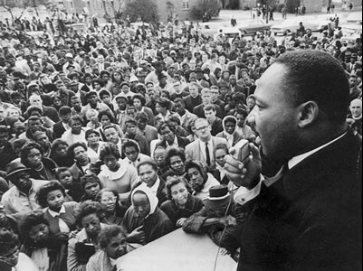
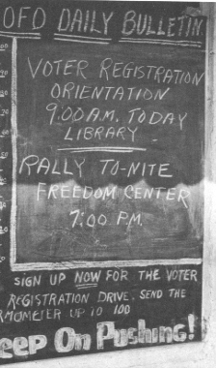
“The world as we have created it is a process of our thinking. It cannot be changed without changing our thinking.”
- Albert Einstein
“Never doubt that a small group of thoughtful, committed citizens can change the world. Indeed, it is the only thing that ever has.”
- Margaret Mead

Slide 37
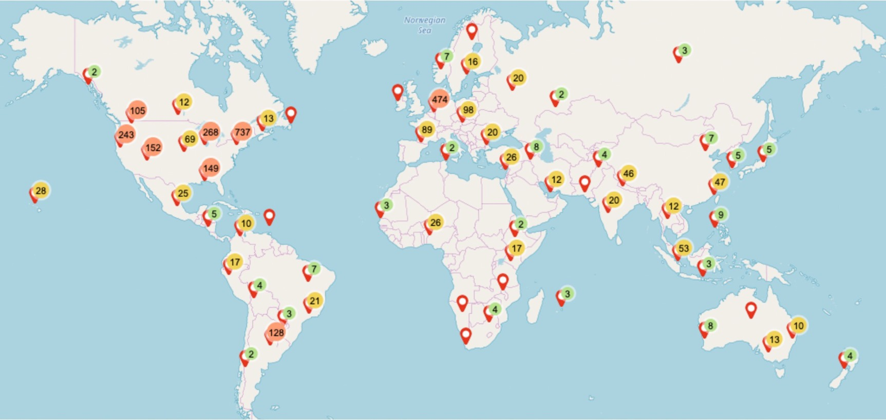
En-ROADS simulations:
Over 80,000 participants in 86 countries
As of November 2021
Notes:
Script: You are part of a global movement to become more knowledgeable about and equipped to solve climate change by experiencing this interactive workshop.
Updated: November 2021

Slide 38
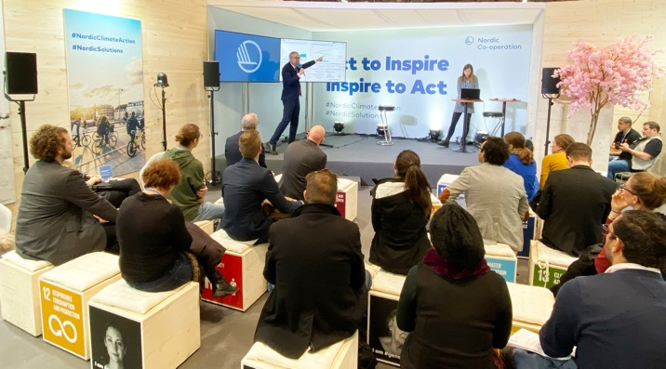
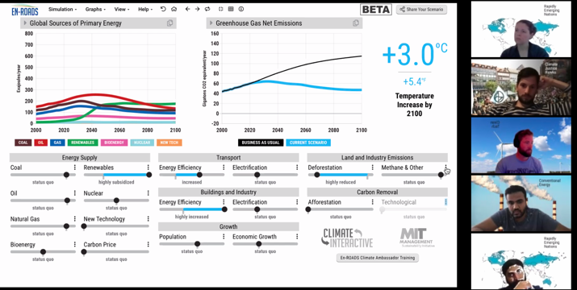
The En-ROADS Training Program
Join this free, self-paced online course to…
Learn more about the En-ROADS simulator
Facilitate engaging events to spark climate action – both online and in-person
Gain valuable insights on systems thinking, multisolving, advanced facilitation tips, and more
Begin your journey as an En-ROADS Climate Ambassador
  So far, we have over 400 En-ROADS Climate Ambassadors from more than 50 different countries!
Register at: https://learn.climateinteractive.org

Slide 39

The En-ROADS Climate Ambassador Program
The En-ROADS Climate Ambassador Program is a unique leadership opportunity to become a climate leader in your field for those who complete the En-ROADS training.
500+
En-ROADS Climate Ambassadors
70+
Countries
34+
Languages
from all walks of life: professors, business leaders, entrepreneurs, artists, activists, engineers, scientists, students, lawyers, & beyond
As of May 2022
Notes:
Updated May 2022

Slide 40
Insights from En-ROADS
A combination of solutions is needed to address climate change: “It takes more than one seed to plant a garden”:
Keeping climate change to well below 2°C, and limiting it to 1.5°C, is possible.
      We can still avoid the worst-case scenarios – it is still physically and technologically possible.
All successful scenarios significantly cut burning of coal, oil, and gas in the next 10-20 years
There are many lower-leverage actions that help address climate change globally but which are not as high of a priority as reducing fossil fuel use.
There are many opportunities to increase equity as we take these actions.

Slide 41
Additional En-ROADS Insights
The transition from high-carbon to low-carbon takes decades due to the long lifetime of fossil fuel capital infrastructure.
A brand-new energy source takes too long to scale up to contribute much on its own.
Even when low-carbon energy sources are encouraged, we still burn fossil fuels unless they are actively discouraged.
Reducing other greenhouse gas emissions (methane, N₂O, F-gases) reduces temperature quite a bit.
A carbon price is high leverage because it changes the fuel mix and reduces energy demand.
New technologies grow via reinforcing “learning” feedback loops.
When energy becomes inexpensive, energy demand increases modestly.
Accelerated growth in natural gas (e.g., via subsidy), without a carbon price, competes with renewables and does not reduce greenhouse gas emissions.
In a scenario in which many actions that limit fossil fuel demand have already been taken, more nuclear/new zero-carbon energy/renewables just displaces the other low-carbon sources (a dynamic known as “crowding out”).
Reducing deforestation is lower leverage in the long term than many expect, because its impact is overshadowed by the amount of greenhouse gas emissions that come from burning fossil fuels.

Slide 42
System Dynamics In En-ROADS
Capital Stock Turnover – Changes to infrastructure take time
Price-Demand Feedback – Price, demand, and supply are linked
Crowding Out – Low-carbon supplies compete for long-term market share
Squeezing the Balloon – Fossil fuel supplies experience compensating feedback
Economies of Scale and Learning – Success builds success via Progress Ratio
Drivers of Growth – Population and GDP growth drives emissions
Bathtub Dynamics – CO₂ emissions must be lower than removals for CO₂ concentration and temperature to stop rising

Slide 43
Features of En-ROADS
Transparent
  All equations and structure are available in the online Reference Guide
Flexible
  Assumptions are adjustable
Globally aggregated to be fast
  Complementing, not supplanting, the integrated assessment models used by the IPCC
Supports grounding discussions to learn and strategize, backed with real data & science
  However, not to serve as predictions for the future, which is dependent on too many behavioral variables

Slide 44
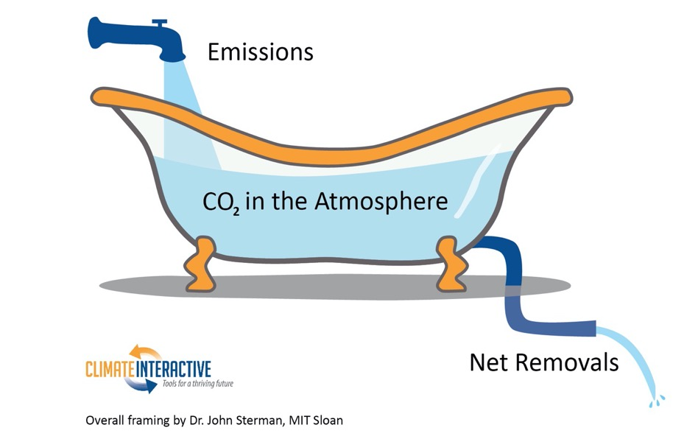
Bathtub Dynamics
Notes:
Note: The metaphor of a bathtub helps explain the dynamics of rising CO₂ concentration in the atmosphere. If more CO₂ enters the atmosphere (like water flowing into a tub) than is removed (like water draining from the tub), then the amount of CO₂ in the atmosphere (the amount of water in the tub) will continue to increase. To flatten CO₂ concentration, we need to bring CO₂ emissions down to equal removals. If your bathtub is overflowing, you turn off the tap before you go get a mop and bucket.
To understand more about stocks, flows, and the bathtub framing below, watch our video as part of our Climate Leader learning series.

Slide 45
En-ROADS Core Structure
Temperature
Impacts
Total greenhouse gases (GHGs)
Energy CO₂ emissions
Land use CO₂ emissions
CO₂ removal
Other greenhouse gases
(N₂O, methane,
f-gases)
Population
Consumption
Energy Intensity
Carbon Intensity
Notes:
*This slide is animated.

Slide 46
Multisolving

Slide 47
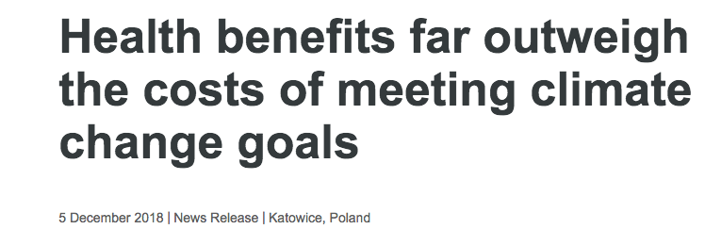
“The health burden of polluting energy Sourcess is now so high, that moving to cleaner and more sustainable choices for energy supply, transport and food systems effectively pays for itself,” says Dr Maria Neira, WHO Director of Public Health, Environmental and Social Determinants of Health.
“When health is taken into account, climate change mitigation is an opportunity, not a cost.”
Notes:
Sources: https://www.who.int/news-room/detail/05-12-2018-health-benefits-far-outweigh-the-costs-of-meeting-climate-change-goals

Slide 48
Clean Energy & Health
Health benefits from wind and solar power in the United States from 2007 to 2015 were even greater than their climate benefits.
Source: Millstein, et al (2017)
Notes:
Sources: Millstein, et al (2017). The climate and air-quality benefits of wind and solar power in the United States. NATURE ENERGY 2, 17134. DOI: 10.1038/nenergy.2017.134. http://rdcu.be/uZwc
These figures specifically come from Table 3: Cumulative and 2015 benefits from avoided air pollution and avoided GHG emissions. 2015 US dollars.

Slide 49
Clean Energy & Jobs
If $200 billion was invested every year in energy efficiency and clean energy in the US, 4.2 million jobs would be created by 2030, and the 2030 unemployment rate would be reduced by 1.5%.
Source: Pollin, et al (2014)
Notes:
Sources: Pollin et al (2014). Green Growth: A U.S. Program for Controlling Climate Change and Expanding Job Opportunities. Center for American Progress & Political Economy Research Institute. https://www.americanprogress.org/issues/green/reports/2014/09/18/96404/green-growth/

Slide 50

Health Benefits of Climate Action: Global
Limiting warming to 1.5-2°C by cutting fossil fuel emissions would:
Prevent ~153 million premature deaths from air pollution by 2100¹
Save ~$800 Billion per year due to health benefits from clean power and $400 Billion per year from clean transportation
  ~$1.2 Trillion per year total²
Source: Shindell et al., 2018; Shindell et al., 2016
Notes:
Sources:
1. Shindell, D., Faluvegi, G., Seltzer, K. et al. Quantified, localized health benefits of accelerated carbon dioxide emissions reductions. Nature Clim Change 8, 291–295 (2018). https://doi.org/10.1038/s41558-018-0108-y
2. Shindell, Drew T., Yunha Lee, and Greg Faluvegi. "Climate and Health Impacts of US Emissions Reductions Consistent with 2 °C." Nature Climate Change Nature Climate Change 6.5 (2016): 503-507.
Photo: https://unsplash.com/photos/4NhqyQeErP8

Slide 51
Health Benefits of Climate Action: U.S.
The U.S. would save billions in health care costs by 2030²
Prevent ~295,000 premature deaths by 2030 from air pollution caused by fossil fuel use
Prevent ~29,000 Emergency Room visits/year for childhood asthma
Prevent 15 million adult work hours lost/year
Source: Shindell et al., 2016
Notes:
Sources:
1. Shindell, D., Faluvegi, G., Seltzer, K. et al. Quantified, localized health benefits of accelerated carbon dioxide emissions reductions. Nature Clim Change 8, 291–295 (2018). https://doi.org/10.1038/s41558-018-0108-y
2. Shindell, Drew T., Yunha Lee, and Greg Faluvegi. "Climate and Health Impacts of US Emissions Reductions Consistent with 2 °C." Nature Climate Change Nature Climate Change 6.5 (2016): 503-507.
Photos:
Power station: https://pixabay.com/images/id-374097/
Emergency room: https://pixabay.com/images/id-3323451/
Clock: https://pixabay.com/images/id-650753/

Slide 52
Impacts at different levels of warming

Slide 53
1.5ºC of warming (or 2.7ºF)
Increase of 3.0 - 4.5°C (5.4 - 8.1°F) in extreme temperatures
in some regions¹
70% of coral reefs bleached²
Drought: 2 months longer
Increase in average drought length³
13% of people face severe heat waves at least every 5 years⁴
Notes:
Script: By limiting warming to 1.5ºC, you have achieved our collective goal! This is no small feat and something we should all be proud of.
Congratulations!!! We have arrived at a set of policies that will avert the worst impacts of climate change, especially for the world’s most vulnerable.
While there are still impacts that we will need to adapt to, look at how significantly the impacts were reduced compared to a 4ºC scenario of warming:
[Review bullets on the slide]
Notes:
Increase in temperature extremes: The overall message is that there is no single 1.5-degree world; many regions will experience much greater warming than 1.5 degrees. During the summer in mid-latitudes, increases of up to 3 degrees C in extreme temperature may occur, with the strongest warming happening in central and eastern North America, central and southern Europe, the Mediterranean, western and central Asia, and southern Africa. During the winter in high-latitudes, increases of up to 4.5 degrees C may occur.
Coral bleaching: Many societies depend on coral reefs for fisheries and tourism. Reefs protect the shoreline from storm surge and erosion, among other benefits.
Severe heat waves: defined as having a Heat Wave Magnitude Index daily greater than 20. The Heat Wave Magnitude Index takes into account both heat wave duration and intensity
Updated: September 2020
Sources:
1. IPCC, 2018: Summary for Policymakers. In: Global Warming of 1.5°C. An IPCC Special Report on the impacts of global warming of 1.5°C above pre-industrial levels and related global greenhouse gas emission pathways, in the context of strengthening the global response to the threat of climate change, sustainable development, and efforts to eradicate poverty [Masson-Delmotte, V., P. Zhai, H.-O. Pörtner, D. Roberts, J. Skea, P.R. Shukla, A. Pirani, W. Moufouma-Okia, C. Péan, R. Pidcock, S. Connors, J.B.R. Matthews, Y. Chen, X. Zhou, M.I. Gomis, E. Lonnoy, T. Maycock, M. Tignor, and T. Waterfield (eds.)]. World Meteorological Organization, Geneva, Switzerland, 32 pp.
2. Schleussner, C.-F., Lissner, T. K., Fischer, E. M., Wohland, J., Perrette, M., Golly, A., Rogelj, J., Childers, K., Schewe, J., Frieler, K., Mengel, M., Hare, W., and Schaeffer, M.: Differential climate impacts for policy-relevant limits to global warming: the case of 1.5 °C and 2 °C, Earth Syst. Dynam., 7, 327–351, https://doi.org/10.5194/esd-7-327-2016, 2016.
3. Naumann, G. et al. (2018) Global Changes in Drought Conditions Under Different Levels of Warming, Geophysical Research Letters
4. Dosio, A., L. Mentaschi, E.M. Fischer, and K. Wyser, 2018: Extreme heat waves under 1.5°C and 2°C global warming. Environmental Research Letters, 13(5), 054006, doi:10.1088/1748-9326/aab827.
Photos:
Fan: https://pixabay.com/images/id-3571028/
Thermometer: https://pixabay.com/images/id-4767444/
Trees: https://pixabay.com/images/id-947331/
Dead coral: https://unsplash.com/photos/l77WKwkDpWQ
Live coral: https://unsplash.com/photos/0G01UI1MQhg

Slide 54
2ºC of warming (or 3.6ºF)
Risk of river flooding more than doubles¹
Average 170% increase in river flooding, with highest risk in U.S., Asia, and Europe
90% of coral reefs bleached²
Drought: 4 months longer
Increase in average drought length³
Over 50% of world’s population exposed to lethal heat
for more than 20 days per year⁴
Notes:
Script: By limiting warming to 2ºC, you have come very close to our stated goal and should be very proud of the progress you have made! While there are still some serious impacts that the world will need to adapt to and prepare for, the impacts are FAR less severe than we would have seen under a baseline scenario.
Let’s take a look at the impacts we would expect to see in a 2ºC world: [Read bullets on the slide]
Notes:
Flooding: This does not include impacts from flash floods, pluvial floods (when extreme rainfall means that the ground cannot absorb the water), and coastal floods.
Coral bleaching: Many societies depend on coral reefs for fisheries and tourism. Reefs protect the shoreline from storm surge and erosion, among other benefits.
Updated: September 2020
Sourcess:
1. Alfieri, L., Bisselink, B., Dottori, F., Naumann, G., de Roo, A., Salamon, P., Wyser, K. and Feyen, L. (2017), Global projections of river flood risk in a warmer world. Earth's Future, 5: 171-182. doi:10.1002/2016EF000485
2. Schleussner, C.-F., Lissner, T. K., Fischer, E. M., Wohland, J., Perrette, M., Golly, A., Rogelj, J., Childers, K., Schewe, J., Frieler, K., Mengel, M., Hare, W., and Schaeffer, M.: Differential climate impacts for policy-relevant limits to global warming: the case of 1.5 °C and 2 °C, Earth Syst. Dynam., 7, 327–351, https://doi.org/10.5194/esd-7-327-2016, 2016.
3. Naumann, G. et al. (2018) Global Changes in Drought Conditions Under Different Levels of Warming, Geophysical Research Letters
4. Mora, C., Dousset, B., Caldwell, I. et al. Global risk of deadly heat. Nature Clim Change 7, 501–506 (2017). https://doi.org/10.1038/nclimate3322
Photos:
Flood: https://unsplash.com/photos/_whs7FPfkwQ
Thermometer: https://pixabay.com/images/id-4767444/
Trees: https://pixabay.com/images/id-947331/
Dead coral: https://unsplash.com/photos/l77WKwkDpWQ
Live coral: https://unsplash.com/photos/0G01UI1MQhg

Slide 55
3ºC of warming (or 5.4ºF)
Arctic sea ice is gone in 2 out of every 3 summers¹
50% of insect species lose >50% of their habitat range²
Drought: 11 months longer
Increase in average drought length³
Area burned by summer wildfires in Mediterranean doubles⁴
^{Compared to today}
Notes:
Script: However, I want to be clear. A 3-4 degree future is still very bleak – especially for the world’s most vulnerable nations and communities who experience the impacts of climate change disproportionately. We need to do better. Far better. Here’s what a 3 degree future means for our world: [Read bullets from the slide].
Notes:
Arctic sea ice: Melting of Arctic sea ice has a positive feedback effect on global warming, as ice and snow reflect energy from the sun back into space. Without sea ice, more of the energy is absorbed, contributing to further warming. A warming Arctic and lessening sea ice are linked to extreme weather effects in other parts of world, as a result of the global atmospheric circulation. For more on this topic, see https://www.carbonbrief.org/qa-how-is-arctic-warming-linked-to-polar-vortext-other-extreme-weather
Insects: Insects are important as pollinators, for nutrient cycling, and for breaking down waste, among other services. They are the major or sole food source for many amphibian, reptile, bird, and mammal species.⁵
Updated: September 2020
Sourcess:
1. Sigmond, M., Fyfe, J.C. & Swart, N.C. Ice-free Arctic projections under the Paris Agreement. Nature Clim Change 8, 404–408 (2018). https://doi.org/10.1038/s41558-018-0124-y
2. Warren, R., et al. "The projected effect on insects, vertebrates, and plants of limiting global warming to 1.5 C rather than 2 C." Science 360.6390 (2018): 791-79
3. Naumann, G. et al. (2018) Global Changes in Drought Conditions Under Different Levels of Warming, Geophysical Research Letters
4. Turco, M. et al. (2018) Exacerbated fires in Mediterranean Europe due to anthropogenic warming projected with nonstationary climate-fire models, Nature Communications. https://www.nature.com/articles/s41467-018-06358-z
5. https://www.si.edu/spotlight/buginfo/benefits
Photos:
Arctic: https://pixabay.com/images/id-1913559/
Trees: https://pixabay.com/images/id-947331/
Bee: https://pixabay.com/images/id-4243850/
Wildfire: https://www.flickr.com/photos/slworking/29034137667

Slide 56
4+ºC of warming (or 7.2+ºF)
Sea level rise this century: ~1.2 meters (~4 feet)¹
More than two thirds of glaciers in the
Himalaya Mountains melted²
One in six species could go extinct³
Three-quarters of world population exposed to lethal
heat for >20 days/year⁴
Notes:
Script: If we do not take to reduce our fossil fuel use, we could see severe impacts by the end of the century. For example…
Notes:
Glaciers: The Hindu Kush Himalaya mountains provide water for two billion people. Water from Himalayan glaciers accounts for a significant part of the water in major rivers, including the Indus and Ganges. Estimates for the contribution of glacial melt to the Indus, for example, range from 21% to 80% based on different studies.²
Lethal heat: Populations in tropical areas will be exposed to much more lethal heat. “By 2100, mid-latitudes (for example, 40° N or S) will be exposed to ∼60 deadly days per year compared to almost the entire year in humid tropical areas under RCP 8.5.”⁴
Updated: September 2020
Sources:
1. Vermeer, M. & Rahmstorf, S. (2009). Global sea level linked to global temperature. Proceedings of the National Academy of Sciences. 106(51) 21527-21532. https://www.pnas.org/content/106/51/21527
2. P. Wester, A. Mishra, A. Mukherji, A. B. Shrestha (eds) (2019) The Hindu Kush Himalaya Assessment—Mountains, Climate Change, Sustainability and People. Springer Nature Switzerland AG, Cham.
3. Urban, M. Accelerating extinction risk from climate change. Science.348.6234 (2015), 571-573. https://science.sciencemag.org/content/348/6234/571
4. Mora, C., Dousset, B., Caldwell, I. et al. Global risk of deadly heat. Nature Clim Change 7, 501–506 (2017). https://doi.org/10.1038/nclimate3322
Photos:
Wave: https://pixabay.com/images/id-1913559/
Glacier: https://pixabay.com/images/id-276995/
Thermometer: https://pixabay.com/images/id-4767444/
Skeleton: https://pixabay.com/images/id-433340/

Slide 57
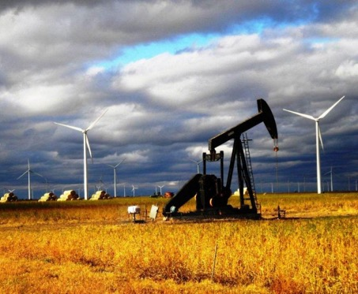
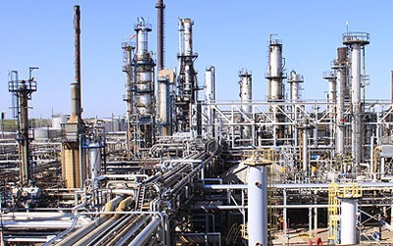
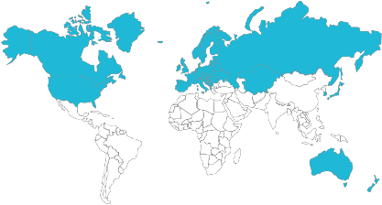
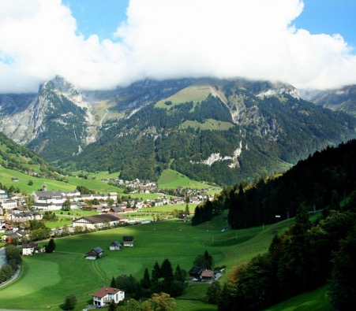
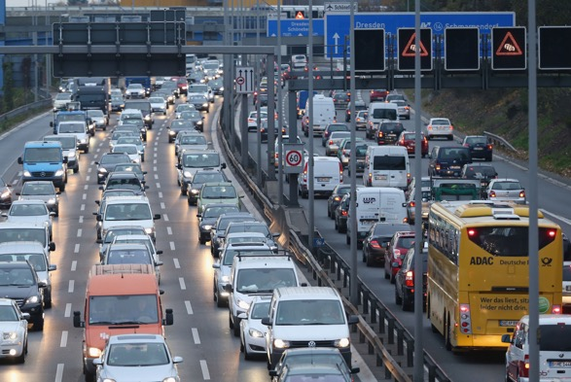
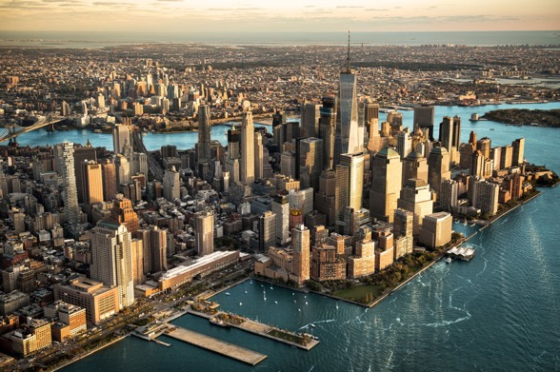
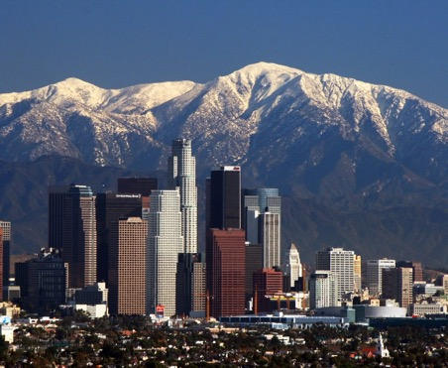
Developed Nations
Leaders of:
  Australia
  Canada
  European Union
  Japan
  New Zealand
  Russia & Former Soviet Republics
  South Korea
  USA

Slide 58
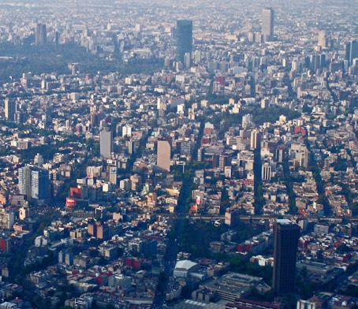
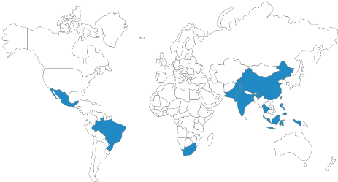
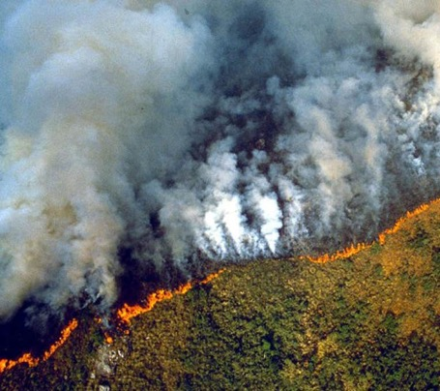
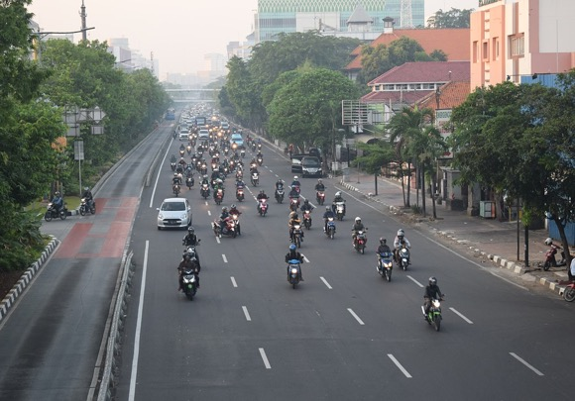
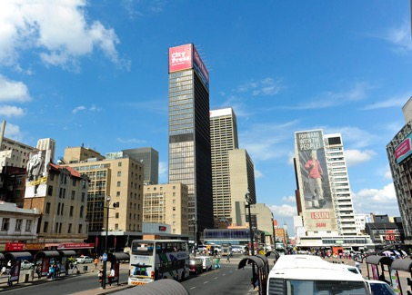
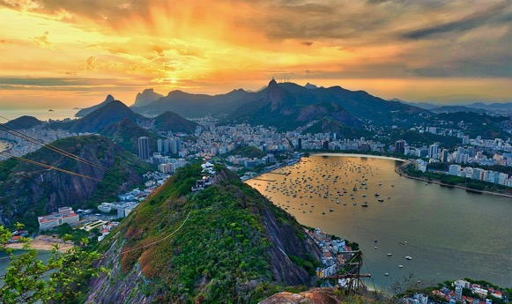
Rapidly Emerging Nations
Leaders of:
  China
  India
  Indonesia
  Brazil
  Mexico
  South Africa

Slide 59
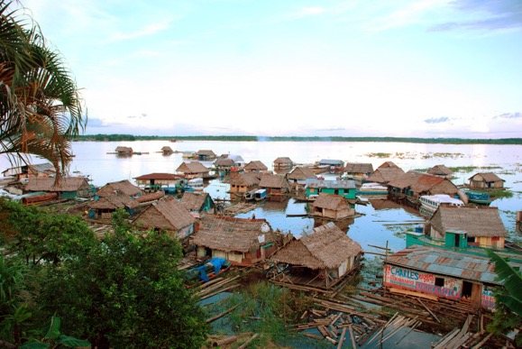




Developing Nations
Leaders of over 100 nations in
  Africa
  Central and Latin America
  South and Southeast Asia
  Middle East
  Small Island States

