Slide 1
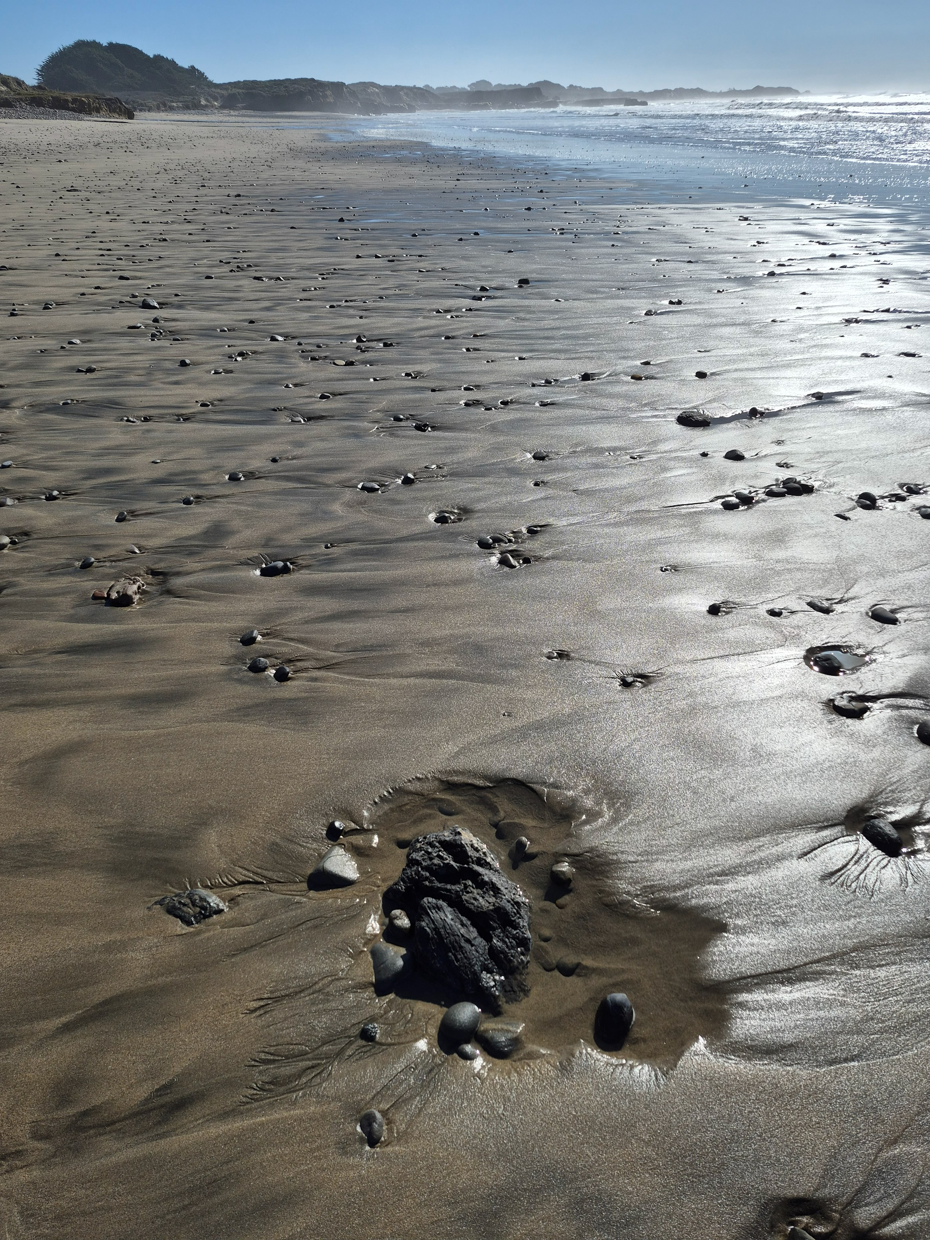
Defending California from offshore oil, again…
Cascade Creek, Ano Nuevo State Park

Slide 2
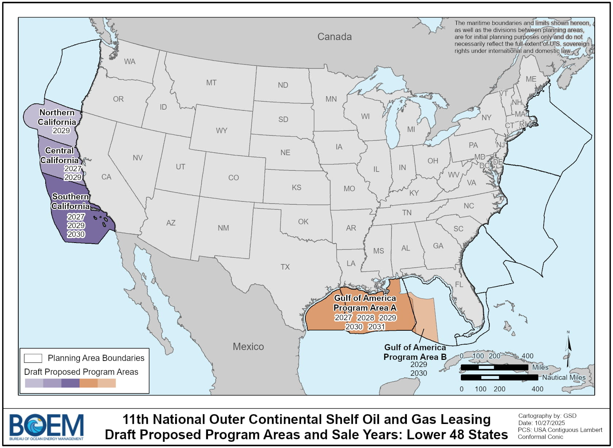
What’s going on?
The Bureau of Ocean Energy Management proposes six lease sales off California, two off the Central Coast in 2027 and 2029. California already hosts 27 offshore oil platforms, 7th largest oil producer in the nation.

Slide 3
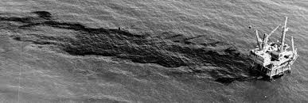
What could this mean?
Santa Barbara Oil Spill, Union Platform A, 1969
-Threat of oil spills
-Harm to marine life
-Increased air pollution
-Acceleration of climate change
-Coastline industrialization

Slide 4
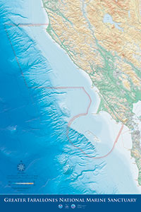
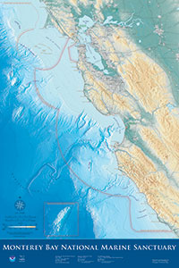
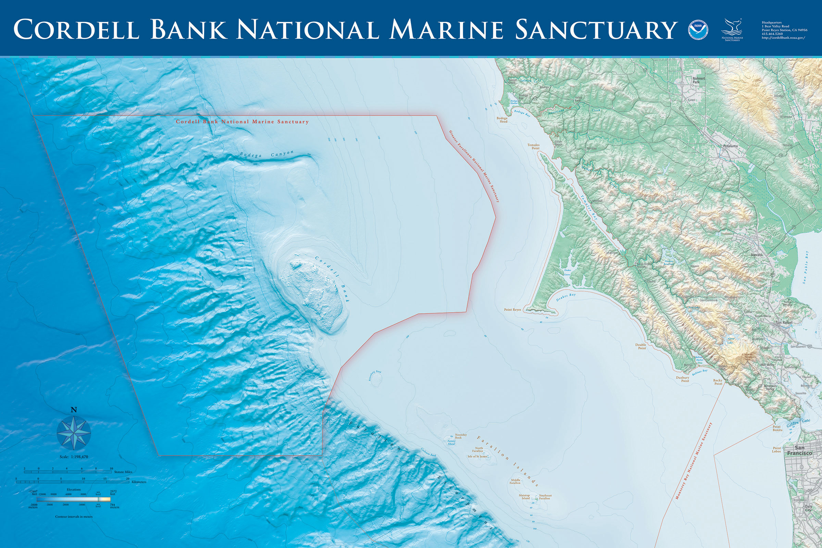
The Central Coast also has three contiguous national marine sanctuaries: Greater Farallones, Cordell Bank, and Monterey Bay.

Slide 5
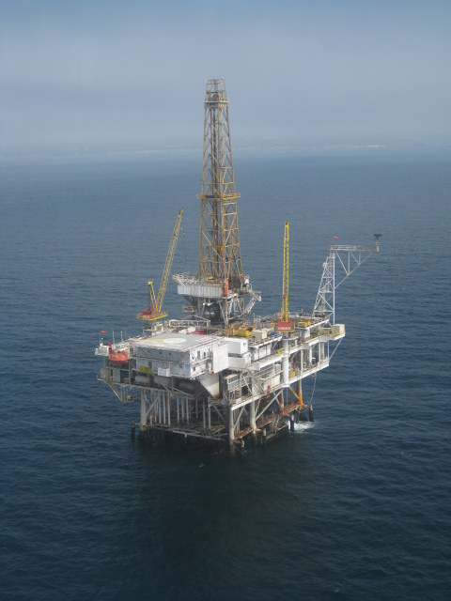
Deadline to make your official comment is 1/23/26, 9 PM PST
regulations.gov
Search “BOEM-2025-0483”
Submit comment
You don’t need to be a scientist or a lawyer, just speak your mind and heart.

Slide 6
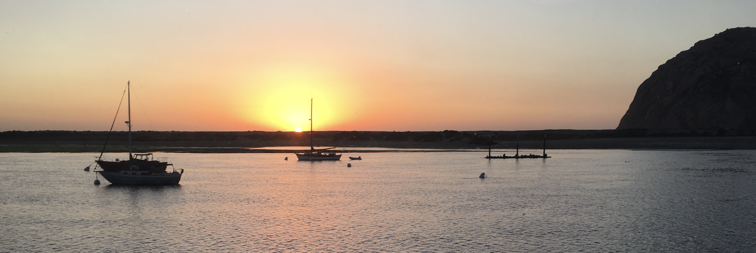
We fought then; we fight now…
US Rep. Leon Panetta obtained annual moratoria in 1980s on federal funding to support offshore oil leasing, thanks to organizing by Gary Patton, Richard Charter and local governments.
Supervisor Justin Cummings is re-organizing the local government coalition for action on offshore oil, and seabed mining.

Slide 7
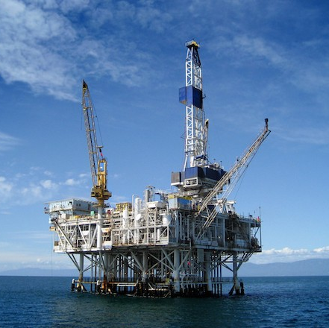
We built the Blue Wall…
Frustrated, Santa Cruz City leaders formulated a local strategy.
In November 1985 82% of Santa Cruz City voters agreed to:
Subject zoning changes for onshore facilities for offshore oil to a vote of the people, and
Spend funds to spread the idea in California.
Save Our Shores was contracted, and I was hired.

Slide 8
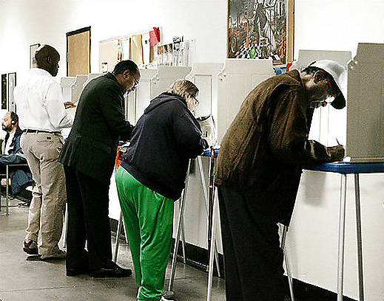
SOS engaged local governments and organizations.
26 communities from San Diego to Humboldt passed laws, most by popular vote.
Marin County’s ordinance, approved in 2020, made it 27.

Slide 9
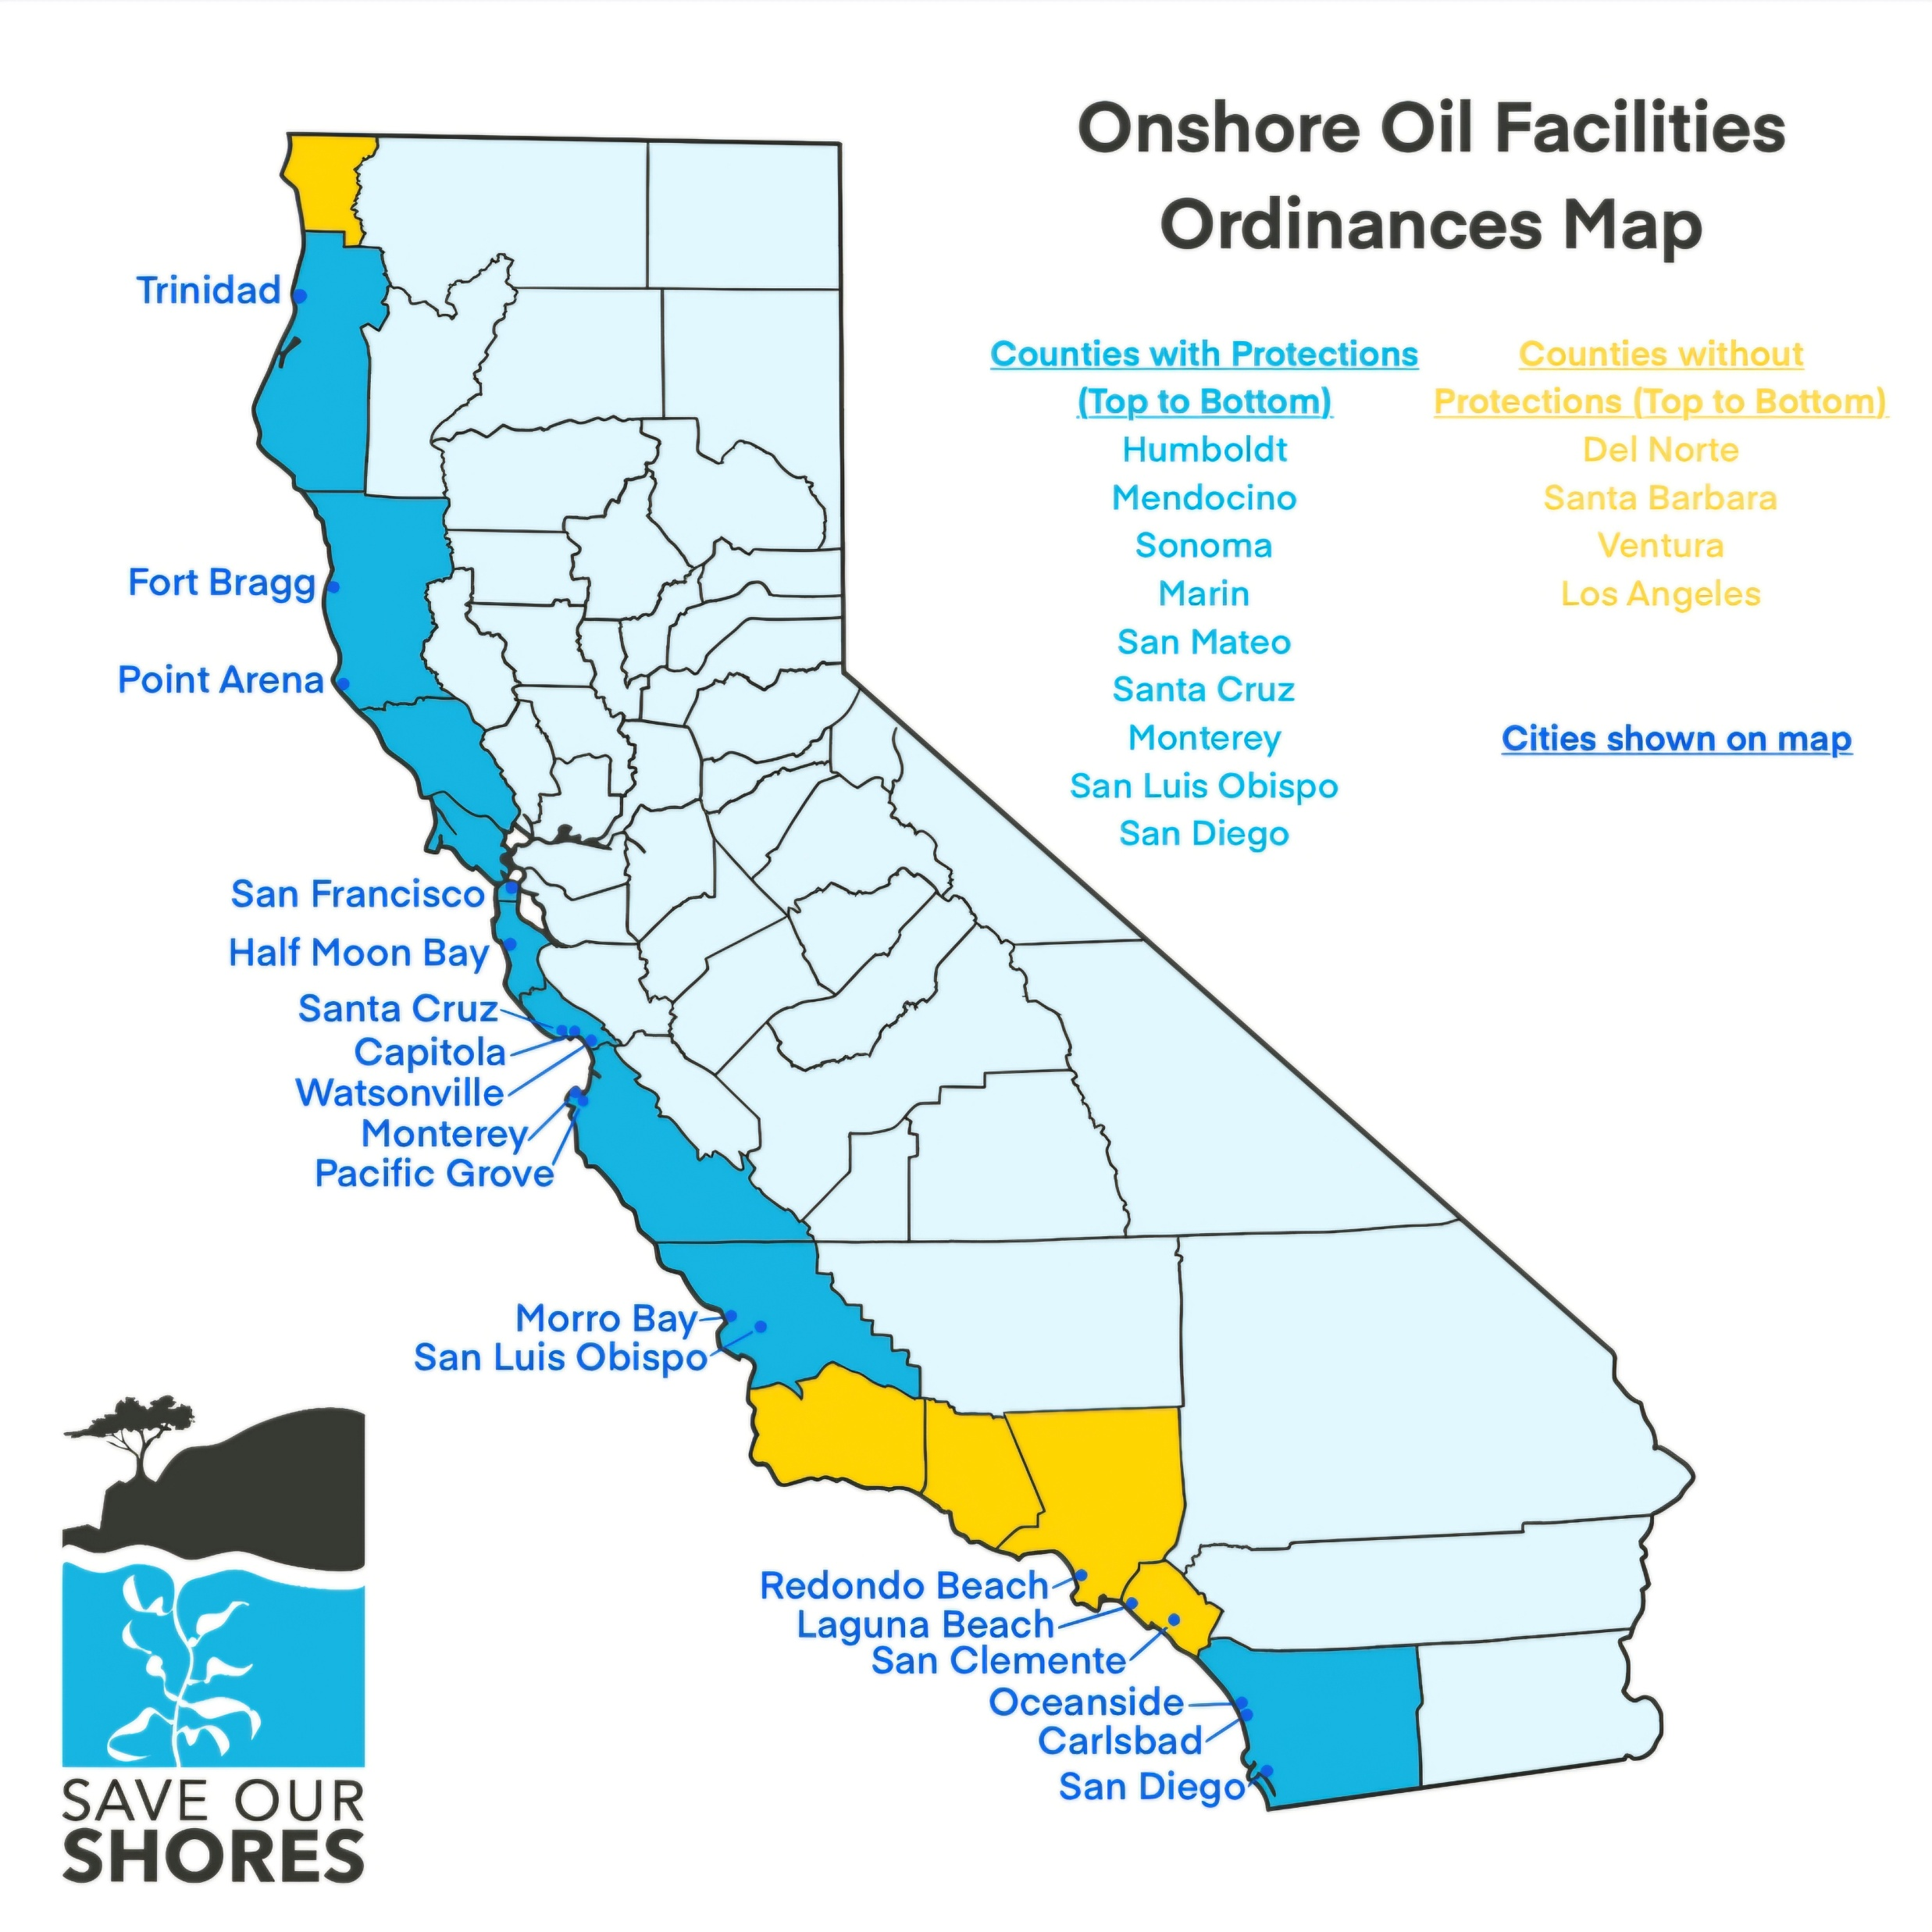

Slide 10
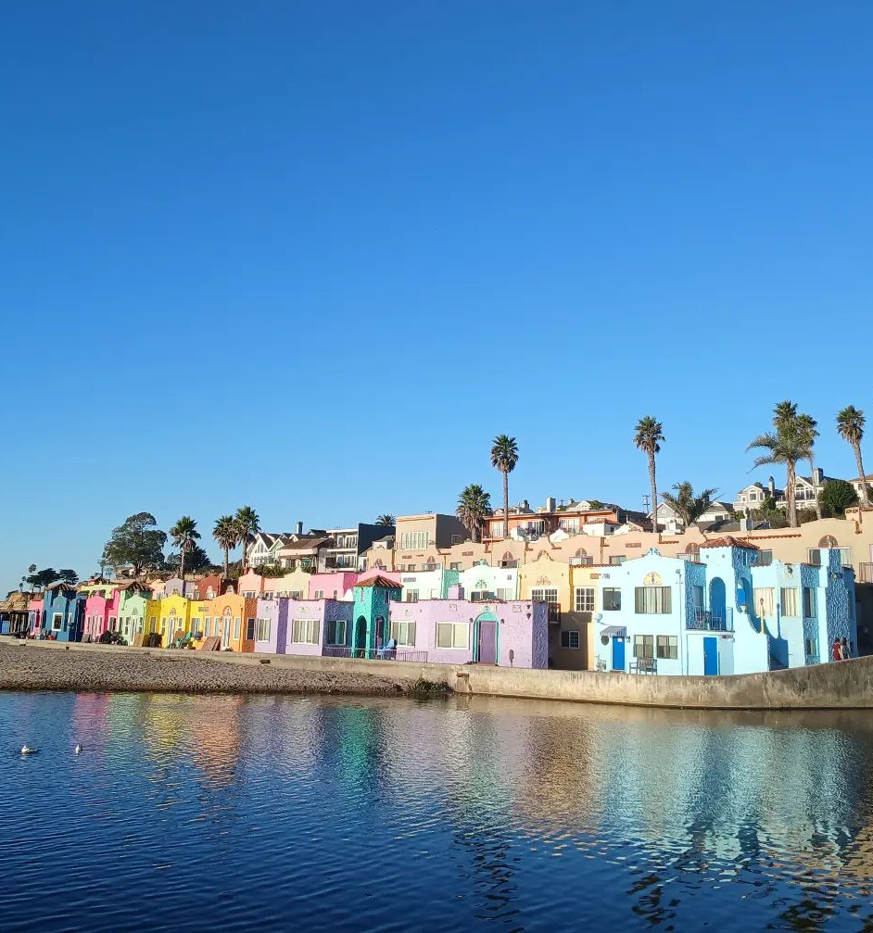
Fortifying the Blue Wall
Strengthen existing laws: Santa Cruz City and County, Capitola and Watsonville,
Add language on emerging threat of seabed mining, and
Then, add laws where they don’t exist.
Capitola City Council, tomorrow night, 6 PM!

Slide 11
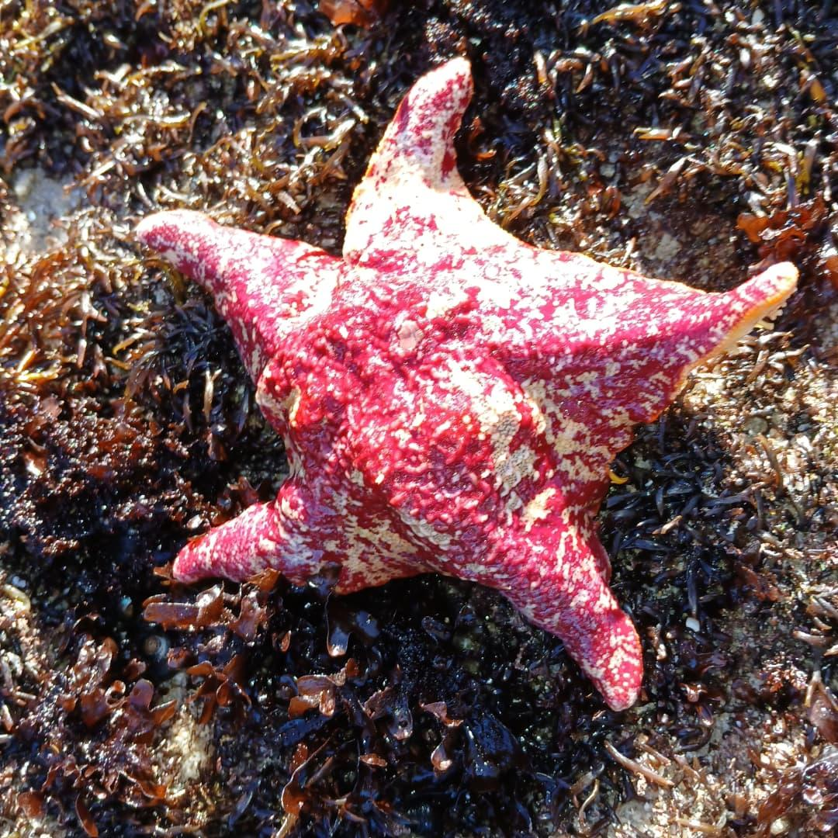
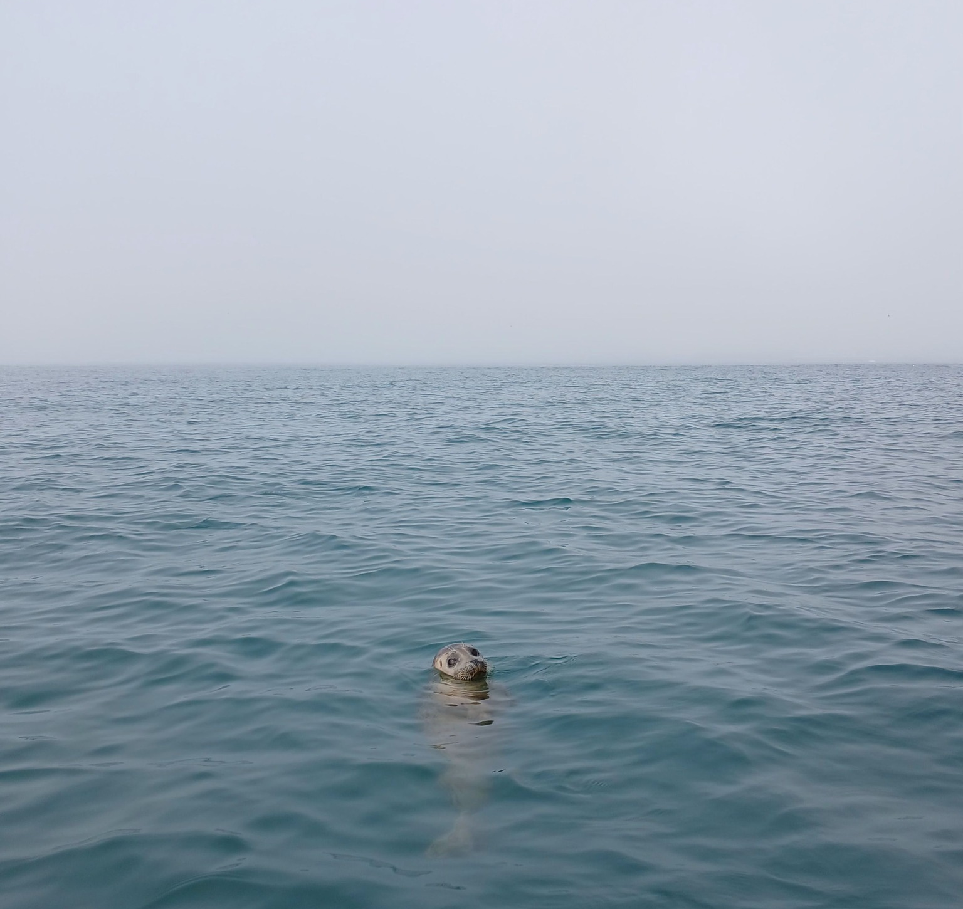
For more information: saveourshores.org savemycoast.org

